Slide 1
Welcome to our class

Slide 2
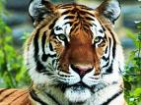
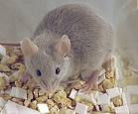
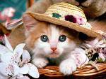
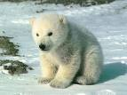
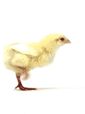
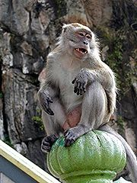
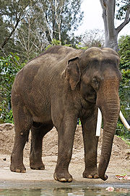
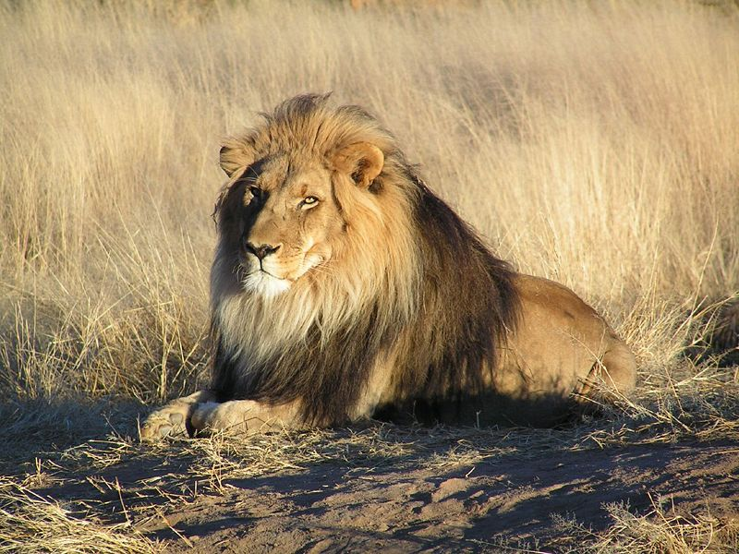
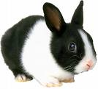
I.WARM-UP :
CROSSWORD
1
C
C
A
T
1
2
L
I
O
O
N
2
3
M
M
O
U
S
E
3
4
E
L
E
P
P
H
A
N
T
4
5
B
E
E
A
R
5
6
R
A
B
B
I
T
T
6
7
C
H
I
7
I
C
K
E
N
8
G
O
A
T
8
T
9
T
I
9
I
G
E
R
10
D
O
O
G
10
11
M
O
N
N
K
E
Y
11
12
H
O
R
S
S
E
12
key

Slide 3
COMPETITIONS
Unit 6 :
Period :30
Section A : Reading
Reading

Slide 4
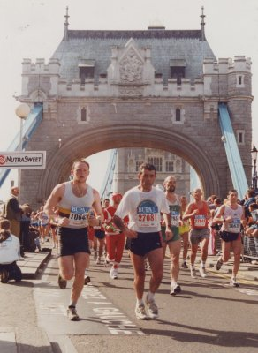
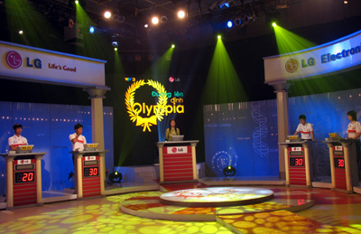
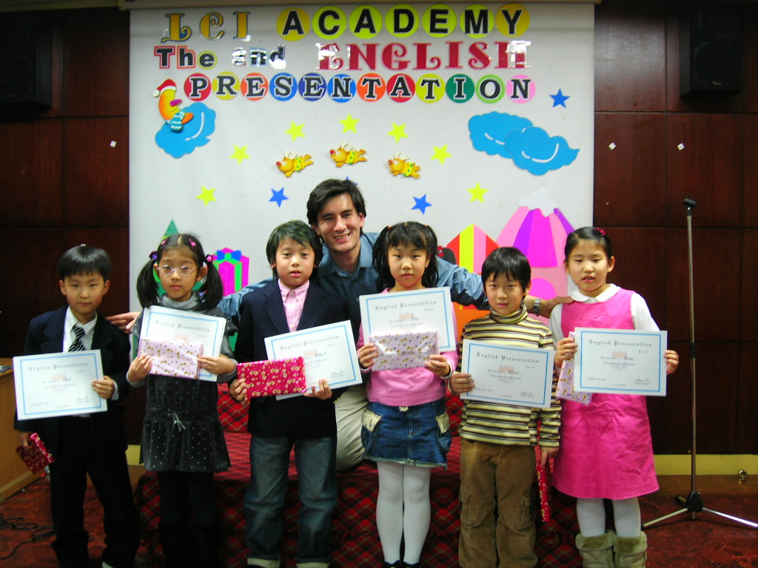
1.English competition
2.Sao Mai Television Singing Contest
3.London Marathon
4.Olympic Games
5.Quiz: Road to Mount Olympia
6. Athletics Meeting
C
F
B
E
D
A

Slide 5
Listen to the passage

Slide 6
UNIT 6: COMPETITIONS - A : READING
Vocabulary:
- competition (n):
[,kɔmpə'ti∫n]
➔ competitor (n):
[kəm'petitə(r)]
➔ compete (v):
[kəm'pi:t]
- judge (n )
['dʒʌdʒ]
trọng tài
- representative (n):
[,repri'zentətiv]
đại diện
- annual ( adj )= yearly
['ænjuəl]
- aim (n)
[eim]
mục đính, ý định
/ ( V ) nhắm vào , tập trung vào
- stimulate (v)
['stimjuleit]
= encourage
khuyến khích , kích thích
-sponsore (v)
['spɔnsə]
tài trợ
The competition was sponsored by the Students’ Parents Society .
- worksheet (n)
['wə:k∫i:t]
a sheet of paper

Slide 7
UNIT 6: COMPETITIONS - A : READING
Vocabulary:
- observe (v)
[ə'bz3:v]
quan sát , theo dõi
- maximum (n)
['mæksiməm]
tối đa
-> The maximum score for each activity is 15 points
- to be awarded
[ə'wɔ:d]
giải thưởng nhận được
- try to find out ( sth ):
cố gắng tìm ra
- smoothly (adv)
một cách trôi chảy
-> smooth (adj)
trôi chảy , suôn sẻ
- recite (v )
[ri'sait]
thuật lại
-> reciting ( n )
reciting the poem
- a bit
một chút , một ít
Thu felt a bit disappointed .
- apologise for / apologize for
[ə'pɔlədʒaiz]
xin lỗi về…

Slide 8
UNIT 6: COMPETITIONS - A : READING
Vocabulary:
- competition (n):
[,kɔmpə'ti∫n]
➔ competitor (n):
[kəm'petitə(r)]
➔ compete (v):
[kəm'pi:t]
- representative (n):
[,repri'zentətiv]
đại diện
- annual ( adj )= yearly
['ænjuəl]
- aim (n)
[eim]
mục đính, ý định
/ ( V ) nhắm vào , tập trung vào
- stimulate (v)
['stimjuleit]
= encourage
khuyến khích , kích thích
-sponsore (v)
['spɔnsə]
tài trợ
The competition was sponsored by the Students’ Parents Society .
- worksheet (n)
['wə:k∫i:t]
a sheet of paper
- judge (n )
['dʒʌdʒ]
trọng tài

Slide 9
UNIT 6: COMPETITIONS - A : READING
Vocabulary:
- observe (v)
[ə'bz3:v]
quan sát , theo dõi
- maximum (n)
['mæksiməm]
tối đa
-> The maximum score for each activity is 15 points
- to be awarded
[ə'wɔ:d]
giải thưởng nhận được
- try to find out ( sth ):
cố gắng tìm ra
- smoothly (adv)
một cách trôi chảy
-> smooth (adj)
trôi chảy , suôn sẻ
- recite (v )
[ri'sait]
thuật lại
-> reciting ( n )
reciting the poem
- a bit
một chút , một ít
Thu felt a bit disappointed .
- apologise for / apologize for
[ə'pɔlədʒaiz]
xin lỗi về…

Slide 10
UNIT 6: COMPETITIONS – A : READING
Task 1
MATCHING
representative
2) annual
3) stimulate
4) in all
5) spirit
6) smoothly
a) without problems or difficulties
b) enthusiasm and energy
c) altogether or as a total
d) a person chosen or appointed on behalf of another person or a group
e) encourage or make something more active
f) happening or done once every year

Slide 11
UNIT 6: COMPETITIONS – A : READING
Read the text then fill in the table:
Name of the competition
Participants
Organized by
Aim
Sponsored by
Competition’s rule
Awards
Winner
English Competition
Representatives of 3 classes
English teacher
To stimulate the spirit of learning English among students
The students’ Parents Society
To participate … our competition
A set of CDs … dictionary
Group B

Slide 12
UNIT 6: COMPETITIONS – A : READING
Task 2 :
Read paragraph 3 again and complete the sentences
to recite the poem
because he could not remember the last sentence .
1.In Activity 5, Hung was unable ………………………
.....................................................................................
2. Having achieved the highest score , Group B…………
....................................................................................
3. Group C lost the game because they just got …………
4. Nga encouraged her group by saying …………………
...........................................................................................
……………………………………………….
became
the winner of the competition .
60 points
“ for me the
important thing was our participation in the competition
and the enjoyment we had from it .

Slide 13
Homework
- learn by heart vocabulary
answer the questions on page 68 .
translate the poem on page 68 into Vietnamese .
Prepare new lesson : speaking
competitions

