Slide 1
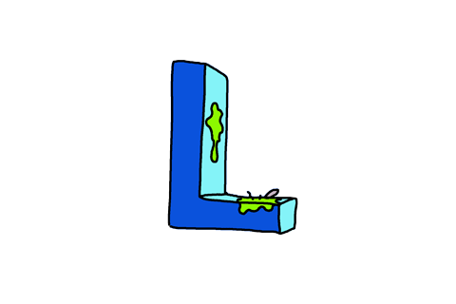
WORDS SEARCH PUZZLE
Find words in the puzzle.

Slide 2
WORDS SEARCH PUZZLE
RULES:
There are words about jobs hidden in the picture.
The words can be vertical, diagonal, horizontal, forward or backward.
Find the words within 3 minutes to get points for your teams.

Slide 3
B | E | X | Z | K | L | Q | B | N | L | W | E
R | A | L | O | C | A | C | O | C | F | B | Y
V | R | B | M | N | P | O | I | R | U | N | Y
S | A | M | S | U | N | G | N | T | A | D | F
K | Z | O | B | M | C | O | U | M | Z | I | K
C | S | M | I | C | R | O | S | O | F | T | O
U | K | D | L | F | Y | G | H | G | E | X | O
B | H | E | J | K | S | L | A | Q | W | C | B
R | G | Z | P | I | B | E | R | J | Q | R | E
A | N | C | W | O | M | O | S | B | Y | B | C
T | X | T | R | E | V | E | L | I | N | U | A
S | P | V | F | H | O | P | T | J | B | J | F
KFC
FACEBOOK
STARBUCKS
ZARA
YOUTUBE
COCACOLA
SAMSUNG
MICROSOFT
UNILEVER
GOOGLE

Slide 4
review
B | E | X | Z | K | L | Q | B | N | L | W | E
R | A | L | O | C | A | C | O | C | F | B | Y
V | R | B | M | N | P | O | I | R | U | N | Y
S | A | M | S | U | N | G | N | T | A | D | F
K | Z | O | B | M | C | O | U | M | Z | I | K
C | S | M | I | C | R | O | S | O | F | T | O
U | K | D | L | F | Y | G | H | G | E | X | O
B | H | E | J | K | S | L | A | Q | W | C | B
R | G | Z | P | I | B | E | R | J | Q | R | E
A | N | C | W | O | M | O | S | B | Y | B | C
T | X | T | R | E | V | E | L | I | N | U | A
S | P | V | F | H | O | P | T | J | B | J | F
KFC
FACEBOOK
STARBUCKS
ZARA
YOUTUBE
COCACOLA
SAMSUNG
MICROSOFT
UNILEVER
GOOGLE

Slide 5
Unit 5: Ambition
Lesson 5I: Culture

Slide 6
www.phuongnam.edu.vn

Slide 7
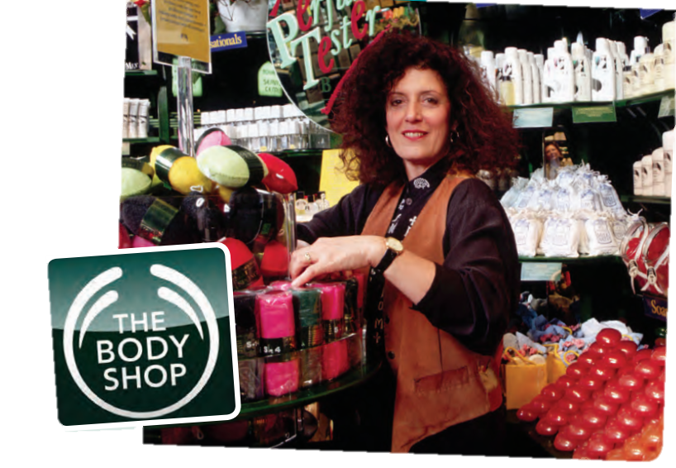
1. There are more 35 The Body Shop showroom in Vietnam.
2. Product includes:
_Body products: body scrub, body butter and body lilies
_Cosmetics: lipstick, eye shadow, mascara...
_Skin care ranges: Tea Tree, Vitamin C, Vitamin E,...
_Hair care: their famous Banana shampoo and Banana conditioner
_Fragrances for Women and Men
_Bath products: shower gels and solid soaps
_High-end skincare range such as Oils of Life
_Face masks: sheet masks
www.phuongnam.edu.vn

Slide 8
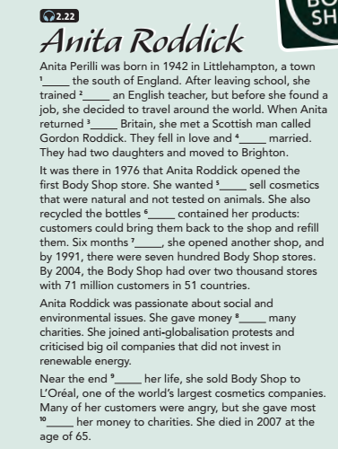
1. in
2. as
3. to
4. got
5. to
6. that
7. later
8. to
9. of
10. of
www.phuongnam.edu.vn

Slide 9
3. Read the text again and answer the questions.
1. Where did Roddick go after she left school?
=> She travelled around the world.
2. Where did she live when she opened her first Body Shop store?
=> She lived in Brighton.
3. What was different about the Body Shop products?
=> They were natural and not tested on animals.
4. Why did some of her customers feel angry?
=> Because she sold the Body Shop to a big cosmetic company that was less concerned about selling natural products.
www.phuongnam.edu.vn

Slide 10
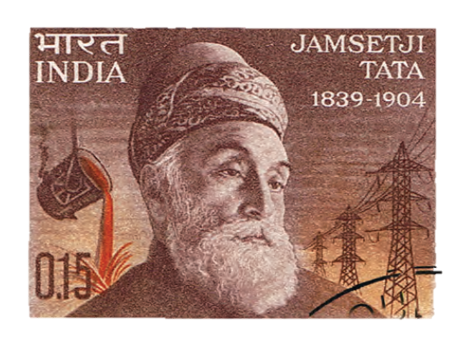
Answer:
1 Cotton
2 Indian Institute of Science
3 Steel
4 Electricity
5 Tata Airlines
www.phuongnam.edu.vn

Slide 11
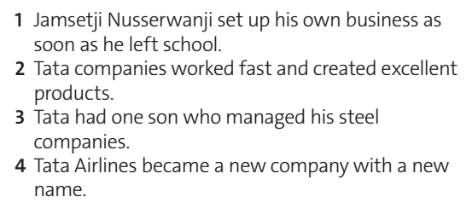
=> F
=> T
=> F
=> T
www.phuongnam.edu.vn

Slide 12
SPEAKING
=> Coco Chanel was a French fashion designer. She also introduced the phenomenally successful perfume “Chanel No.5”
=> Walt Disney was an American motion-picture and television producer and showman, famous as a pioneer of animated cartoon films and as the creator of such cartoon characters as Mickey Mouse and Donald, Snow White, Cinderella,...
=> Steve Jobs was a charismatic pioneer of the personal computer era. He was also the co-founder, chief excutive and chairman of Apple Computer.
www.phuongnam.edu.vn

Slide 13
Q: Do you know any entrepreneurs from Viet Nam?
What are they famous for?

Slide 15
RULES:
There are five logos in this game.
Your mission is to look at each logo and guess what the brand is and what this brand is famous for.
You will get 1 point for each correct answer.

Slide 16
1
2
3
4
5
FINISH

Slide 17
VinGroup

Slide 18
Vietnam Airline

Slide 19
VNPT

Slide 20
Vinamilk

Slide 21
thegioididong

Slide 22
01
Homework
02
03
1. Practice listening at home
3. Do exercise in the workbook
4. Prepare Review (P.69)
04
?
05
06

Slide 23
www.phuongnam.edu.vn

Slide 24
Thank you!
CTCP ĐẦU TƯ VÀ PHÁT TRIỂN GIÁO DỤC PHƯƠNG NAM

