Slide 1
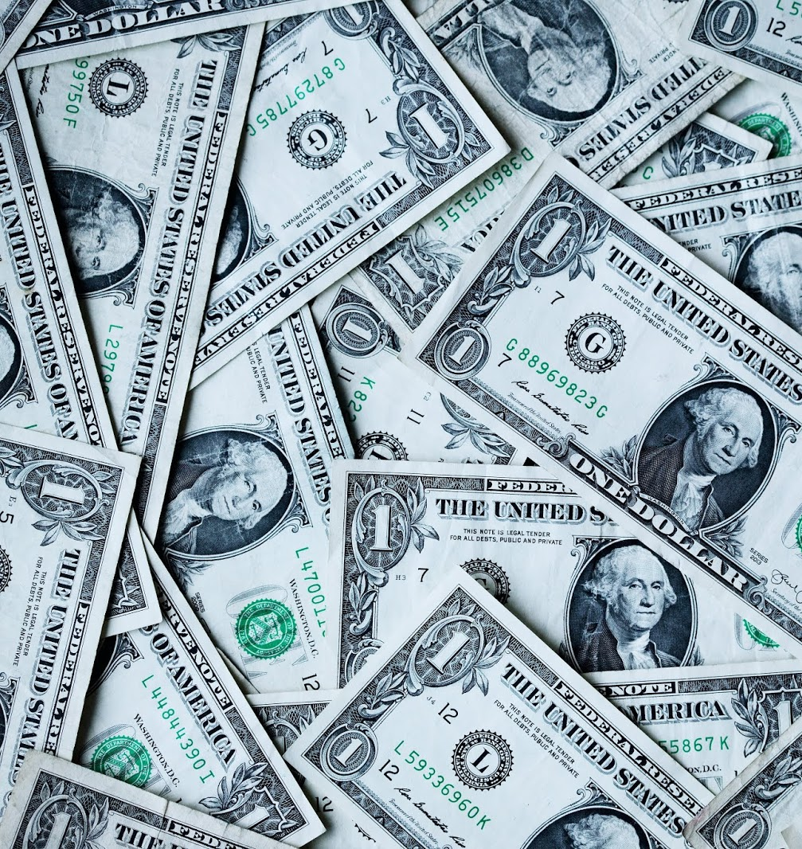
UNIT 6: MONEY
CULTURE
THE WORLD BANK

Slide 2
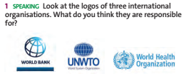
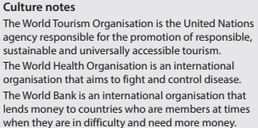

Slide 3
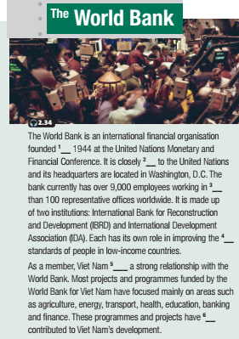
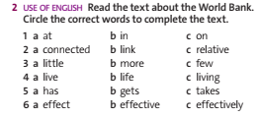

Slide 4
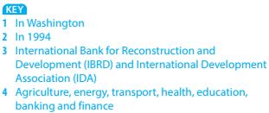

Slide 5
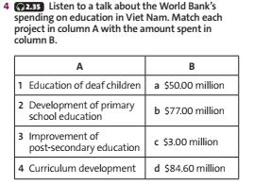

Slide 6
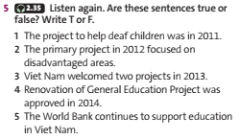

Slide 7
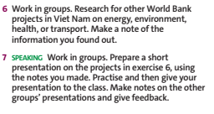

Slide 8
1/ Learn by heart all new vocabulary, phrases, and structures.
2/ Prepare for the next lesson.

Slide 9
THANK YOU
FOR YOUR ATTENTION

