Slide 1
CẢI LƯƠNG

Slide 2
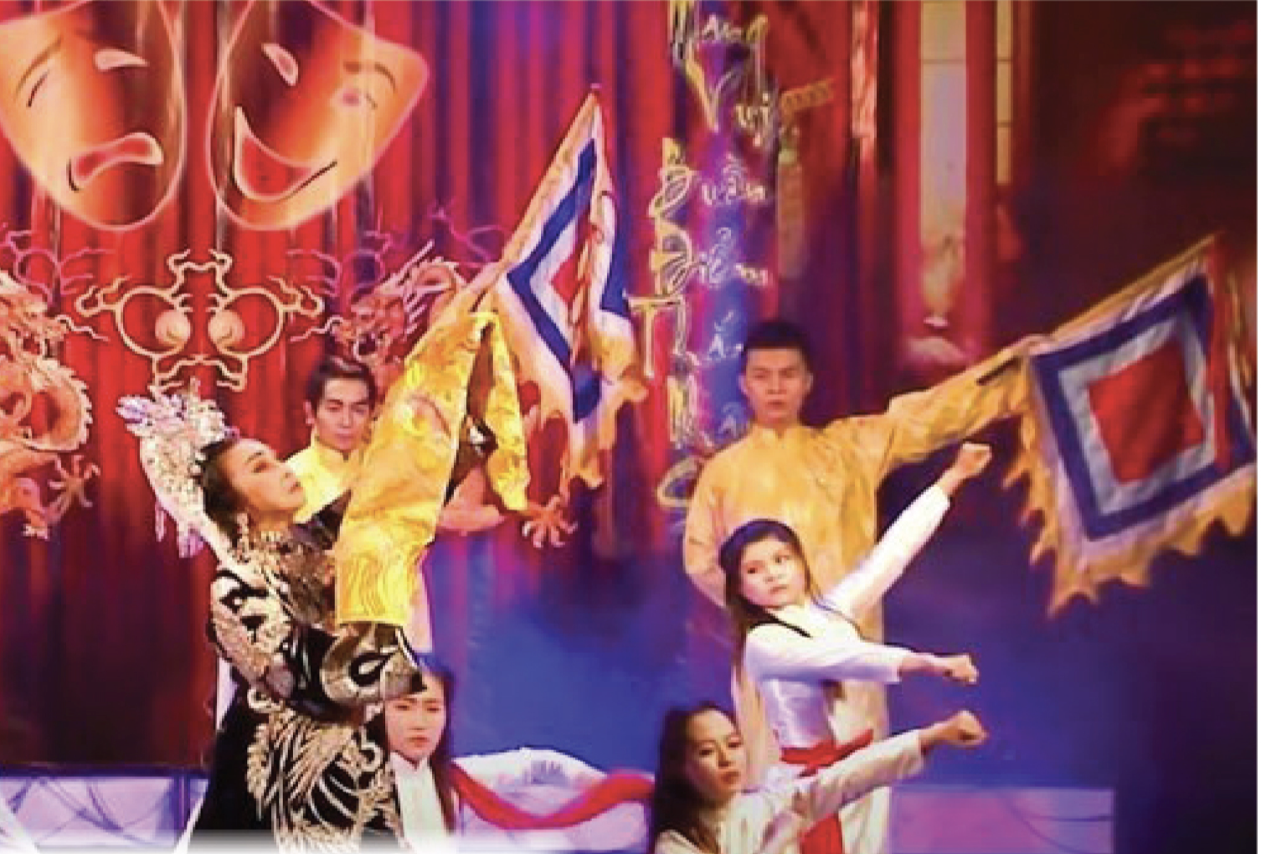
Exercise 1. SPEAKING Work in pairs. What is the theatrical form in the photo? Have you seen any performances like this live or on TV?

Slide 3
Exercise 2. You are going to read an article about Cải Lương, a traditional Vietnamese theatrical art form. Match the headings (A–G) with paragraphs (1­–5). There are two extra headings.
A The Development of Cải Lương
B The pioneers
C The early days
D A Vibrant Fusion of Arts
E The Future of Cải Lương
F Viet Nam’s rich heritage
G The instrumental ensemble

Slide 4
Exercise 2. You are going to read an article about Cải Lương, a traditional Vietnamese theatrical art form. Match the headings (A–G) with paragraphs (1­–5). There are two extra headings.
A The Development of Cải Lương
B The pioneers
C The early days
D A Vibrant Fusion of Arts
E The Future of Cải Lương
F Viet Nam’s rich heritage
G The instrumental ensemble

Slide 5
Exercise 2. You are going to read an article about Cải Lương, a traditional Vietnamese theatrical art form. Match the headings (A–G) with paragraphs (1­–5). There are two extra headings.
A The Development of Cải Lương
B The pioneers
C The early days
D A Vibrant Fusion of Arts
E The Future of Cải Lương
F Viet Nam’s rich heritage
G The instrumental ensemble

Slide 6
Exercise 2. You are going to read an article about Cải Lương, a traditional Vietnamese theatrical art form. Match the headings (A–G) with paragraphs (1­–5). There are two extra headings.
A The Development of Cải Lương
B The pioneers
C The early days
D A Vibrant Fusion of Arts
E The Future of Cải Lương
F Viet Nam’s rich heritage
G The instrumental ensemble

Slide 7
Exercise 2. You are going to read an article about Cải Lương, a traditional Vietnamese theatrical art form. Match the headings (A–G) with paragraphs (1­–5). There are two extra headings.
A The Development of Cải Lương
B The pioneers
C The early days
D A Vibrant Fusion of Arts
E The Future of Cải Lương
F Viet Nam’s rich heritage
G The instrumental ensemble

Slide 8
Exercise 3. Read the text again. Choose the correct answers (a–c).
1 Cải Lương
a has gained popularity among young audiences.
b offers a depiction of Vietnamese history and culture.
c is influenced by other Western art forms.
2 The children of Cải Lương performers
a started acting at a very young age.
b did not want to pursue their parents’ career.
c enjoyed modern entertainment.

Slide 9
Exercise 3. Read the text again. Choose the correct answers (a–c).
3 Cải Lương owes its development to
a the audience in southern Viet Nam.
b the preservation of this rich heritage.
c the contributions of eminent figures over the years.
4 There is growing concern that
a Cải Lương will lose its identity.
b younger generations will lose interest in Cải Lương.
c young Cải Lương performers will not be talented.

Slide 10
Exercise 4. Listen to a radio interview. Who is being interviewed?
Mai Trinh, a Cải Lương actress.

Slide 11
Exercise 5. Listen again. Decide whether these statements are true or false. Write T or F.
1 Mai Trinh’s involvement in Cải Lương began at a young age.
2 Her first stage performance in Phù Đổng Thiên Vương left a lasting impression on her.
3 Thanks to her parents, she got several significant roles, which shaped her career.
4 The future of Cải Lương faces challenges due to the impact of modern entertainment.
1 TRUE
2 TRUE
3 FALSE Her teacher, Phung Ha, was the one who made her career in Cải Lương
4 TRUE
Transcript

Slide 12
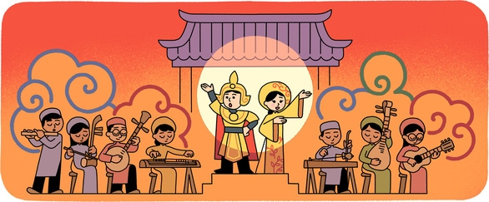
Exercise 6. SPEAKING Work in groups. Research and prepare a presentation about Cải Lương. Present it to the whole class.

Slide 13
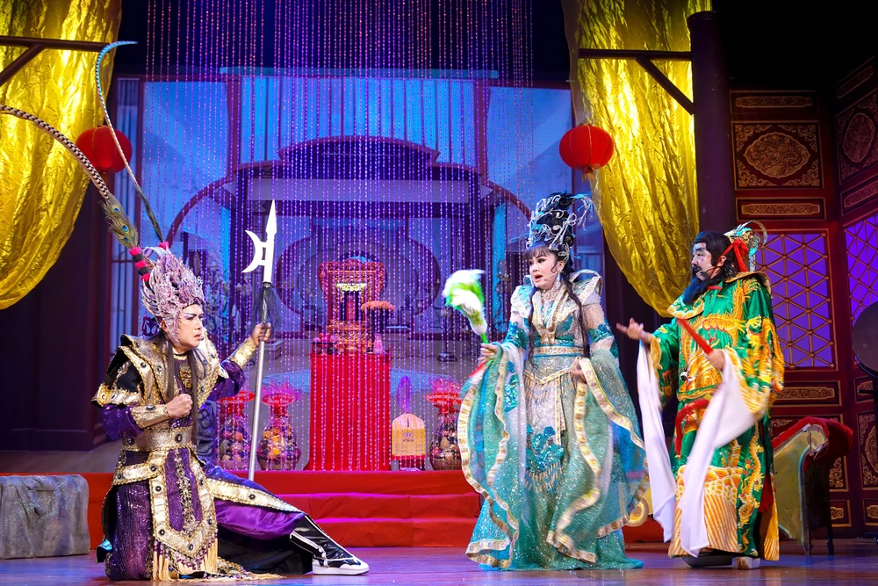
Exercise 6. SPEAKING Work in groups. Research and prepare a presentation about Cải Lương. Present it to the whole class.
Suggested ideas:
Origin and history
Performance style and themes
Musical instruments and singing style
Theatrical techniques
Costumes and gestures
Cultural significance and evolution
Challenges and preservation efforts
Global recognition.

Slide 14
HOMEWORK
Complete the presentation and prepare to present in the next lesson

Slide 15
Transcript 1.38
Journalist Who is the most influential figure in your career? Mai Trinh My parents inspired me, but to tell you the truth, my teacher, Phung Ha, was the one who made my career in Cải Lương and let me play famous roles that impressed audiences. I learned from her how to move, dance, use weapons in acting and even how to put on makeup.
Journalist That’s amazing! What do you think sets Cải Lương apart from other art forms?
Mai Trinh What I find most intriguing about Cải Lương is its ability to encompass multiple art forms. The combination of music, singing, acting, and dance creates a unique experience for both performers and audiences. Moreover, Cải Lương is open to adaptation. It is both traditional and modern.
Journalist How do you envisage the future of Cải Lương in the modern world?
Mai Trinh Given the influence of modern entertainment and changing audience preferences, the future of Cải Lương is a matter of concern. However, I believe that Cải Lương will be alive and well if we find innovative ways to engage younger generations.
Journalist Thank you for sharing your insights and passion for Cải Lương.
Journalist Good morning! Today, I have the pleasure of speaking with Mai Trinh, a talented Cải Lương actress. Thank you for joining us, Trinh. Can you share with us how you first got involved in Cải Lương?
Mai Trinh Good morning! Thank you for having me. My journey with Cải Lương began when I was a child. I was blessed to come from a Cải Lương family. My parents were both Cải Lương performers, and I would often accompany them to rehearsals and performances. They used to invite celebrities to come and perform at our house. Being exposed to the music, costumes, and storytelling from a young age, I developed a love and passion for Cải Lương.
Journalist That’s wonderful! When did you first perform on stage?
Mai Trinh At the age of nine, I was chosen to perform in “Phu Dong Thien Vuong”, a theatre piece about a national hero, together with other friends. It was an unforgettable experience.

