Slide 1

Let’s review
Answer correctly & spin the wheel for bonus.

Slide 2

1
She can’t have/ might have/ must have left her phone at school. Or perhaps she left it on the bus.

Slide 3
2
There’s no pizza left. They can’t have/ could have/ must have eaten it all.

Slide 4
3
Julia can’t have/ may have/ must have gone on holiday. She was at school yesterday!

Slide 5
4
I didn’t get your email. Do you think you can’t have/ could have/ must have sent it to my old email address?

Slide 6
5
Your smartwatch probably isn’t broken. It can’t have/ could have/ must have run out of charge.

Slide 7
6
The school show is on YouTube. Our teacher can’t have/ might have/ must have uploaded it.

Slide 8
7
You went 130km in less than an hour? You can’t have/ might have/ must have driven very fast!

Slide 9
8
Alex isn’t replying to my texts. He can’t have/ might have/ must have taken his phone with him.

Slide 10
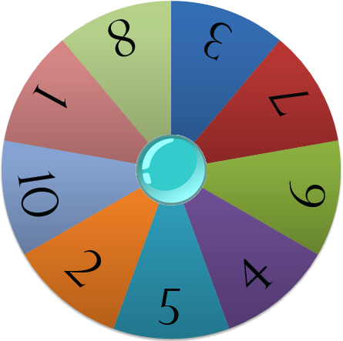

Team Scores
The Big Wheel
Team One
Team Two
Team Three
Team Four
Team Five
Team Six
Team Seven
Team Eight
Spin Wheel
Points

Slide 11






Slide 12

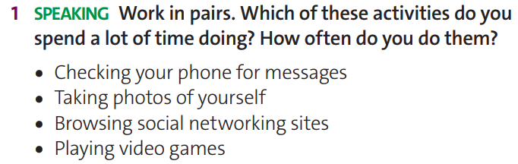
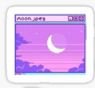

Do your parents ever try to stop you from doing the activities?
What do they do?

Slide 13
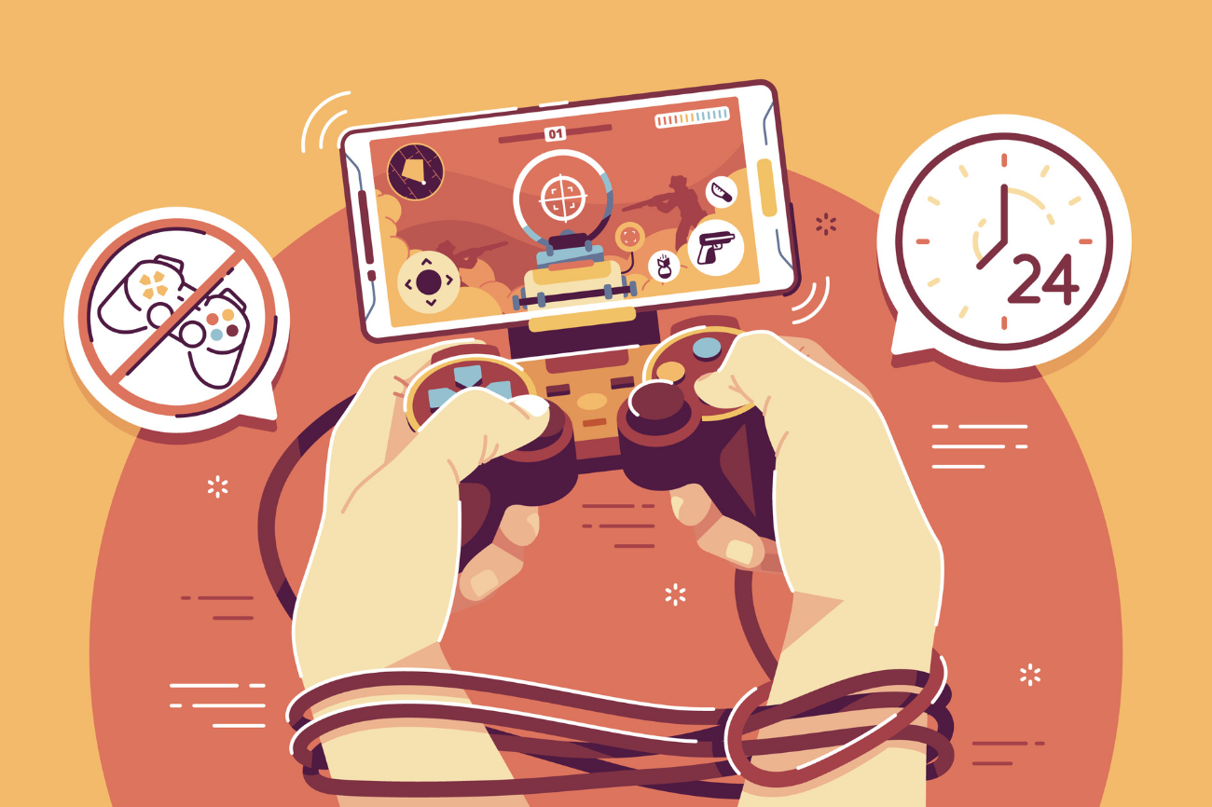
addicted (a) /əˈdɪktɪd/
unable to stop using or doing something as a habit, especially something harmful
addiction (n) /əˈdɪkʃn/

Slide 14

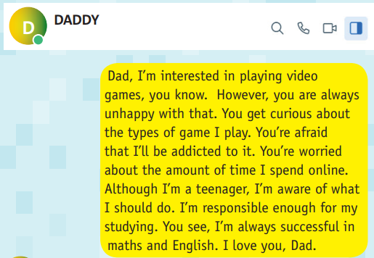
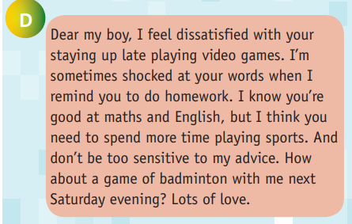

There is no evidence apart from his father’s concern.
We do not know how much time he spent playing them.

Slide 15
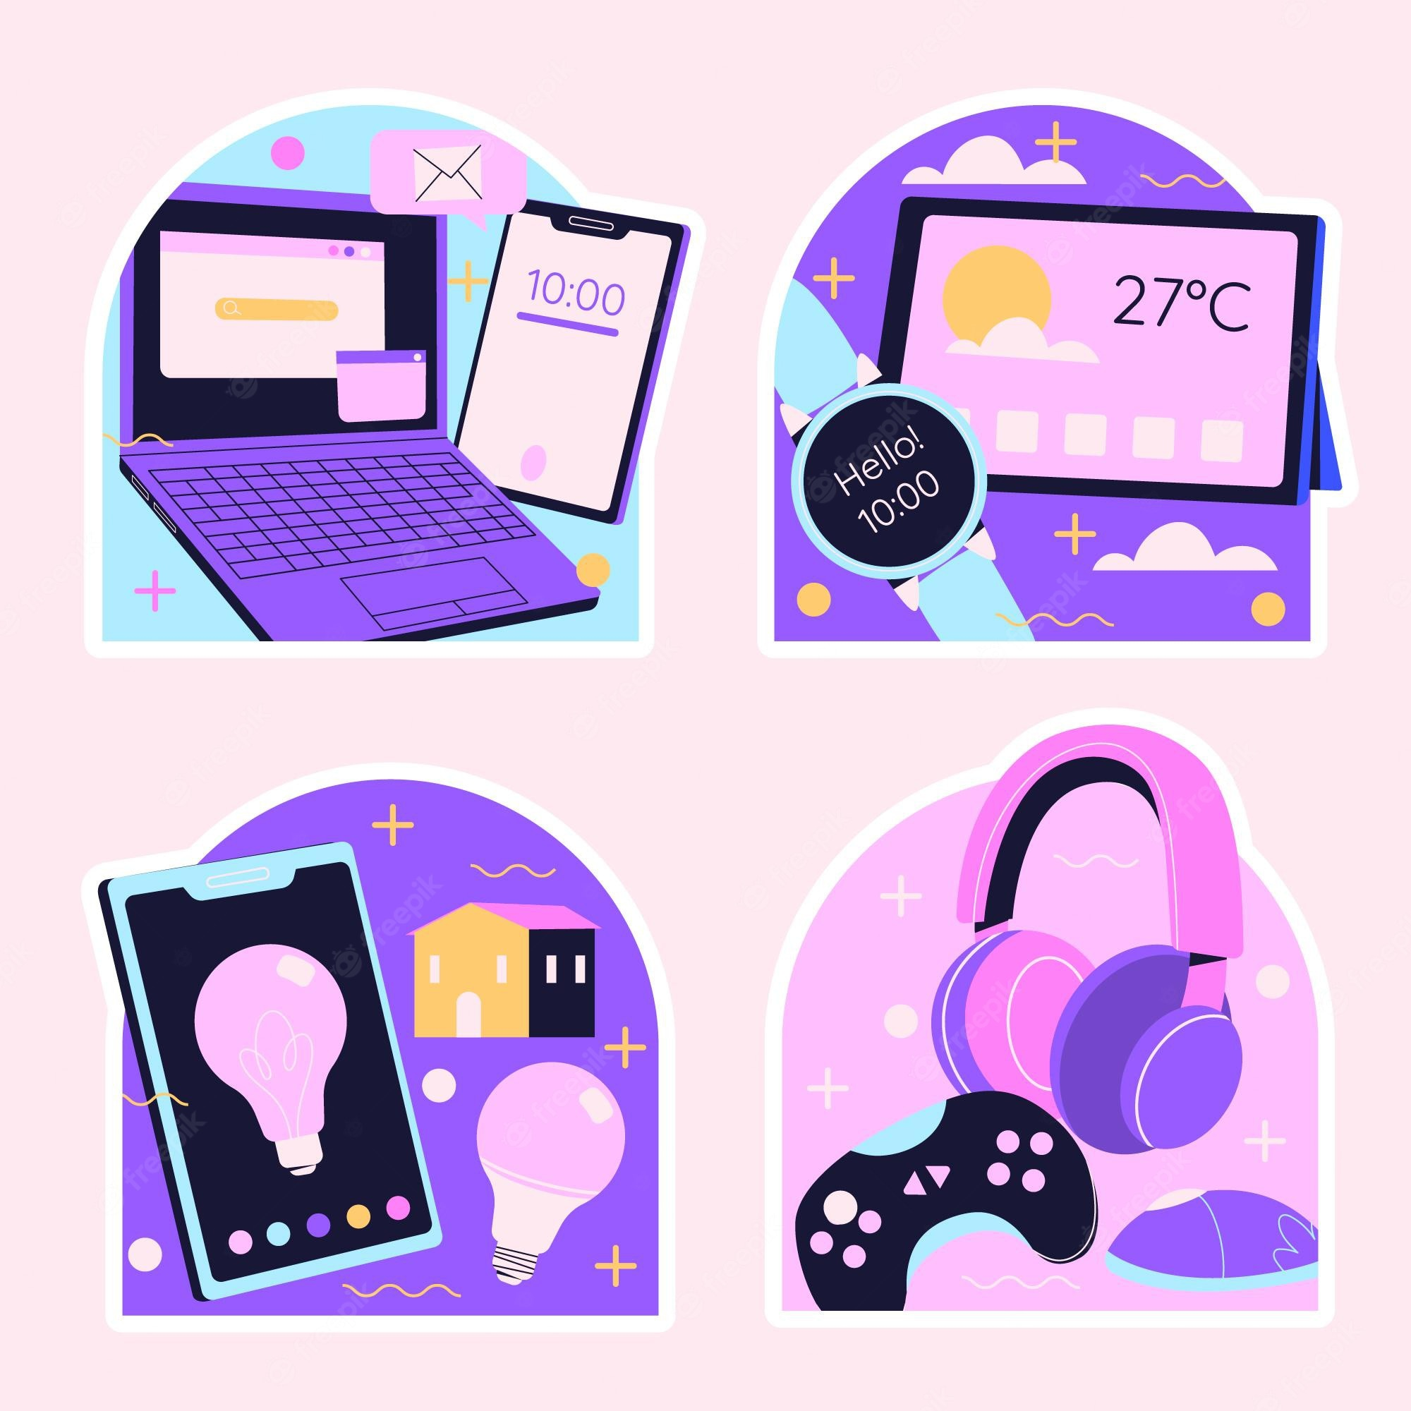
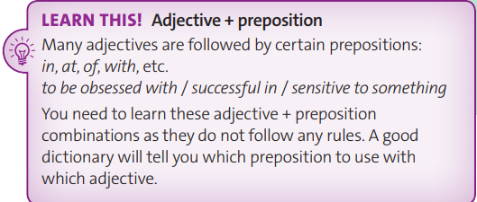


Slide 16
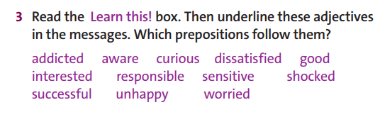

unhappy with | curious about | addicted to | worried about
aware of | successful in | dissatisfied with | shocked at
good at | sensitive to | interested in | responsible for

Slide 17

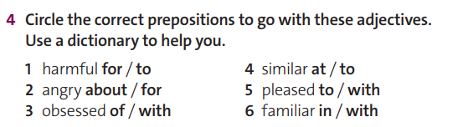

Slide 18


selfie (n)
/ˈselfi/ a picture of a person taken by that person

Slide 19
to
A teenager in the UK, Danny Bowman, became addicted 1 ______ ‘selfies’ and spent up to ten hours a day taking around 200 photos of himself with his phone. This was a true case of addiction: it was harmful 2 ____ his education and his friendships and responsible 3 _____ several health problems. Experts are aware 4 ____ the condition and say it is becoming more and more common. Danny first posted selfies on Facebook when he was fifteen and soon became obsessed 5 ______ reading his friends’ comments. Although he was pleased 6 _____ many of the things his friends wrote, he was also very sensitive 7 ____ criticism. Before long, he was feeling very dissatisfied 8 _____ his appearance. He took more and more photos of himself. His parents became very worried 9 ______ his behaviour. Because they were both mental health nurses, they were familiar 10 ______ addictions. They knew that Danny needed help. Now, after months of hospital treatment, Danny has been successful 11 _____ beating his addiction. But it’s a growing problem, with many other cases similar 12 ____ Danny’s.
to
for
of
with
with
to
with
about
with
in
to

Slide 20

Let’s tell a story!

Slide 21

Use the adjectives in the next slide to tell a story about you or your friend.

Slide 22
Successful | Satisfied | Good | Angry
in | with | at | about

Slide 23



