Slide 1



Unit 4: OUR PLANET
Lesson 4I: CULTURE

Slide 2




www.phuongnam.edu.vn

Slide 3
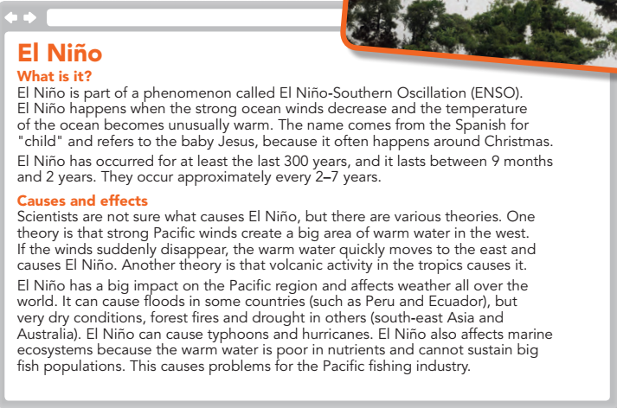
El Niño is a weather phenomenon, which can cause flooding or very dry conditions, forest fires, droughts, typhoons and hurricanes. It can also affect marine ecosystems.
www.phuongnam.edu.vn

Slide 4

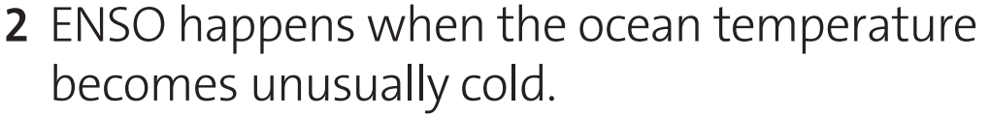
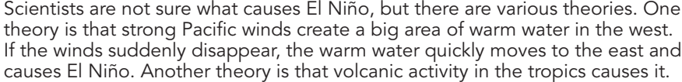
F
F
F
T
F
T
www.phuongnam.edu.vn

Slide 5
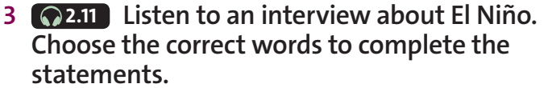

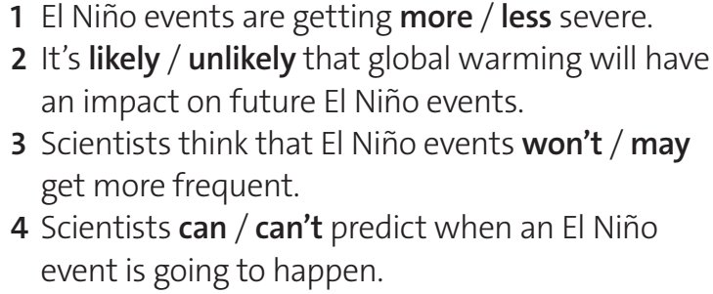
www.phuongnam.edu.vn

Slide 6

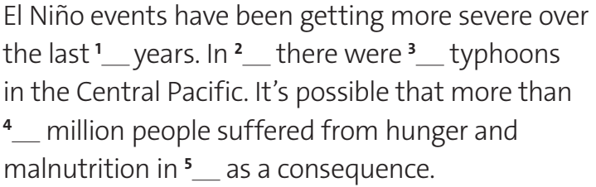
60
2015
16
2016
25
www.phuongnam.edu.vn

Slide 7



www.phuongnam.edu.vn

Slide 8
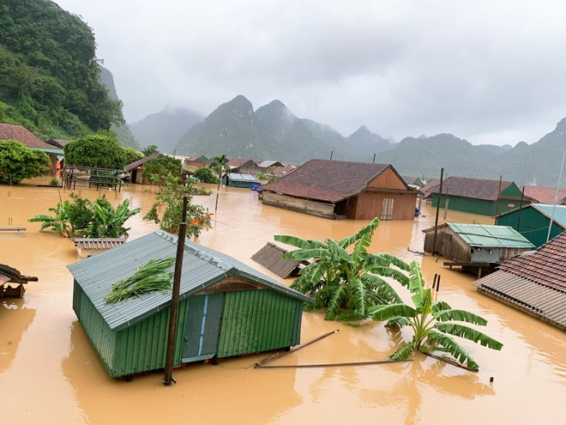
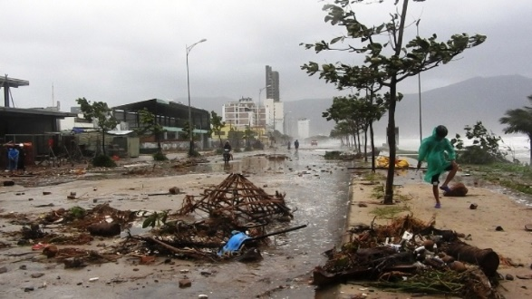
→ Storms and floods are the most frequent and severe natural disasters affecting Viet Nam.
www.phuongnam.edu.vn

Slide 9
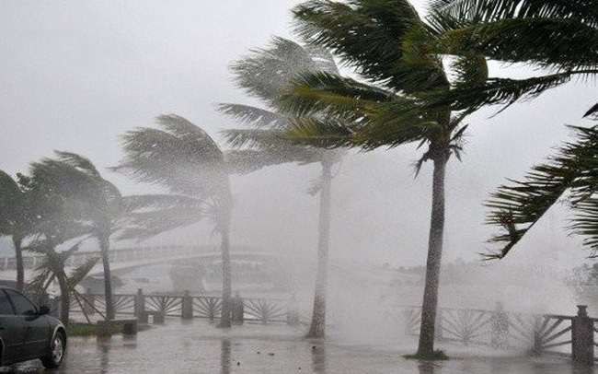
→ [ add date ]
→ The North Central Coast suffers the largest number of typhoons.
www.phuongnam.edu.vn

Slide 10
4 What do the people usually do to prepare for typhoons?
Listen to weather updates and advisories.
Keep watch for warnings and plans regarding evacuation in your community.
Check your house’s condition and make necessary repairs.
Prepare a survival kit (emergency items such as canned goods, biscuits, water and first aid kits).
Keep your survival kit in an area where you can easily get it in case of emergency.
Bring your pets and livestock in the designated evacuation area for animals. If not, keep them in a safe place.
Evacuate immediately once asked by the authorities to do so.
www.phuongnam.edu.vn

Slide 11
Homework
 Learn by heart all the new words.
 Prepare for next lesson – grammar: Past simple affirmative.
www.phuongnam.edu.vn

