Slide 1



Unit 7: TOURISM
Lesson 7G: Speaking

Slide 2
PLANNING
A HOLIDAY
Speaking
7G
I can discuss and plan a holiday trip
Student Book – page 90

Slide 3

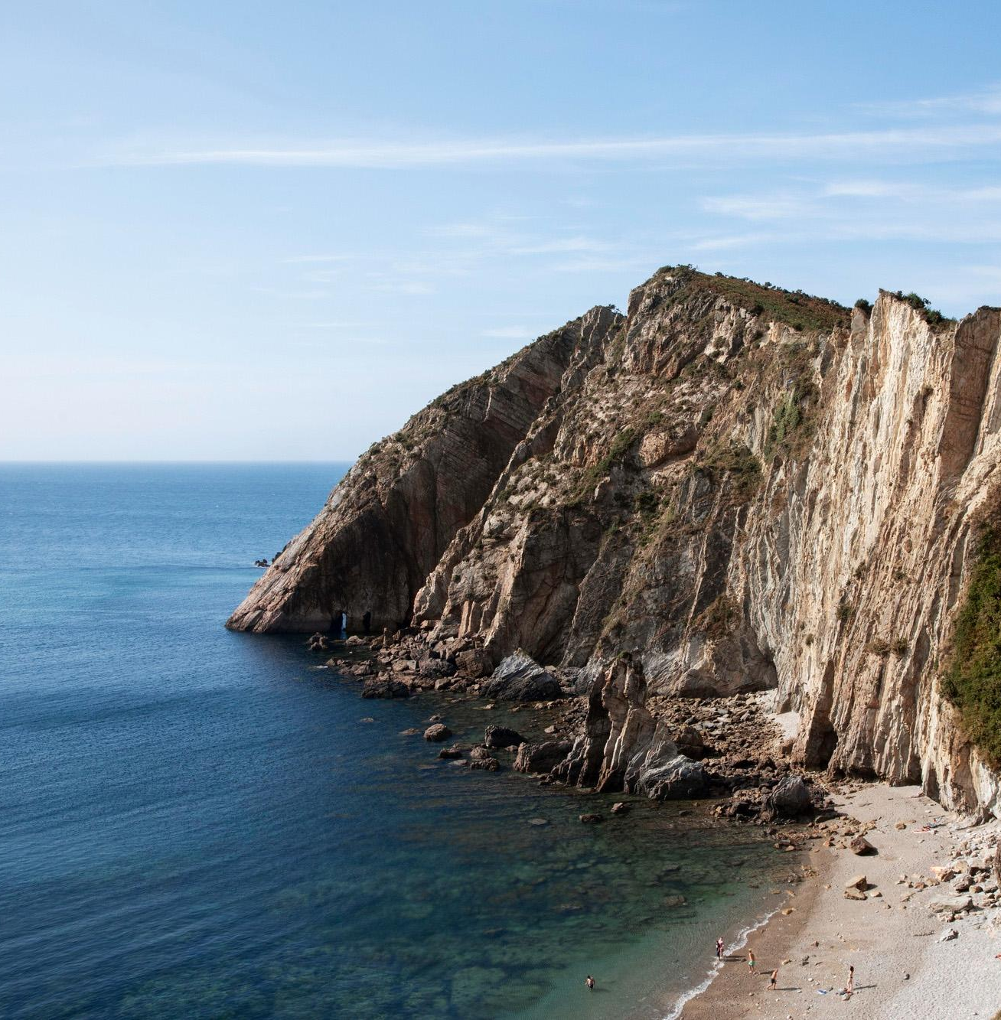
Look at the pictures and guess the names of the countries.

Slide 4

Choose a number
1
2
3
4
5
6
7
8
NEXT

Slide 5


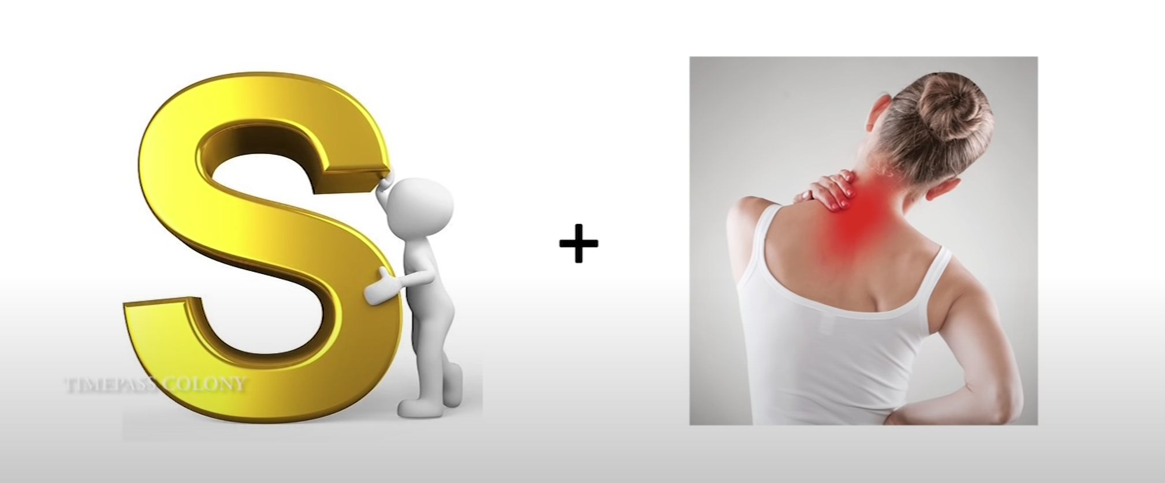
SPAIN
BACK
S + PAIN

Slide 6
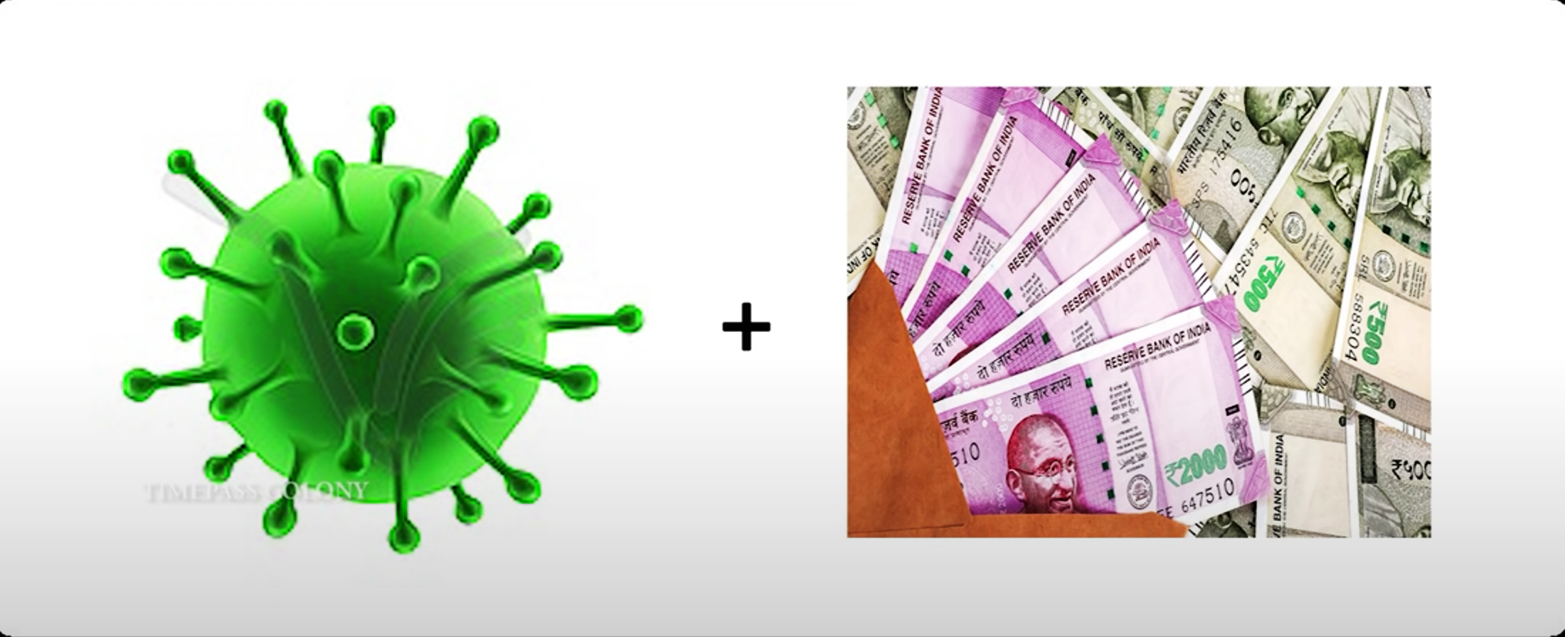
GERMANY
BACK
Germ + Money

Slide 7


EGYPT
BACK
E + Gift

Slide 8

FRANCE
BACK
F + Ran + S

Slide 9

CHINA
BACK
Chain + Aaaaa

Slide 10

CUBA
BACK
Cube + A

Slide 11
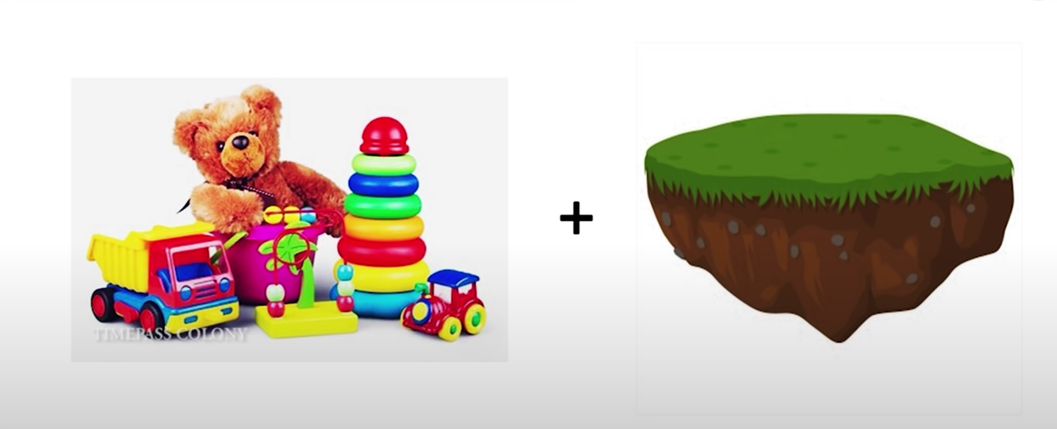

THAILAND
BACK
Tie + Land

Slide 12
IRAN
BACK
E + RAN

Slide 13
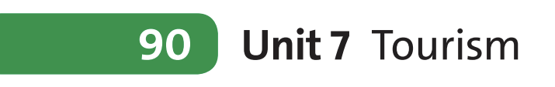
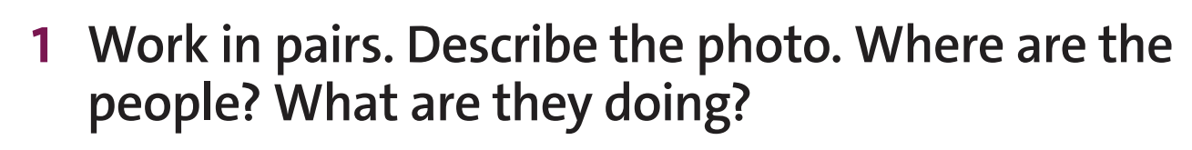
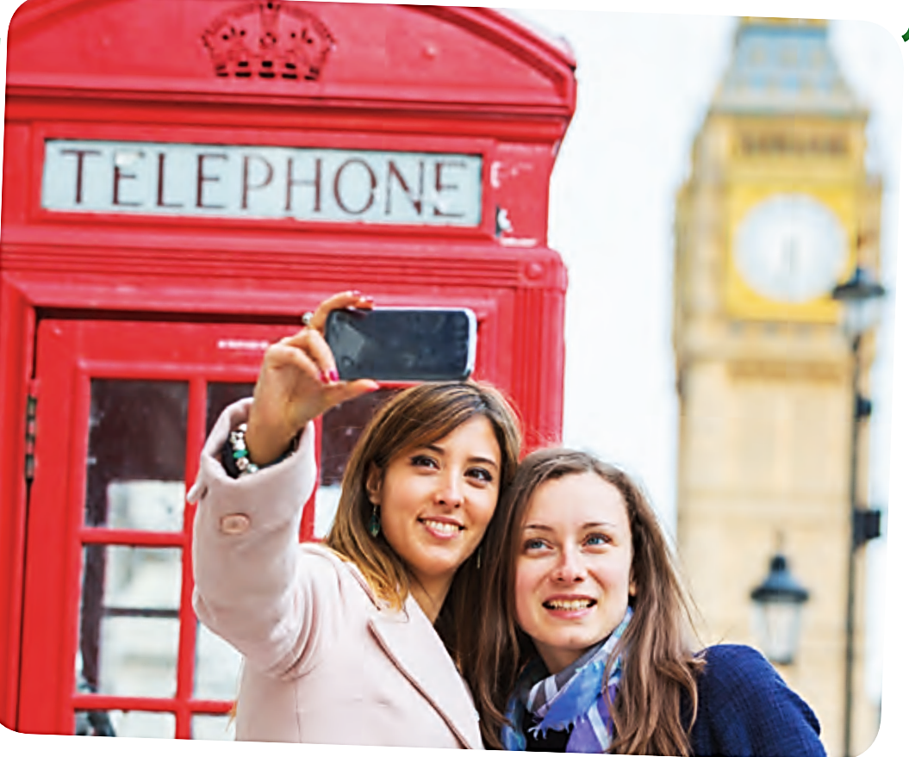

Speaking
There is a red telephone booth and a clock tower in the background.
They’re in London - the capital and largest city of England and the United Kingdom.
They’re taking selfies/ on livestream.
www.phuongnam.edu.vn

Slide 14
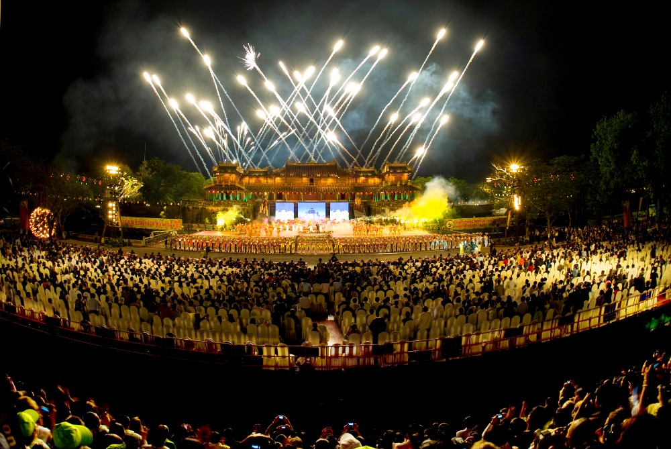
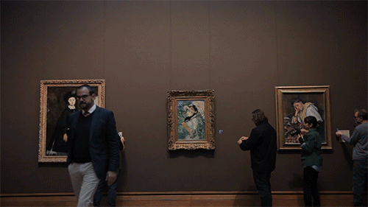
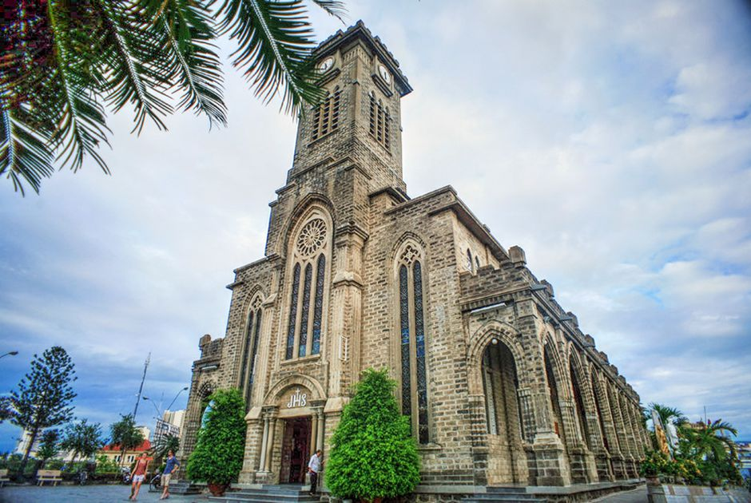
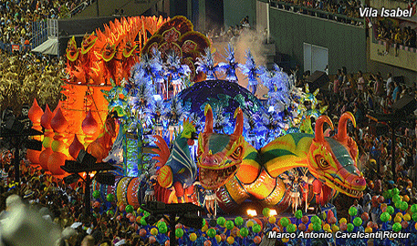
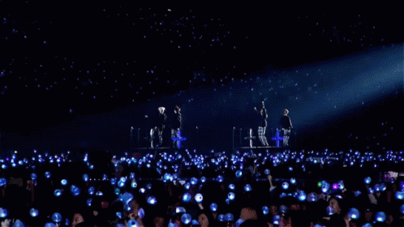
Vocabulary
Art gallery (n) /ˈɑːt ˌɡæl.ər.i/
a building where works of art can be seen by the public
Carnival (n) /ˈkɑː.nɪ.vəl/
public enjoyment and entertainment involving wearing unusual clothes, dancing, and eating and drinking, usually held in the streets of a city
Church (n) /tʃɜːtʃ/
a building for Christian religious activities
(smaller than Cathedral)
Festival (n) /ˈfes.tɪ.vəl/
Concert (n) /ˈkɒn.sət/
a special day or period, usually in memory of a religious event, with its own social activities, food, or ceremonies
a performance of music by one or more musicians or singers
www.phuongnam.edu.vn

Slide 15
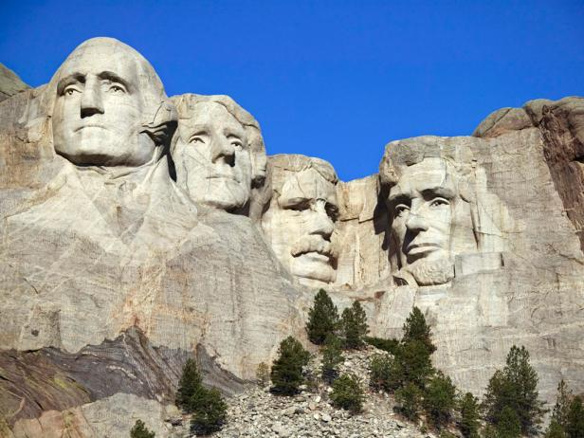
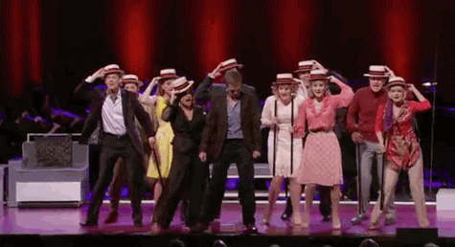
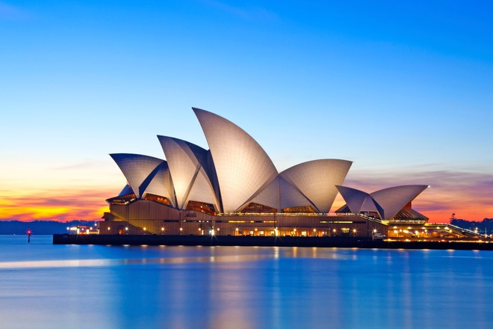
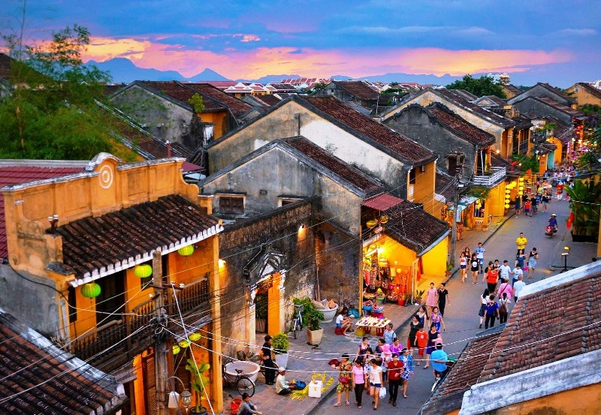
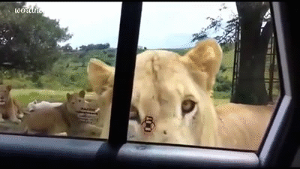
Vocabulary
Monument (n) /ˈmɒn.jə.mənt/
a structure or building that is built to honour a special person or event
Musical (adj) /ˈmjuː.zɪ.kəl/
related to or connected with music
Safari park (n) /səˈfɑː.ri ˌpɑːk/
a large park where wild animals are kept and can move freely, and can be watched by visitors driving through in their cars
Old town (n) /ˈəʊld ˌtaʊn/
the old part of a town or city that is usually close to its modern centre
Opera house (n) /ˈɒp.ər.ə ˌhaʊs/
a theatre that is specially designed for operas to be performed in
www.phuongnam.edu.vn

Slide 16
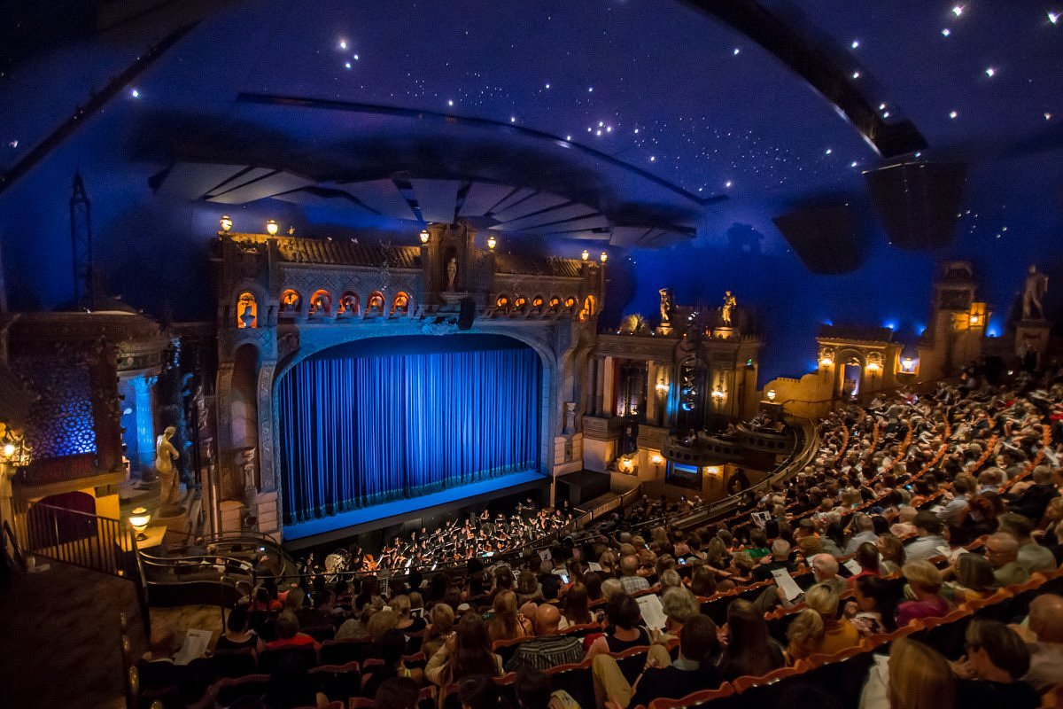
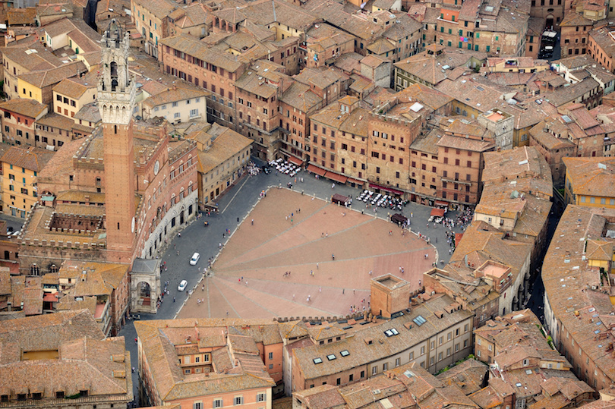
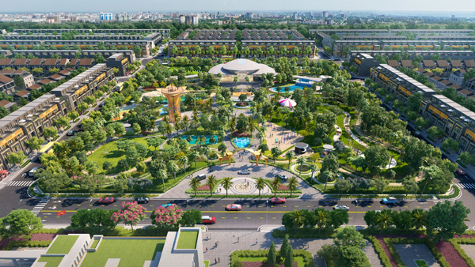
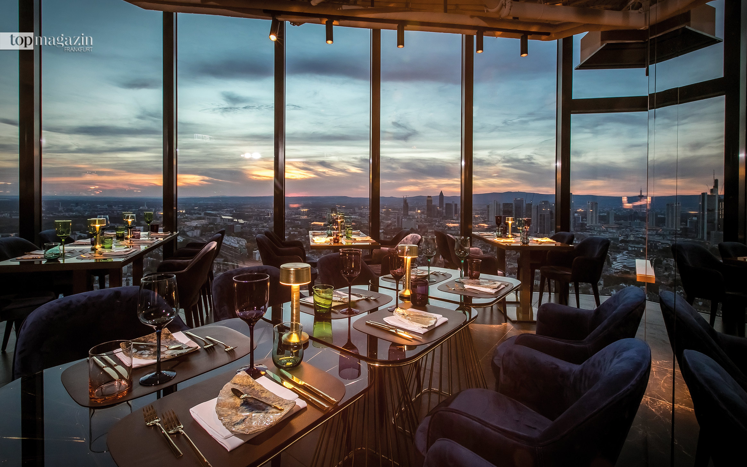
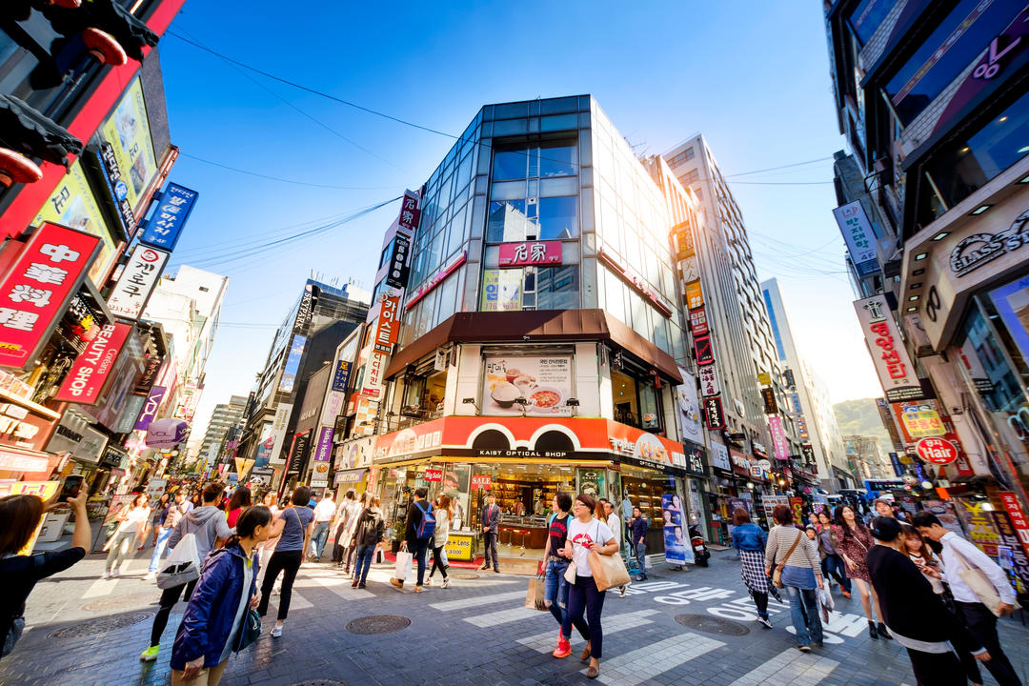
Vocabulary
Park (n) /pɑːk/
a large area of land with grass and trees, usually surrounded by fences or walls
Restaurant (n) /ˈres.tər.ɒnt/
a place where meals are prepared and served to customers
Shopping district (n)
/ˈʃɒp.ɪŋ dɪs.trɪkt/
An area of a city or town containing a significant number of shops or stores
Square (n) /skweər/
Theatre (n) /ˈθɪə.tər/
an open (typically four-sided) area surrounded by buildings in a town, village, or city
a building, room, or outside structure with rows of seats, which people can watch a performance or other activity
www.phuongnam.edu.vn

Slide 17
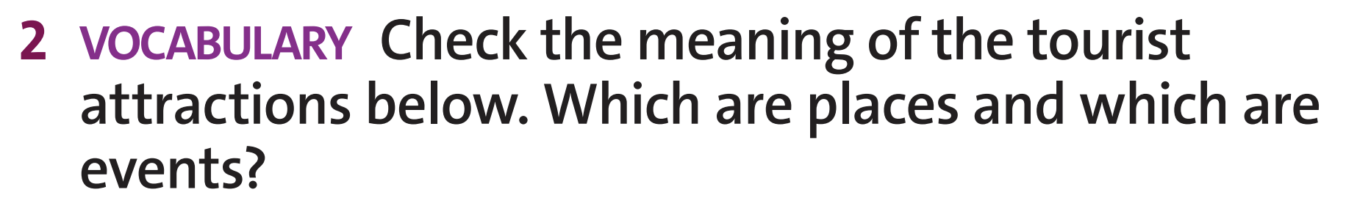
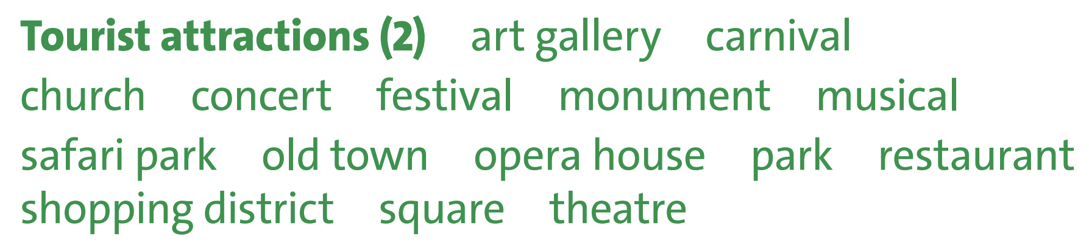
Vocabulary
art gallery
church
monument
national park
old town
opera house
park
restaurant
shopping district
square
theatre
carnival ○
concert ○
festival ○
musical ○
Places
Events
www.phuongnam.edu.vn

Slide 18
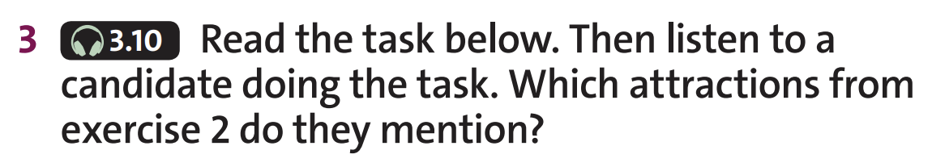
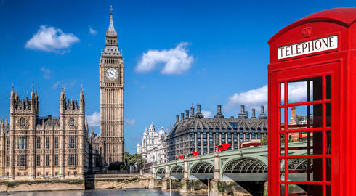
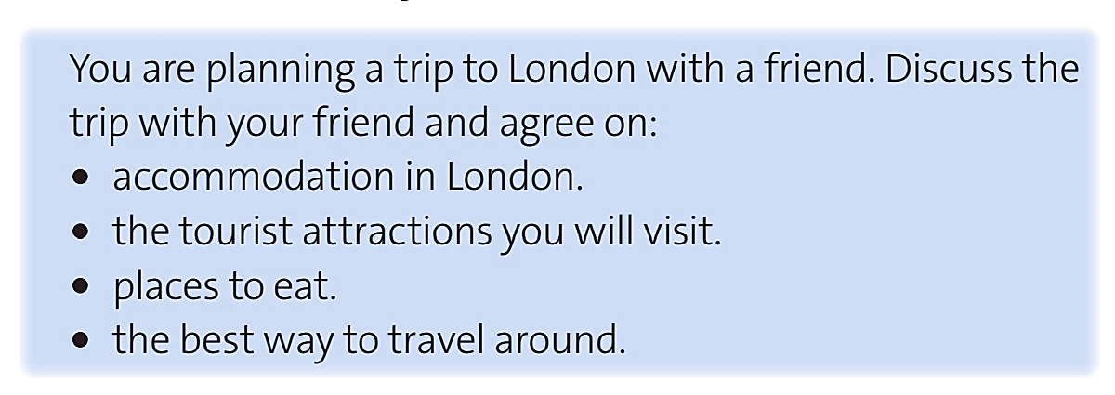
Listening
→ They mentioned art gallery, concert, theatre
www.phuongnam.edu.vn

Slide 19
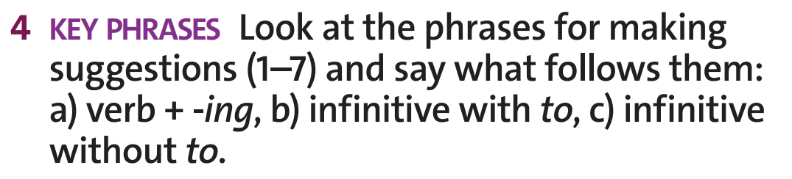
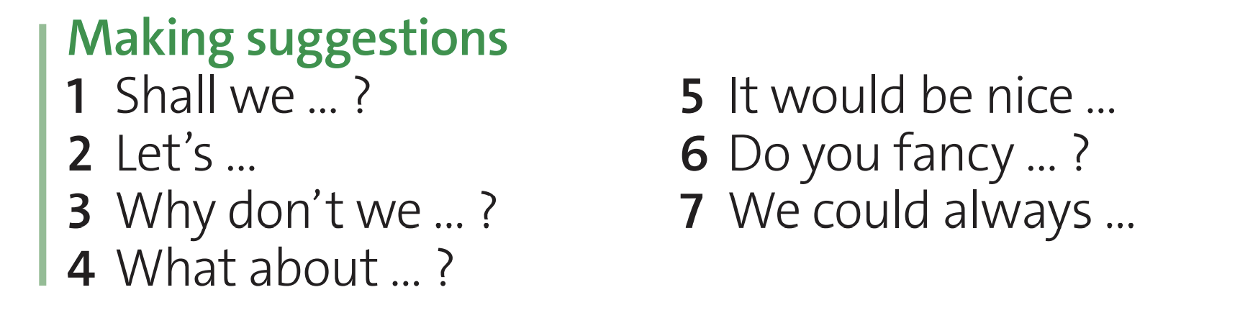
Key phrases
a. verb -ing
b. to infinitive
c. bare infinitive
c
b
c
a
c
c
a
www.phuongnam.edu.vn

Slide 20
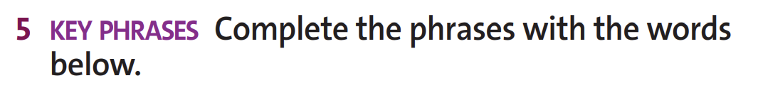

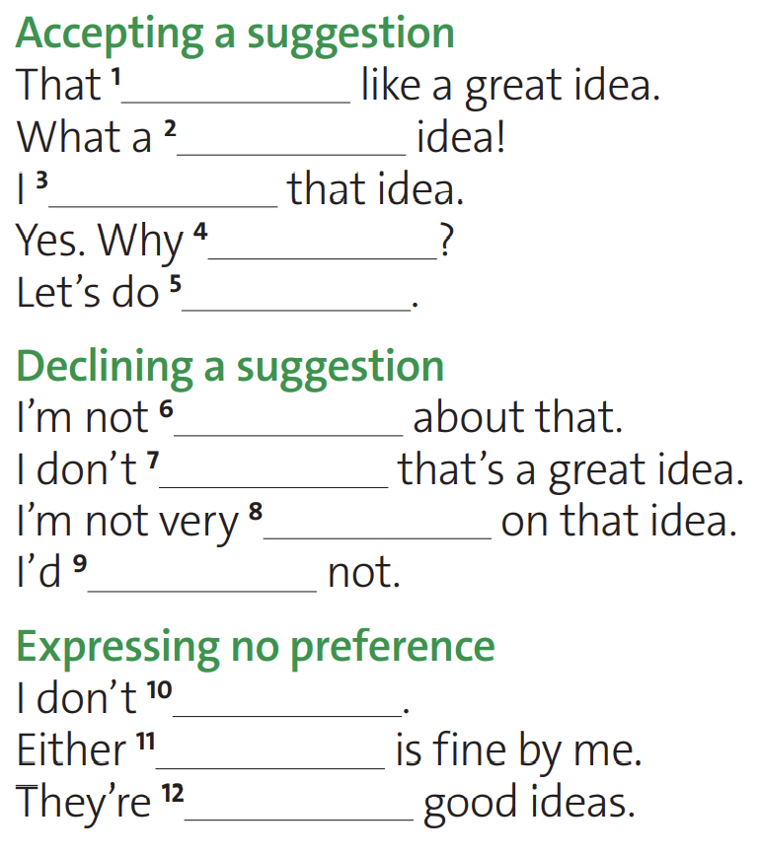
Key phrases
sure
think
keen
rather
sounds
good
like
mind
not
suggestion
that
both
www.phuongnam.edu.vn

Slide 21
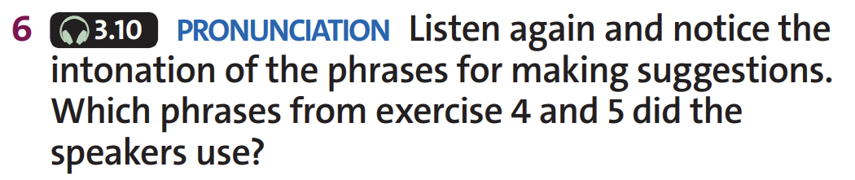
Listening
Answer Keys
Shall we ...?
Let’s do that.
Why don’t we ...?
I’m not sure about that.
What about...?
I don’t mind.
It would be nice ...
I like that idea.
Do you fancy ...?
I’m not very keen on that idea.
Why not?
What about...?
Do you fancy...?
What a good idea!
We could always ....
That’s a really good plan
www.phuongnam.edu.vn

Slide 22
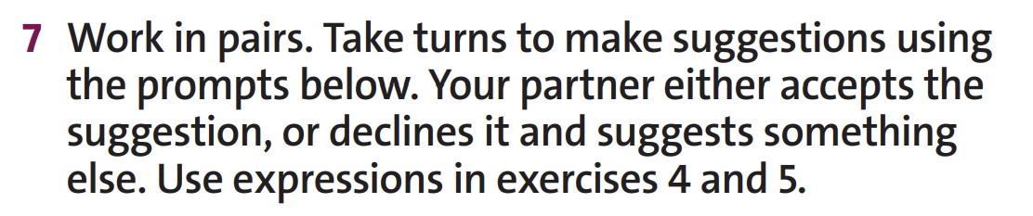

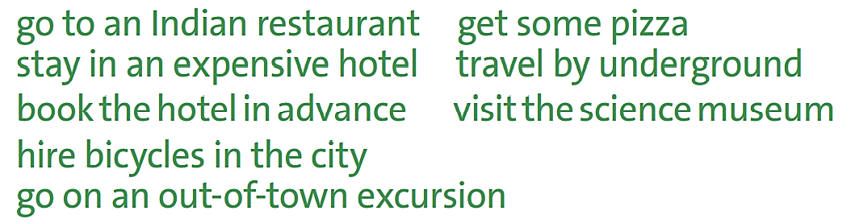
Speaking
Example:
(?) Why don’t we get some pizza for dinner?
(+) Yes, why not? I’m starving!
(ꟷ) Hmm, I’m not sure about that. Just got some pizza the day before.
www.phuongnam.edu.vn

Slide 23
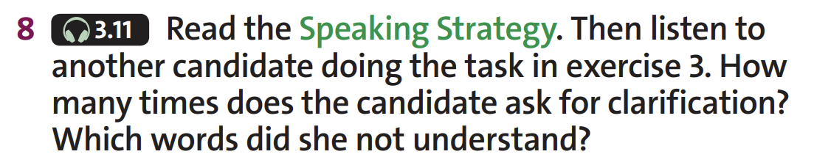
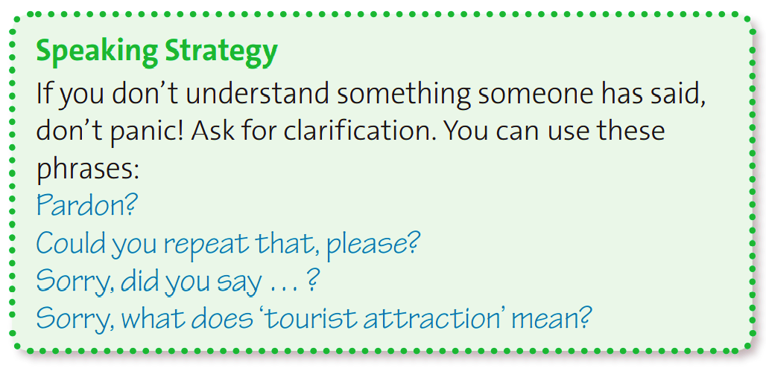
Listening
She asks twice.
She didn’t understand ‘market’ and ‘pricey’
www.phuongnam.edu.vn

Slide 24

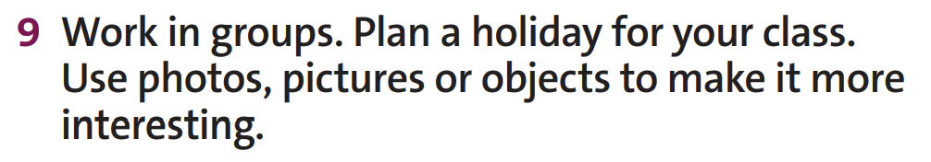

Practice
www.phuongnam.edu.vn

Slide 25
Practice
Suggested conversation: ( 3 students )
A: Hello, summer is coming. Let’s make an excursion to Đà Lạt.
B: What a good idea! I think we should go there by couch. It is very far from our city.
C: Sorry, did you say “couch”? It is about 400 km, so we will be very tired. What about travelling by plane?
A: Either suggestion is fine by me.
B: I think we should travel by couch as plane tickets are pricey.
C: OK! When will we go? How about 26th May 2023? That will be one week after the end of 2nd semester.
A: I like that idea. Let’s start at 6:30 a.m at our school and arrive there at 2:00 p.m.
B: Do you fancy Skyview hotel? It is a very nice and comfortable hotel on a hillside.
A: I’d rather not. Why don’t we choose one downtown? We could always travel to the street at night.
C: I recommend Colline hotel.
A: Great! We can take many photographs, eat a lot of food, and buy souvenirs for our relatives.
B & C: Yeah, I’m so excited!
www.phuongnam.edu.vn

Slide 26
HOMEWORK
Learn by heart new words and phrases.
Do exercises in Workbook.
Prepare Unit 7-H / page 91

Slide 27

www.phuongnam.edu.vn

Slide 28



Thank you!
CTCP ĐẦU TƯ VÀ PHÁT TRIỂN GIÁO DỤC PHƯƠNG NAM

