Slide 2
There are FIVE photos in this game.
You have to describe the photo and guess the job.
You will get ONE point for each correct answer.
Suggested structure:
He/ she is wearing/ doing……..
The background is……………
So, he/ she could be……………….

Slide 3
WARM-UP GAMES
She is serving drinks. The background may be on a train or a plane.
She could be a flight/ train attendant.

Slide 4
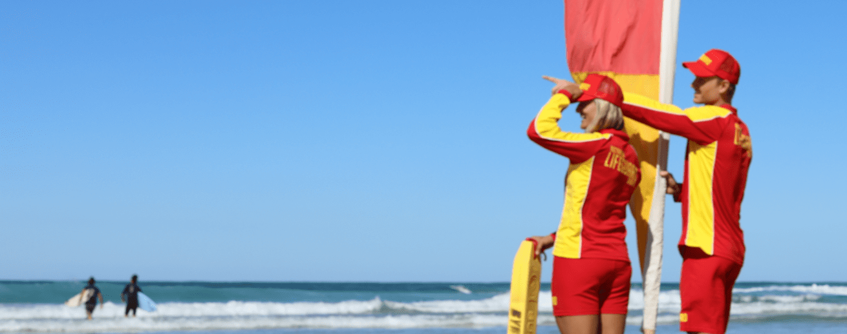
WARM-UP GAMES
They are watching over people at the beach.
They could be lifeguards/ lifesavers.

Slide 5
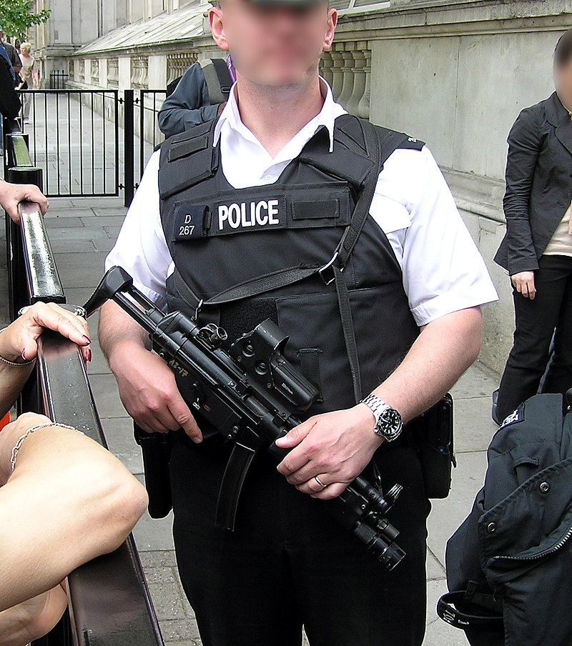
WARM-UP GAMES
He is wearing protective gear and holding a riffle.
He could be a police officer/ police agent.

Slide 6
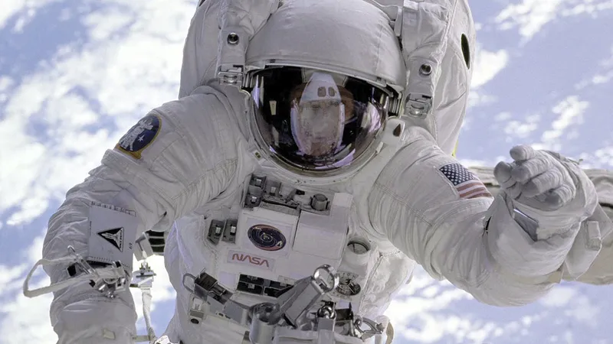
WARM-UP GAMES
He is wearing a spacesuit. The background is the sky or space.
He could be an astronaut.

Slide 7
WARM-UP GAMES
They are wearing anti- fire suits and using water.
They could be firefighters.

Slide 8
Unit 5: Ambition
Lesson 5F: Reading

Slide 9
www.phuongnam.edu.vn

Slide 10
There are colorful lego pieces on the table. He is playing with them.
He could be a…..
He is watching an interview on his tablet. There are 2 people wearing suits.
He could be a…..
www.phuongnam.edu.vn

Slide 11
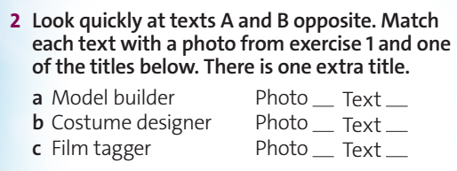
2
a
1
c
www.phuongnam.edu.vn

Slide 12
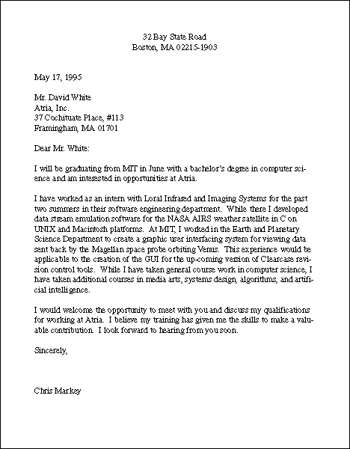
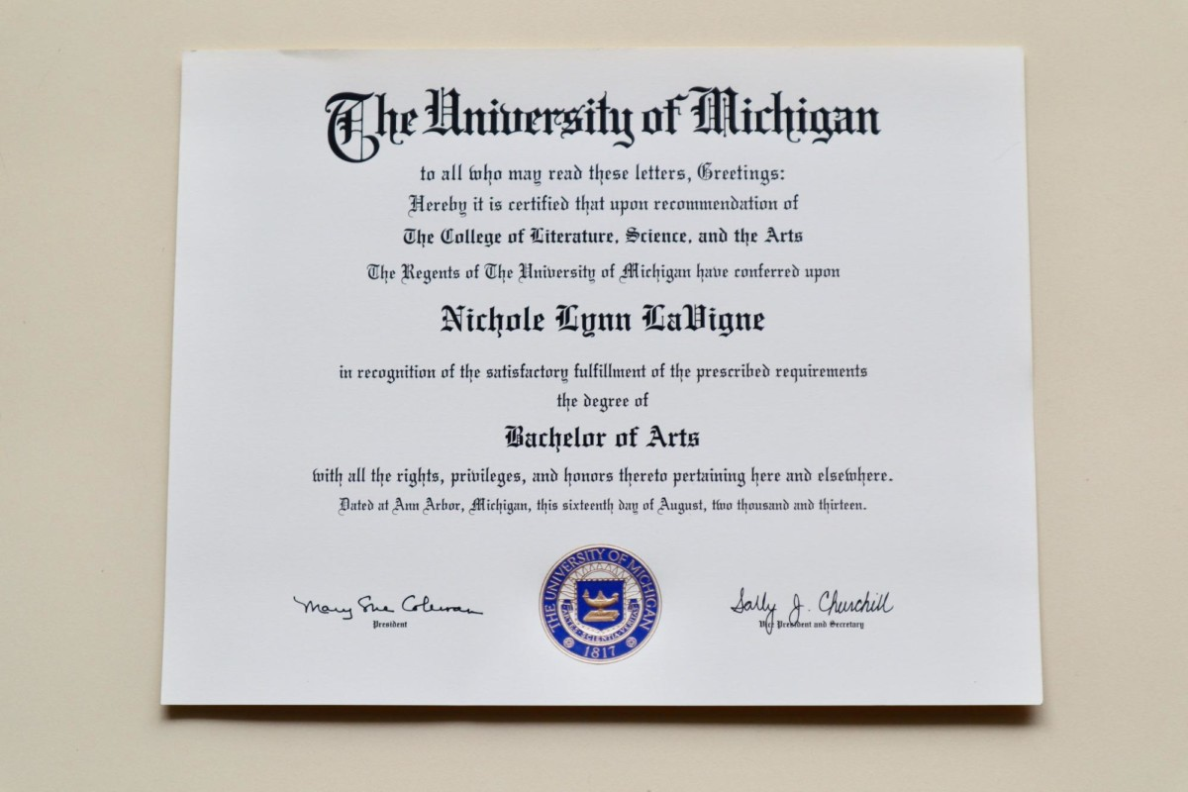
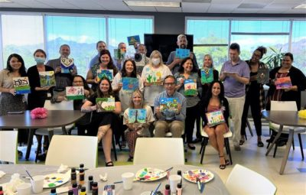
Vocabulary:
graduation /ˌɡrædʒuˈeɪʃn/
the act of successfully completing a university degree, or studies at high school
manufacturer /ˌmænjuˈfæktʃərə(r)/
a person or company that produces goods in large quantities
application /ˌæplɪˈkeɪʃn/
a formal (often written) request for something, such as a job, permission to do something or a place at a college or university
participate /pɑːˈtɪsɪpeɪt/
to take part in or become involved in an activity
provider /prəˈvaɪdə(r)/
a person or an organization that supplies somebody with something they need or want
degree /dɪˈɡriː/
the qualification obtained by students who successfully complete a university or college course
www.phuongnam.edu.vn

Slide 13
www.phuongnam.edu.vn

Slide 14
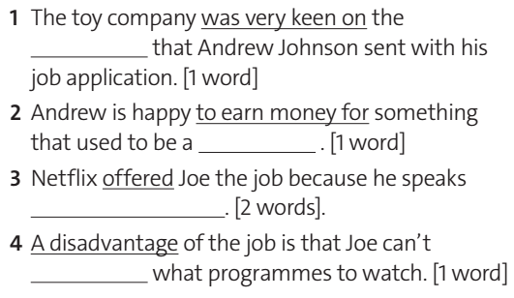
loved
get paid for
www.phuongnam.edu.vn

Slide 15
gave
The only problem with
www.phuongnam.edu.vn

Slide 16
www.phuongnam.edu.vn

Slide 17
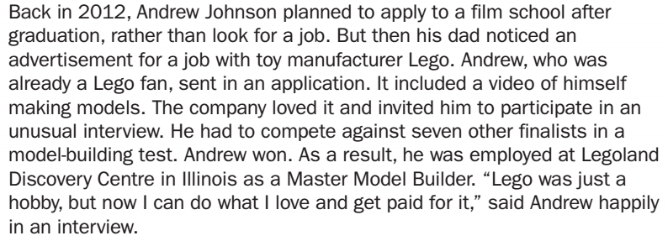
video
hobby
www.phuongnam.edu.vn

Slide 18
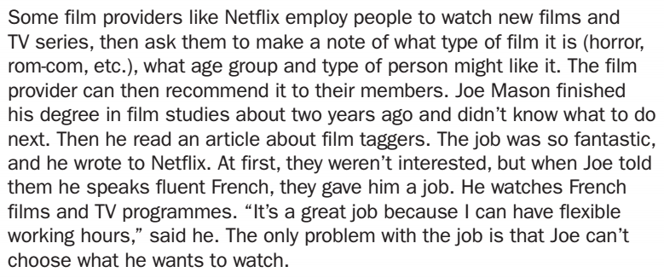
fluent French
choose
www.phuongnam.edu.vn

Slide 19
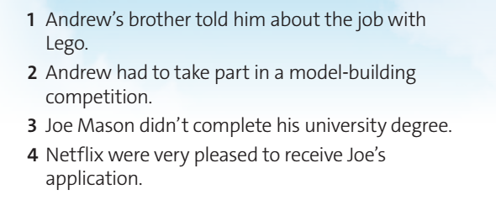
F
His dad told him about the job.
T
www.phuongnam.edu.vn

Slide 20
F
He finished his degree 2 years ago.
F
At first, they weren’t interested.
www.phuongnam.edu.vn

Slide 21
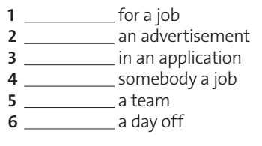
Ex 6:
look
notice
send
offer
join
take
www.phuongnam.edu.vn

Slide 22
Extra job pairs
Engineer vs Gardener
Tour guide vs Waiter
Lifeguard vs Teacher
Designer vs Bus Driver
www.phuongnam.edu.vn

Slide 23
EX 8: INTERNET RESEARCH
EX 8: INTERNET RESEARCH
www.phuongnam.edu.vn

Slide 24
01
Homework
02
03
1. Learn by heart all the new words
2. Finish all the tasks
3. Prepare U5-G (P.66)
04
?
05
06

Slide 25
www.phuongnam.edu.vn

Slide 26
Thank you!
CTCP ĐẦU TƯ VÀ PHÁT TRIỂN GIÁO DỤC PHƯƠNG NAM

