Slide 1
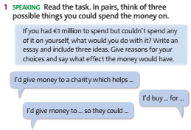

Slide 2
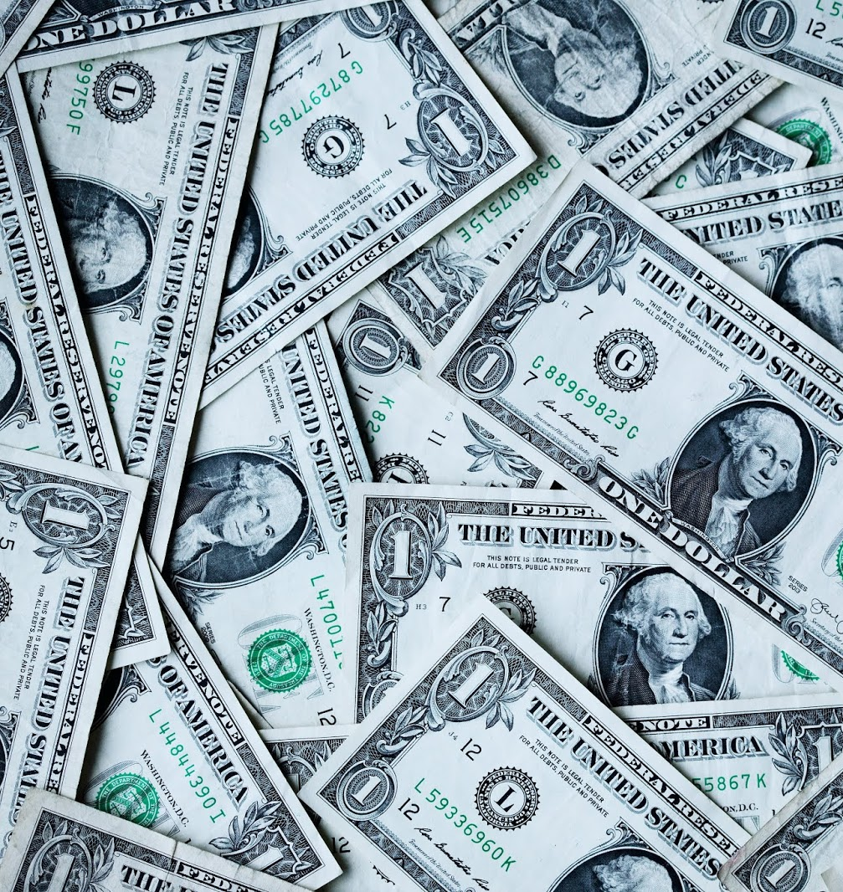
UNIT 6: MONEY
WRITING
AN OPINION ESSAY

Slide 3
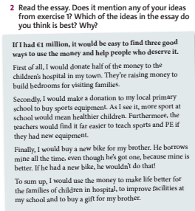

Slide 4
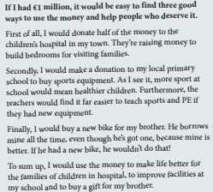
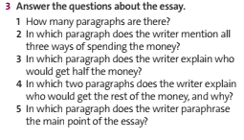

Slide 5
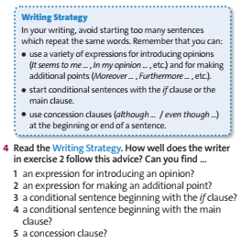
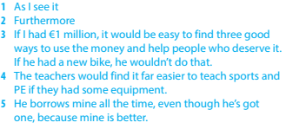

Slide 6
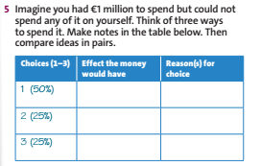

Slide 7
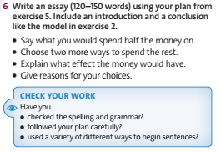

Slide 8
1/ Learn by heart all new vocabulary, phrases, and structures.
2/ Prepare for the next lesson.

Slide 9
THANK YOU
FOR YOUR ATTENTION

