Slide 1
HELLO! HAVE A GOOD DAY!
STUDY
One step closer to success

Slide 2
LET’S WATCH A CLIP
https://www.youtube.com/watch?v=DPOm4Z-HpGY

Slide 3
TENSES
your tasks done.
and VERBS
(part 3)

Slide 4
FUTURE SIMPLE
Tương lai đơn

Slide 5
FUTURE SIMPLE
(+) S + will + V₀
(-) S + won’t + V₀
(?) Will + S + V₀ …?
Notes:
BE GOING TO
FORMULA:
(+) S + am/is/are + going to
(-) S + am not/isn’t/aren’t going to + V₀
(?) Am/Is/Are + S + going to + V₀ …?

Slide 6
FUTURE SIMPLE
USAGES:
Amy thinks it will be sunny.
A: What are you going to do this weekend?
B: I don’t know. Maybe I will stay at home for rest.
A: I don’t know how to start this machine.
B: Wait a minute. I will help you.
1. Diễn tả một dự đoán không có căn cứ xác định.
2. Diễn tả dự định đột xuất xảy ra ngay lúc nói.
3. Diễn tả lời ngỏ ý, hứa hẹn, đề nghị, đe dọa.
Examples:

Slide 7
FUTURE SIMPLE
SIGNALS:
1. next (week, Sunday, Christmas, …..)
2. tonight
3. tomorrow
4. soon/later
5. in (2 hours / a week,…)

Slide 8
FUTURE SIMPLE
NOTE:
Mệnh đề bắt đầu bằng liên từ chỉ thời gian, động từ luôn chia thì HTĐ/HTHT/HTTD dù xảy ra trong tương lai.
when
as soon as
while
before
after
…
S + V 1….

Slide 9
FUTURE SIMPLE
EXAMPLES:
will call
She (call)………………………….. us as soon as she (fly) ……………... to Florida tomorrow.
When we (finish) ……………………………….. our lesson next week, we (have) …………………………… a test.
flies
finish/have finished
will have

Slide 10
FUTURE PROGRESSIVE
Tương lai tiếp diễn

Slide 11
FUTURE PROGRESSIVE
Note:
Những động từ không chia thì tiếp diễn:
FORMULA:
Be, belong, ...
See, hear, smell, taste, feel, sound, seem, ...
Like, love, hate, dislike, want, hope, wish,...
Stop, start, begin, end, ...
Remember, forget, suggest,...
Know, understand, realize, think, ...
(+) S + will be + V-ing
(-) S + won’t be+ V-ing
(?) Will + S + be+ V-ing…?

Slide 12
FUTURE PROGRESSIVE
Examples:
1. Diễn tả một hành động đang xảy ra tại một thời điểm xác định trong tương lai.
will play
I (play)………………………….. tennis next week.
I (play)………………………….........tennis at 7 A.M next week.
I (play)……………………………...... tennis at this time next week.
will be playing
will be playing
USAGES:

Slide 13
FUTURE PROGRESSIVE
Examples:
2. Diễn tả một hành động đang xảy ra (will be + V-ing) trong tương lai thì một hành động khác xen vào (V1,…)
will be waiting
Jenny (wait).............................................. for you when the plane (land) ......................... tomorrow morning.
lands
While students (do) ..........………………. the test, the teacher (supervise) ………………………………............. the students next week.
are doing
USAGES:
will be supervising

Slide 14
FUTURE PROGRESSIVE
SIGNALS:
1. next time, next....., in the future, soon,......
2. While

Slide 15
FUTURE PERFECT
Tương lai hoàn thành

Slide 16
FUTURE PERFECT
FORMULA:
(+) S + will have + V₃
(-) S + won’t have + V₃
(?) Will + S + have + V₃ …?

Slide 17
FUTURE PERFECT
Examples:
1. Diễn tả hành động đã hoàn thành trước một thời điểm ở trong tương lai
will leave
They (leave)………………............for Korea tomorrow.
They (leave)……………....................... for Korea by 5p.m. tomorrow.
They (leave)………………….............…for Korea by this time tomorrow.
will have left
USAGES:
will have left

Slide 18
FUTURE PERFECT
Examples:
2. Diễn tả một hành động xảy ra trước một hành động khác ở trong tương lai.
Trước (will have + V₃ )
Sau (V₁)
Before my father (come) ............................ back tonight, I (do) .................................... homework.
comes
will have done
USAGES:

Slide 19
FUTURE PERFECT
SIGNALS:
1. By the end of ….
2. by, by the time, before, after
3. as soon as, when

Slide 20
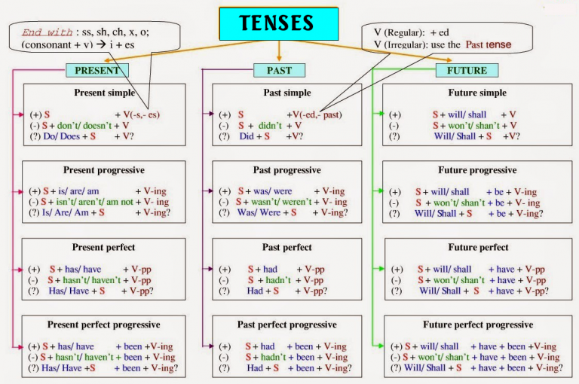

Slide 21
EXERCISES
Workbook:
Practice 9, 10 (p.5,6)
Fighting!

Slide 22
THANKS!
BYE!
Does anyone have any questions?

Slide 23
CREDITS
This is where you give credit to the ones who are part of this project.
Did you like the resources on this template? Get them for free at our other websites.
Presentation template by Slidesgo
Icons by Flaticon
Infographics by Freepik
Images created by Freepik
Author introduction slide photo created by Freepik
Text & Image slide photo created by Freepik.com
JE SUIS JOLIE

