Slide 1
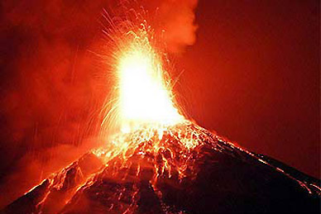
Unit 12: a vacation abroad
1. New words
- (to) pour out:
phun trào
- (to) carve:
chạm khắc
- to be situated:
tọa lạc
- lava (n):
dung nham
- volcano (n):
núi lửa
- overhead (adv)
ở phía trên đầu
= above your head:

Slide 2
Unit 12: a vacation abroad
* Matching
1. (to) pour out:
a. núi lửa
2. (to) carve:
b. phun trào
3. to be situated:
c. ở phía đầu
4. lava (n):
d. dung nham
5. volcano (n):
e. chạm khắc
6. overhead (adv)
= above your head:
f. tọa lạc

Slide 3
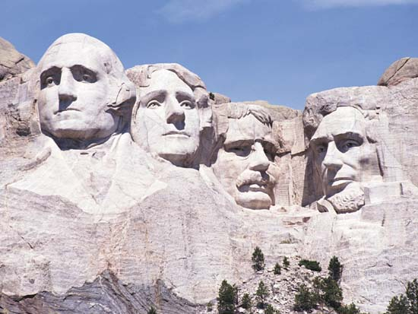
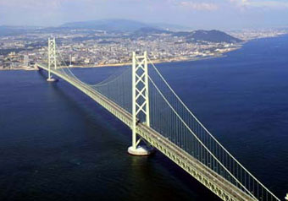
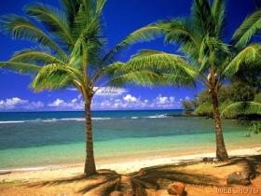
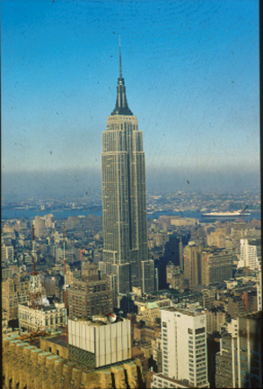
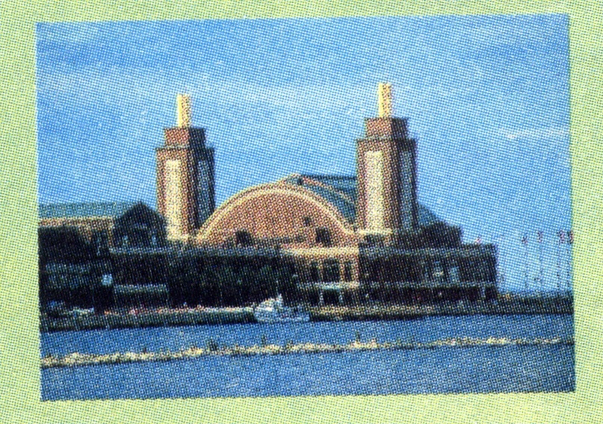
Unit 12: a vacation abroad
San Francisco
Mount Rushmore
Empire State Building
Chicago
Hawaii

Slide 4
Unit 12: a vacation abroad
2. Reading
We went swimming at Waikiki Beach as soon as we arrived on the Hawaiian island of Oahu. We took a small plane to Kilauea Volcano this afternoon. The lava was pouring out when we flew overhead. It was very exciting.

Slide 5
Unit 12: a vacation abroad
2. Reading
Today we went on an eight-hour tour which included Fisherman’s Wharf, the Napa Valley wine-growing area, and the famous prison on the island of Alcatraz in the middle of San Francisco Bay

Slide 6
Unit 12: a vacation abroad
2. Reading
This is a picture of Mount Rushmore where the heads of four American presidents are carved into the rock. Mount Rushmore can be seen more than 100 kilometers away.

Slide 7
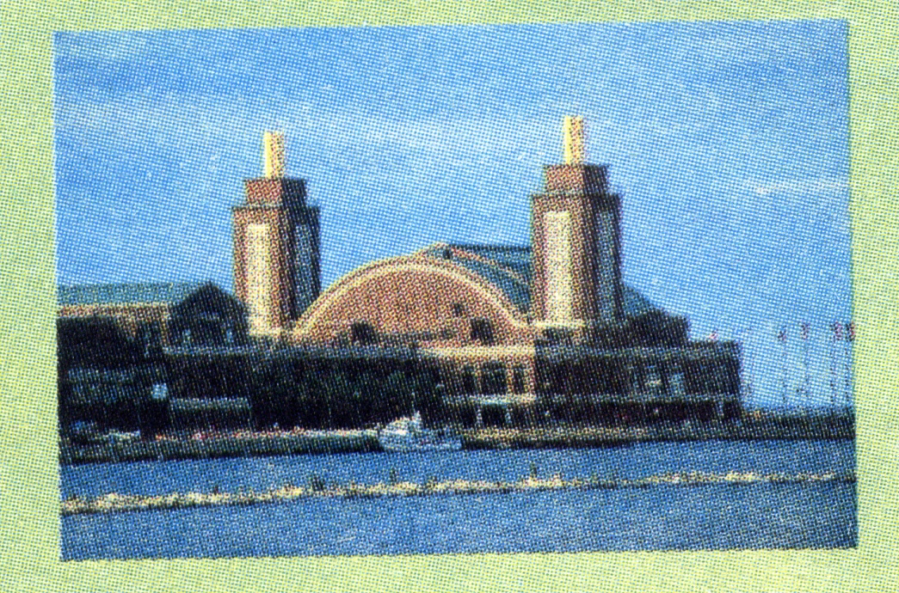
Unit 12: a vacation abroad
2. Reading
Chicago is often called “The Windy City”. It’s situated right on the shore of Lake Michigan, one of the Great Lakes.

Slide 8
Unit 12: a vacation abroad
2. Reading
Yesterday, while Dad was visiting the Statue of Liberty and the Empire State Building, I went shopping. I bought lots of souvenirs of our trip.

Slide 9
Unit 12: a vacation abroad
* Fill in the blanks with the information you read
Place
What she did and saw
Hawaii
Went swimming, visited Kilauea Volcano
New York
Went shopping, bought lots of souvenirs
Chicago
Saw Michigan lake
Mount Rushmore
Saw the heads of 4 American presidents
San Francisco
Visited Fisherman’s Wharf, the Napa valley and the Alcatraz Prison

Slide 10
Unit 12: a vacation abroad
4. Fill in the gaps with the given words
Went
valley
heads
Chicago
air
Alcatraz
windy
Washington
swim
Wharf
eight
New York
Mrs.Quyen and her husband were in the USA. for vacation. They ________ to Kilauea Volcano by _______. They also went for a _______ at Waikiki Beach of Hawaii.
After that they visited Fisherman’s_______ the wine growing area in Napa _______ and the _______ prison in San Francisco. The tour lasted _______ hours. They enjoyed seeing the four _______of presidents in Mount Rushmore and the _______ city on the shore of Lake Michigan.
Finally, they went on seeing the sights and buying
(1)
(2)
(3)
(4)
(5)
(6)
(7)
(8)
(9)
(10)
souvenirs in __________.

Slide 11
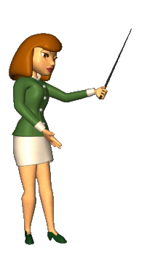
Unit 12: a vacation abroad
5. homework
- Learn the new words.
- Rewrite the hand out and the answers of questions in your notebook.

