Slide 1
Key phrases:
1. guess what is happening in each of : đoán những gì đang xảy ra trong từng
2. look great in : nhìn/trông tuyệt vời trong…
3. buy the hat for myself : tự tay mua cái mũ cho chính mình
4. be extremely excited : cực kỳ vui mừng, rất phấn khích
5. decide to go to the shop at once : quyết định đi đến cửa hàng ngay lập tức
6. glance at me and turn away : liếc nhìn tôi và quay đi
7. a sneaky look on face : một cái nhìn lén lút trên khuôn mặt
8. be busy imagining : bận tưởng tượng, bận suy nghỉ
9. turn round and notice :
10. see a wad of dollar notes exactly like : nhìn thấy một sắp/cọc tiền đô la giống hệt như
11. quickly look into my own bag : nhanh chóng nhìn lại vào túi của tôi

Slide 2
12. make a fuss : làm om sòm, làm lớn chuyện
13. take my money back from : lấy lại tiền của tôi từ
14. point to a wad of dollar notes on : chỉ vào một sắp tiền đô la trên
15. be so shy that : xấu hổ đến mức
16. look at him in the face : nhìn vào mặt anh ấy
17. complain noisily about : phàn nàn, than phiền về
18. imitate in different ways : bắt chước theo nhiều cách khác nhau

Slide 3
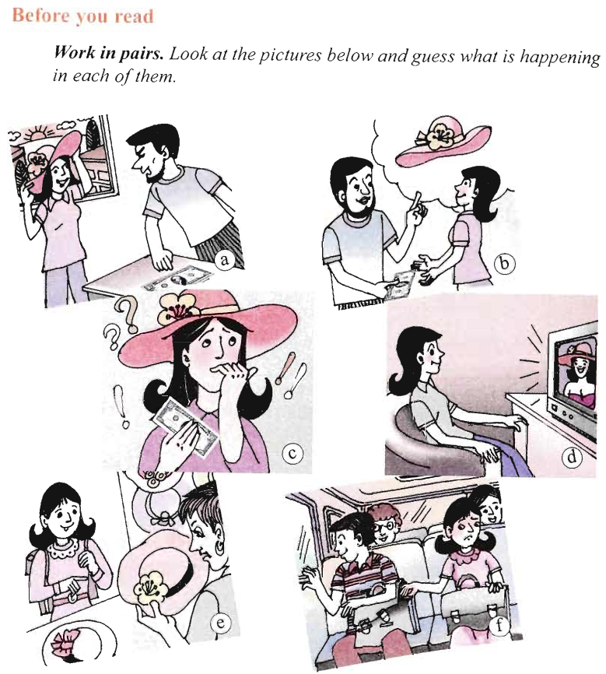
a) A man is pointing at a bank-note, saying something.
b) A man is giving a girl some money to buy a hat.
c) A girl is holding a bank-note, thinking about something.
d) A girl is watching TV, on which a woman is wearing the hat she likes.
e) A girl is at the hatter and buy a hat.
f) A girl is stealing something in boy's bag.

Slide 4
While you read: Read the story and then do the tasks that follow.
MY MOST EMBARRASSING EXPERIENCE
My most embarrassing experience happened a few years ago, when I was a grade 9 student. In those days, my biggest dream was a red hat - a floppy cotton hat like the one my pop star idol wore in her video clip. I thought I would look great in it.
My father knew this, so on my birthday he gave me some money so that I could buy the hat for myself I was extremely excited and decided to go to the shop at once. I got on the bus and sat down next to a schoolboy about my age. The boy glanced at me and turned away. There was a sneaky look on his face, but I didn't think much about it. I was busy imagining how I would look in the hat. After a while, I turned round and noticed that the boy's schoolbag was open. Inside it, I saw a wad of dollar notes exactly like the ones my father had given me. I quickly looked into my own bag - the notes had gone! I was sure that the boy was a thief. He had stolen my money. I didn't want to make a fuss, so I decided just to take my money back from the schoolboy's bag, without saying a word about it. So I carefully put my hand into the boy's bag, took the notes and put them in my own bag.
With the money I bought the pretty hat of my dreams. When I got home, I showed it to my father.
"How did you pay for it?" he asked.
"With the money you gave me for my birthday, of course, Dad," I replied.
"Oh? What's that then?" he asked, as he pointed to a wad of dollar notes on the table.
Can you imagine how I felt then?

Slide 5
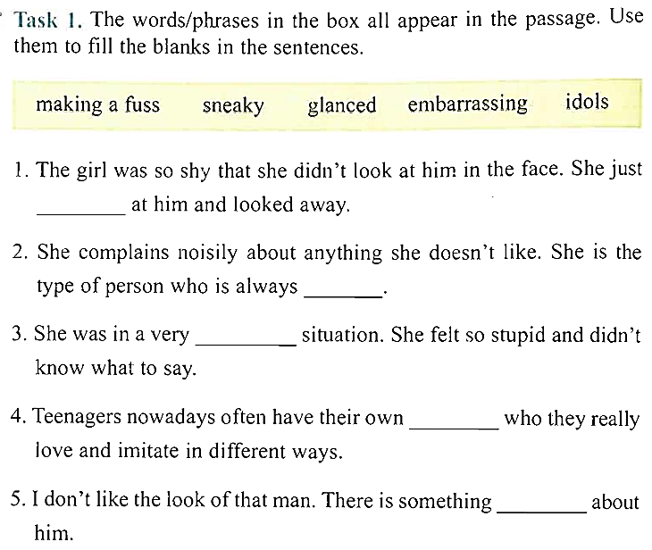
glanced
making a fuss
embarrassing
idols
sneaky

Slide 6
D
B
F
E
A
C

Slide 7
Task 3. Answer the questions.
What did the girl wish to have when she was in grade 9?
2. Why did her father give her some money on her birthday?
3. What did she see in the boy's bag?
4. Why did she decide to take the money from the boy's bag without
saying anything about it?
5. What did she do with the money?
=> She wanted to have a red hat - a floppy cotton hat like the one her pop star idol wore in her video.
=> He gave her some money so that she could buy the hat for herself.
=> She saw a wad of dollar notes exactly like the ones her father had given her.
=> Because she was sure that the boy was a thief and he had stolen her money and she didn't want to make a fuss.
She bought the pretty hat of her dream.

Slide 8
=> Perhaps the girl might want to tell her father the truth and ask him for help.
=> She might feel embarrassed because that was not her money.
=> Perhaps the girl could place a notice on a local newspaper to apologize the boy and contact him to give the money back.
=> Perhaps she should come to the police station, tell the police the truth and ask them for help.

