Slide 1




Unit 8.
LIFE IN THE FUTURE
READING

Slide 2


WARM-UP

Slide 3
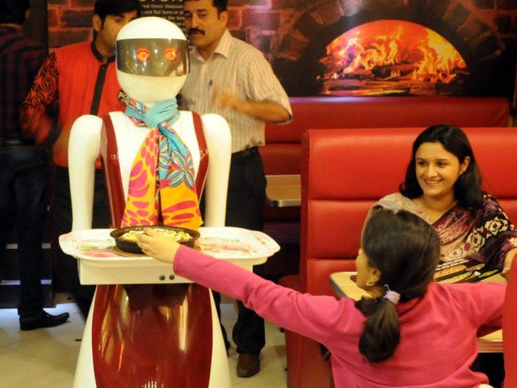
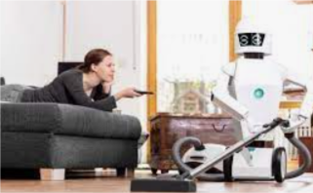
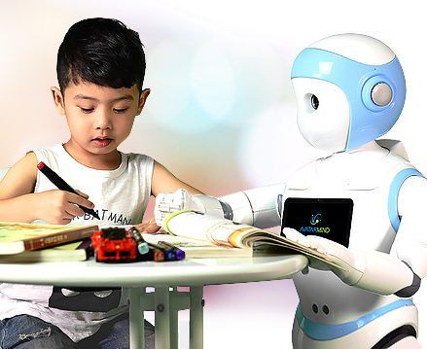
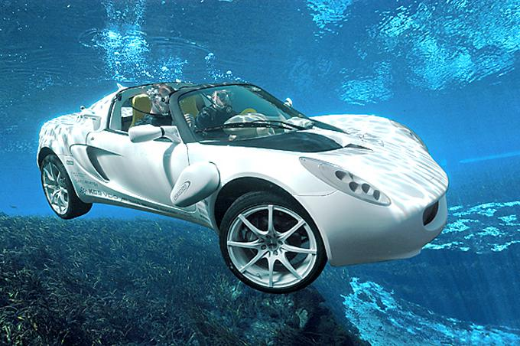
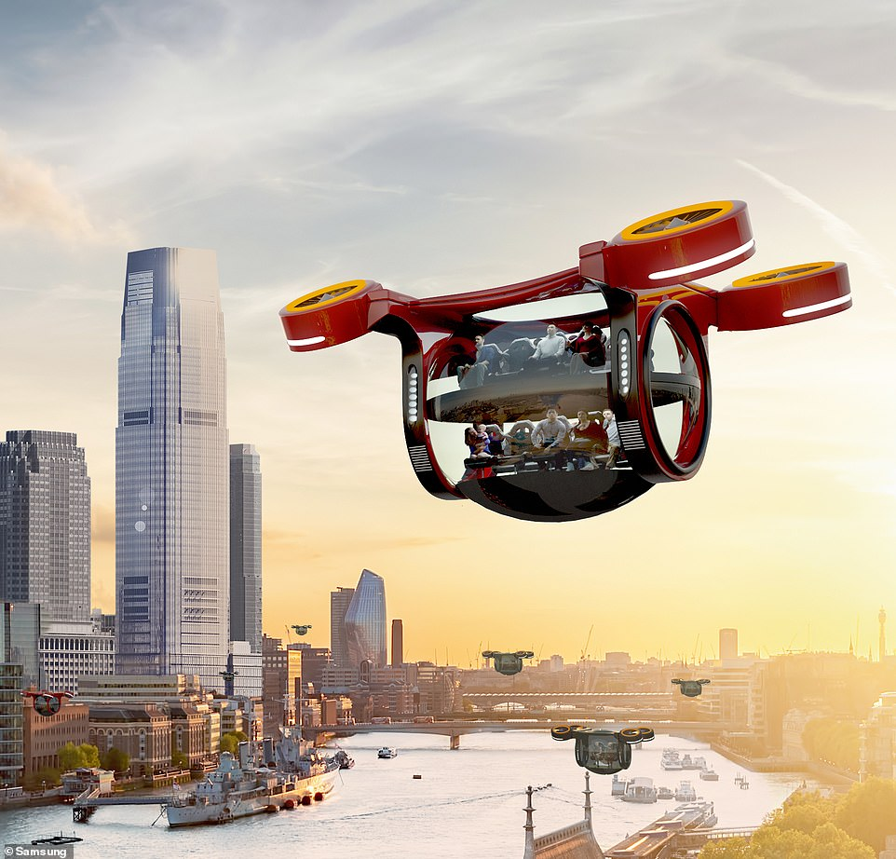

Do you think life will be better in the future? Why?/why not?
List three things that might happen in the future.
Robots serve the meal.
Robots do household chores.
Robots help do homework.
The pandemic will be wiped out.
Bus can fly in the sky.
Car can run on sea water.

Slide 4

BEFORE YOU READ

Slide 5
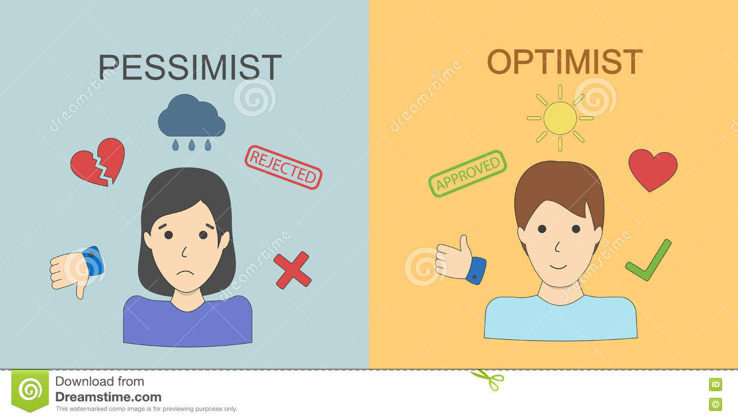
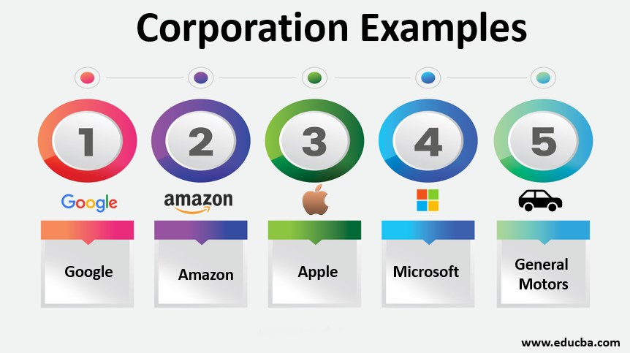
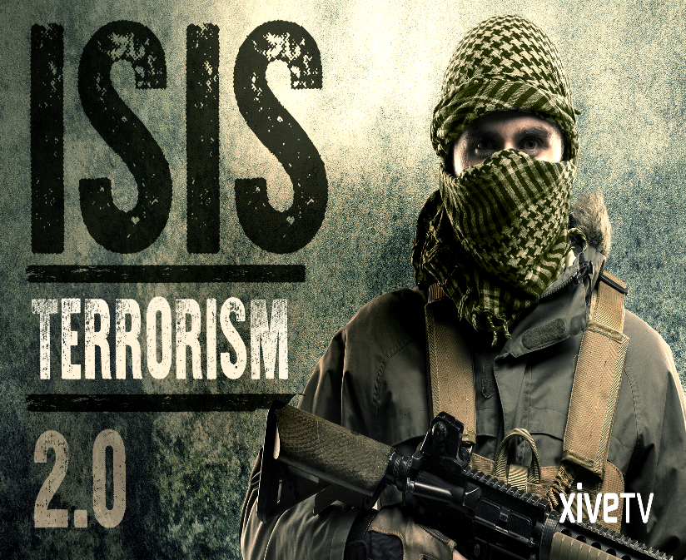
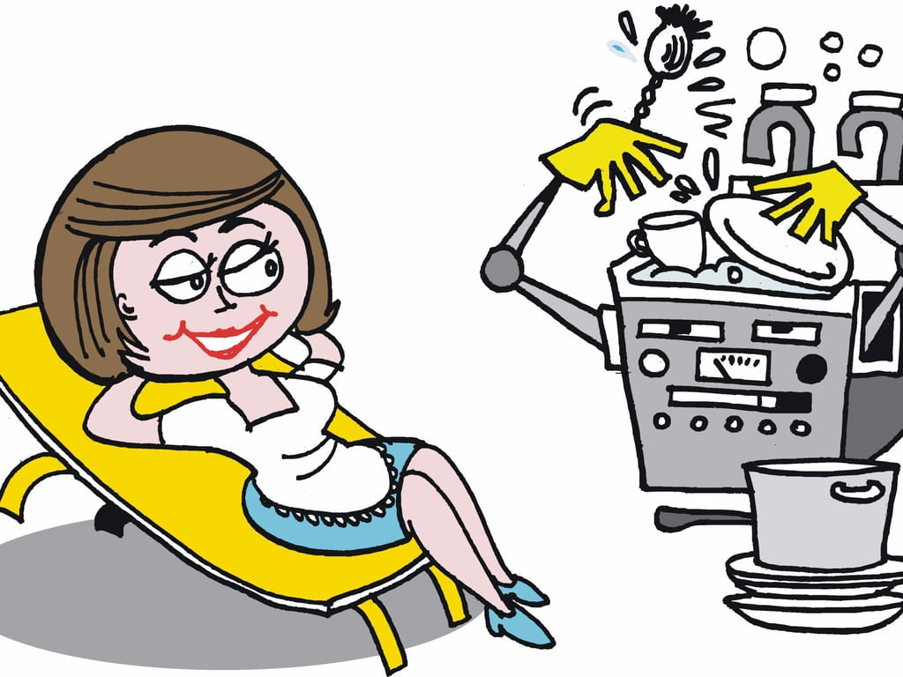
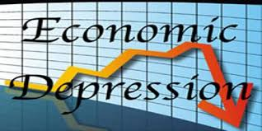
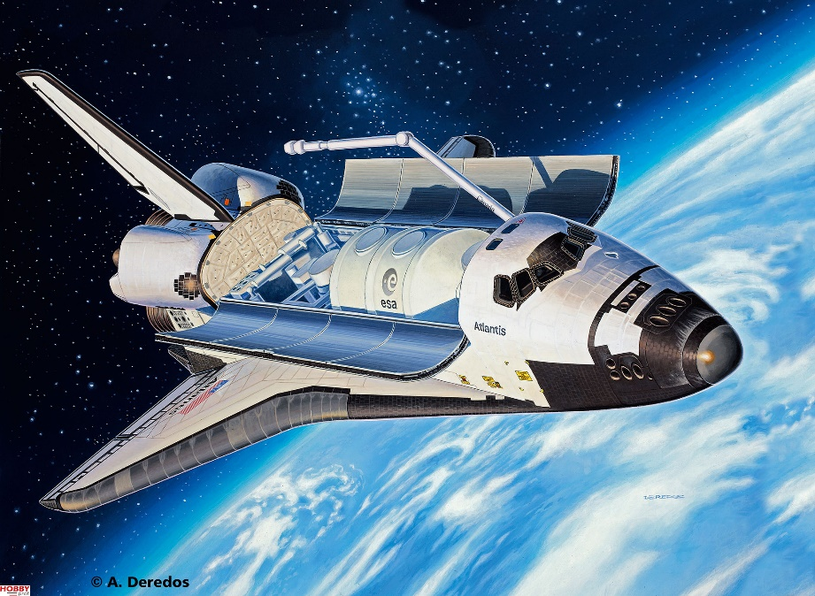
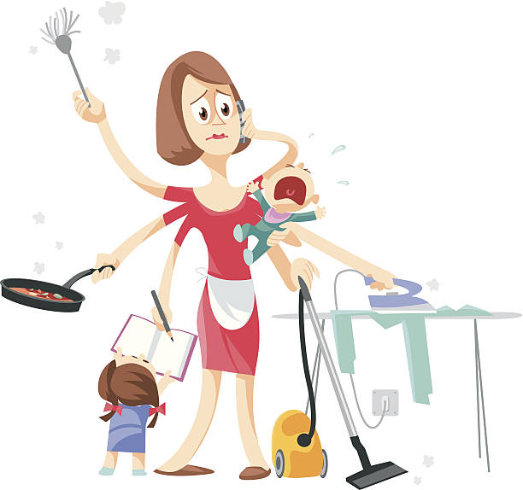
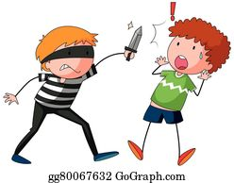
New words:
(a) pessimist :
Pessimistic (adj.):
2.(an) optimist :
Optimistic (adj.):
3.Terrorism (n):
(a) terrorist :
4. (a) corporation:
5. (to) wipe out
= (to) eradicate:
6. (to) threaten:
7. (a) burden:
8. Economic depression (n):
9. (a) labour-saving device:
10. (a) space-shuttle:
Người bi quan
Bi quan
Người lạc quan
Lạc quan
Chủ nghĩa khủng bố
Quân khủng bố
Tập đoàn lớn
Quét sạch
Đe dọa
Gánh nặng
Sự suy thoái kinh tế
Thiết bị tiết kiệm sức lao động
Tàu con thoi

Slide 6
WHILE YOU READ
Read the passage and do the task that follow:

Slide 7

What will life be like in the future? Different people have different answers to this question; some are pessimistic while others optimistic.
Things will be much worse than they are nowadays, pessimists say. The whole world will experience a period of economic depression. Many large corporations will be wiped out and millions of jobs will be lost. The security of the earth will be threatened by terrorism as terrorist groups will become more powerful and more dangerous. On the contrary, optimists believe that life will be far better than it is today. We will be living in a much cleaner environment, breathing fresher air and eating healthier foods. We will also be better looked after by a more modern medical system. Domestic chores will no longer be a burden thanks to the inventions of labor – saving devices.
For better or worse, it is certain that in the future some things will be very different. Developments in micro technology – computers and telecommunication are bound to have a huge influence on various aspects of our lives. Take work, for instance. Robots will do most of the work in factories, so they will be cleaner places for fewer people to work in them. Offices, too, will go electronic with the result that paper will almost completely disappear. More people will work from home on computers linked to a head office. As for travel, it is likely that space – shuttle technology will be used in normal air travel achieving speeds of up to 15, 000 kph. Cars will still be with us, but, instead of petrol, they will run on anything from electricity to methane gas. They will also be fitted with computers to tell us how efficiently we are driving and if there is anything wrong on the road ahead.
Whatever we expect from the future, remember that progress has never moved in straight lines, and history is full of unexpected developments. However, we are confident that the future is in our hands, and it is our responsibility to contribute to bettering our own lives.

Slide 8
Find the words or phrases in the passage which have the following meanings
Task 1
People who always expect bad things to happen
People who always expect good things to happen
A period when there’s little economic activity and many people are poor or without jobs
The use of violent action in order to achieve political aims or to force a government to act
Be destroyed or removed completely
6. Spacecraft designed to be used for travelling between the earth and a space station
Pessimists
Optimists
Economic
depression
Terrorism
Wiped out
Space - shuttle

Slide 9

2. Task 2:Answer the following questions.
1. What will happen in an economic depression?
⇨
2. Why, according to pessimists, will the security of the earth be threatened?
3. What will life be like in the future, according to optimists?
⇨
4. What are the most important factors that will bring about dramatic changes in different aspects of our lives?
⇨
What will life be like in the future? Different people have different answers to this question; some are pessimistic while others optimistic.
Things will be much worse than they are nowadays, pessimists say. The whole world will experience a period of economic depression.
The security of the earth will be threatened by terrorism as
On the contrary, optimists believe that
We will be living in a much cleaner environment, breathing fresher air and eating healthier foods. We will also be better looked after by a more modern medical system. Domestic chores will no longer be a burden thanks to the inventions of labor – saving devices.
For better or worse, it is certain that in the future some things will be very different.
Many large corporations will be wiped out and millions of jobs will be lost (lines 3-4 para 2)
Many large corporations will be wiped out and millions of jobs will be lost.
Many large corporations will be wiped out and millions of jobs will be lost.
⇨ Because terrorist groups will become more powerful and more dangerous. (lines 4-5 para 2)
terrorist groups will become more powerful and more dangerous.
terrorist groups will become more powerful and more dangerous.
life will be far better than it is today.
life will be far better than it is today.
Life will be far better than it is today. (lines 7-10, para 2)
Developments in micro technology – computers and telecommunication are bound to have a huge influence on various aspects of our lives.
They are developments in micro technology – computers and telecommunication (lines 2-3 para 3)
Developments in micro technology – computers and telecommunication are bound to have a huge influence on various aspects of our lives.
Notes:
9

Slide 10
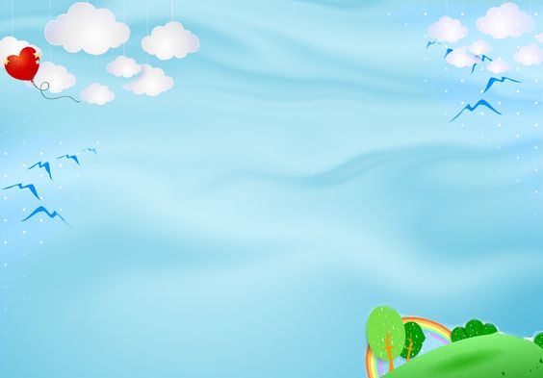
Task 3
The influences of technology in future life
Work
Travel
Factories
Offices
people
Travelling by
space-shuttle
Car
will
be
Run
by
robots
will
go
electronic
will
work
from
home
is
Very
fast at
15,000kms/hour)
Could
run
on
electricity,
methane gas

Slide 11
AFTER YOU READ

Slide 12
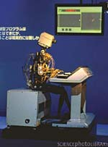
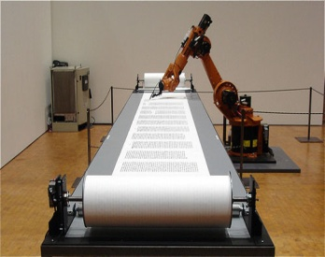
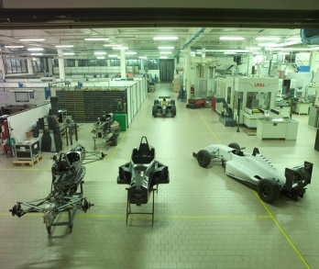
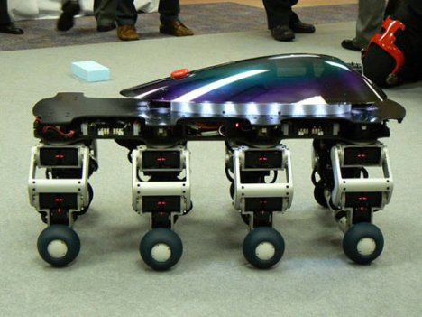
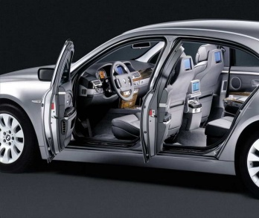
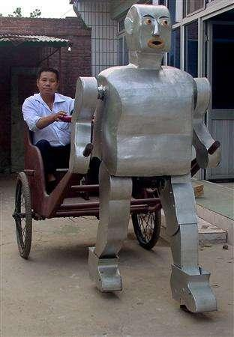
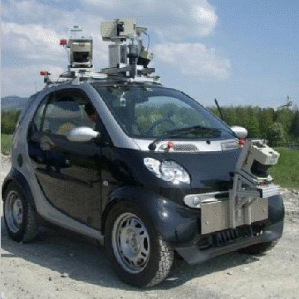
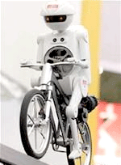
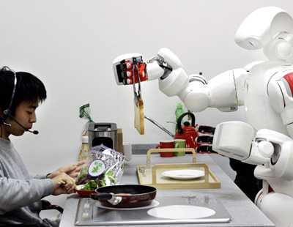
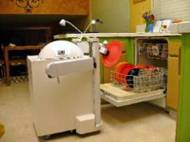
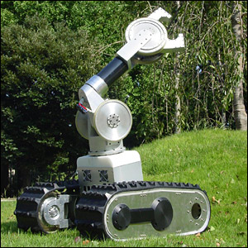
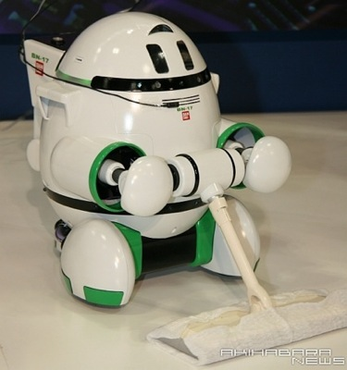
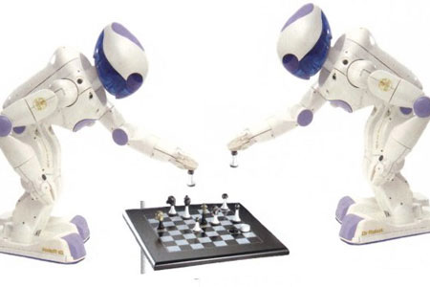
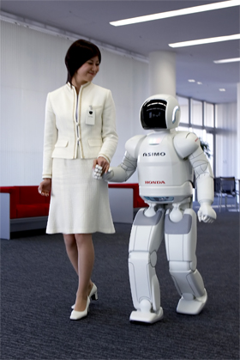
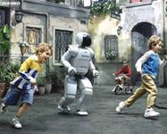
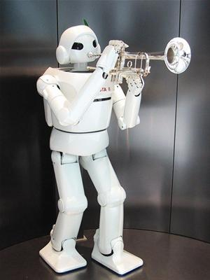
Do most of work in factories.
Lose their jobs(people)
Do household chores
III. AFTER YOU READ: Look at the pictures and discuss the advantages
and disadvantages of robots.
Drive vehicles(avoid accidents)
Carry out difficult tasks
Entertain people
Work as they’re programmed, unable to deal with sudden situations
Make friends with people
Be emotionless
 | Advantages | Disadvantages
Work/ offices
Travel
Daily life

Slide 13
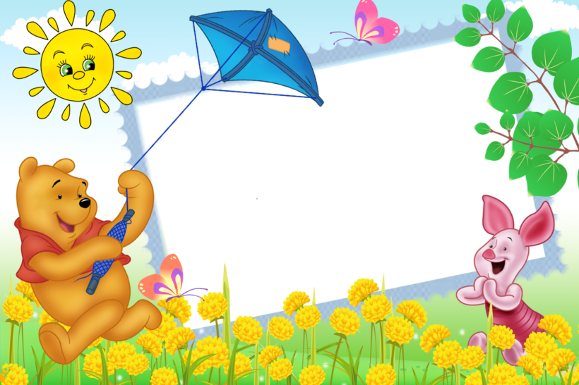
HOME WORK
- Learn all new words by heart.
- Prepare for Listening

Slide 14

Thanks for your attention!

