Slide 2
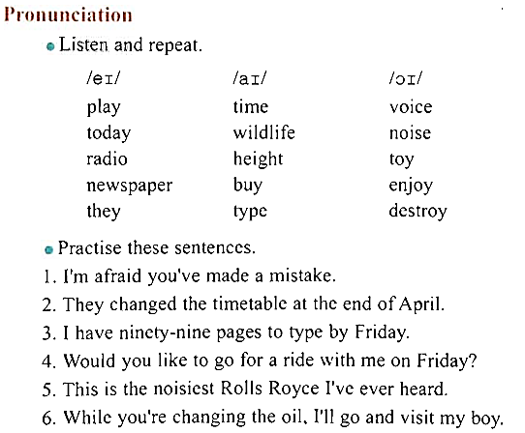

Slide 3
REVISON OF THE PRESENT PERFECT TENSE
ÔN LẠI THÌ HIỆN TẠI HOÀN THÀNH
1. Công thức
a. Khẳng định : S + have/has + V_{3/ed} + …
b. Phủ định : S + haven’t/hasn’t + V_{3/ed} + …
c. Câu hỏi : Have/Has + S + V_{3/ed} + …?
2. Cách dùng
a. Diễn tả một hành động xảy ra trong quá khứ, kéo dài đến hiện tại và có thể tiếp tục xảy ra trong tương lai.
Ex : I have learned English for 10 years.
b. Diễn tả một hành động xảy ra trong quá khứ nhưng không xác định, và muốn nhấn mạnh vào kết quả.
Ex : I have met her several times.

Slide 4
3. Dấu hiệu nhận biết
- Trong câu có các trạng từ: already (rồi), ever (đã từng), never (chưa bao giờ), yet (chưa), so far (cho đến bây giờ), just (vừa mới), recently (gần đây), lately (gần đây), up to now/up to present/up to this moment (cho tới tận bây giờ),…
- Since + mốc thời gian: kể từ …
- Since + mệnh đề : từ khi …
- for + khoảng thời gian: được…
- It is the first time/This is the first time + mệnh đề chia thì hiện tại hoàn thành.
- …
4. Vị trí của các trạng từ trong thì hiện tại hoàn thành:
- already, never, ever, just: thường đứng sau “have/ has” và đứng trước V_{3/ed}
- yet: đứng cuối câu, và thường được sử dụng trong câu phủ định và nghi vấn.
- so far, recently, lately, up to present, up to this moment, in/for/during/ over + the past/last + thời gian: có thể đứng đầu hoặc cuối câu.

Slide 5
CẤU TRÚC VỚI “BECAUSE OF” VÀ “IN SPITE OF”
1. Cấu trúc “because of”
- Because of : vì, do
- Because of + Danh từ/Cụm danh từ/Danh động từ
- Because of = Due to = Because
Ex: Because of his illness, he had to cancel the appointment.
2. Cấu trúc “In spite of”
- In spite of : bất chấp, mặc dù
- In spite of + Danh từ/Cụm danh từ/Danh động từ
- In spite of + the fact that + mệnh đề
- In spite of = Despite = Even though = Although= Though
Ex: In spite of his illness, he managed to come to school.
Ex: In spite of the fact that he was ill, he managed to come to school.

Slide 6
have been
has lived
have met
have done
have had
have taken
have watched

Slide 7
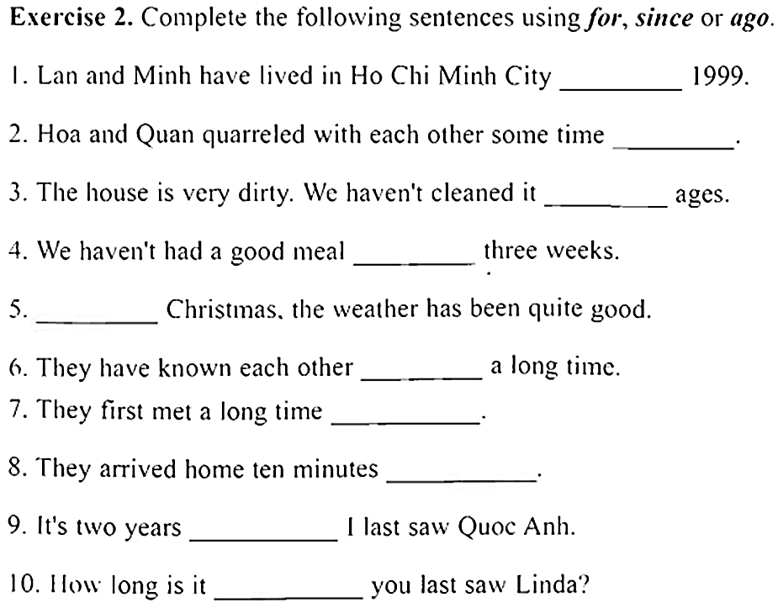
since
ago
for
for
since
for
ago
ago
since
since

Slide 8
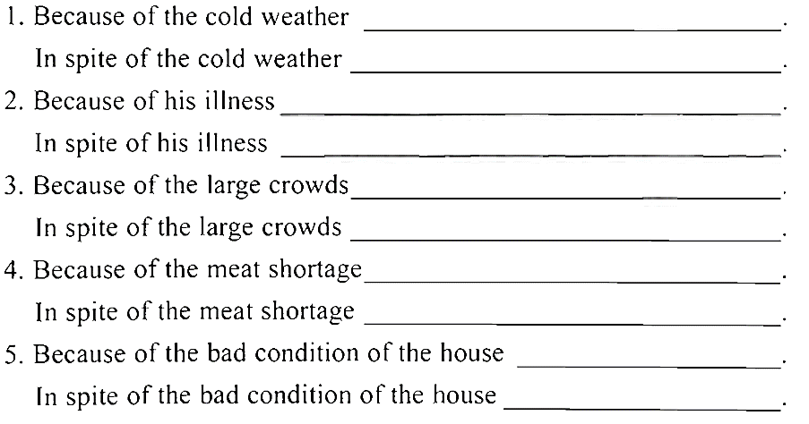
,we kept the fire burning all day.
,we all wore shorts.
,he had to cancel the appointment.
,he managed to come to school.
,we could not see what was going on.
,there were enough seats for everyone.
, everyone is living on beans.
, we have managed to get some beef.
, the council demolished it.
, they enjoyed living there.

Slide 9
Complete the sentences with the Present Perfect forms of the verbs in brackets.
1. _________________ (you, attend) Prof. Donald’s presentation about the mass media development?
2. Since its appearance, the Internet _________________ (play) an essential role in our daily life.
3. Mickey Mouse and Donald Duck cartoons _________________ (attract) million of viewers around the world.
4. She _________________ (not, report) the number of TV viewers to me yet.
5. I _________________ (read) this kind of magazine for many years.
6. Britney Spears _________________ (be) my favorite singer since I watched her song Baby One More Time.
7. They _________________ (not, urge) me to finish this report.
8. How many times _________________ (she, watch) this movie?
9. Tommy _________________ (recommend) me to use the new cellphone model which was released last month.
10. I _________________ (not, write) to the newspaper for ages.
Have you attended
has played
have attracted
hasn‘t reported
have read
has been
haven‘t urged
has she watched
has recommended
haven‘t written

Slide 10
Complete the following sentences by using because, because of, though or in spite of.
1. Lan went to the dentist ____________her toothache.
2. Nam didn't go to the dentist ____________ his toothache.
3. Nga went to the dentist ____________ she didn't have a toothache. She just wanted a check-up.
4. ____________ the fact that Dan is fairly tall, he can't reach the ceiling.
5. ____________ Matt is very tall, he can reach the ceiling.
6. Tim can't reach the1ceiling ____________ he isn't as tall as Matt.
7. ____________ not being tall, Nick can reach the ceiling by standing on a chair.
8. Eric's brother didn't iron his shirt ____________ it was wrinkled.
9. My brother ironed his shirt ____________ its wrinkle.
10. I would like to raise tropical fish ____________ it's difficult to maintain a fish tank in good condition.
because of
in spite of
though
In spite of
Because
because
In spite of
though
because of
though

Slide 11
Finish the second sentence so that it has a similar meaning to the first one, beginning with the given words or phrases.
1. We didn't buy the colour TV because of its high price.
=> Because the colour TV………………………………………………………………………..
2. Although the Internet has some bad effects. more and more people use it.
=> In spite ……………………………………………………………………………………….
3. In spite of a heavy snowstorm. the reporters went out to do their tasks.
Even though …………………………………………………………………………………..
4. The weather was very bad. so they had to cancel the live show.
Because ……………………………………………………………………………………….
5. He bought a newspaper to read about the football match though he saw it on TV last night.
=> Despite ……………………………………………………………………………………….
was expensive, we didn't buy it.
of (its) having some bad effects, more and more people use the Internet.
the snowstorm was heavy, the reporters went out to do their tasks.
the bad weather, they had to cancel the live show.
seeing the football match on TV last night, he bought a newspaper to read it.

