Slide 1





Welcome to our lesson !
Unit 6 : AN EXCURSION
Part E: LANGUAGE FOCUS
Class: 10C4 - 10C10

Slide 2



Warm- up
Name the things you see in the pictures.
1.
2.
3.
4.

Slide 3
Warm- up
Name the things you see in the pictures.
1.
2.
flowers
bird
3.
4.
tiger
church

Slide 4
Warm- up
Name the things you see in the pictures.
1.
1.
2.
flowers
bird
/ ə/
/ 3:/
3.
4.
tiger
church
/ ə /
/ 3:/

Slide 5
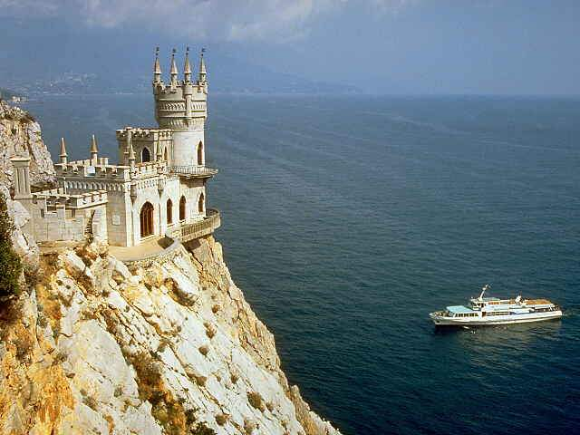
UNIT 6
AN EXCURSION
E. LANGUAGE FOCUS

Slide 6
UNIT 6
AN EXCURSION
E. LANGUAGE FOCUS
PRONUNCIATION: / ə / - / 3: /
1. Presentation :
/ ə / : -a ( about , pagoda ) -e ( seven, development )
-i ( opposite, ability )
-o ( today, of, together )
-u ( suggest, support )
-er ( teacher, driver ) -or ( actor, doctor )
/ 3: / : -ir ( bird, shirt, girl ) -or ( work , world, word ) -ur ( church, nurse ) -er ( German, prefer, refer )
-ear ( early, earn, search )

Slide 7
UNIT 6
AN EXCURSION
E. LANGUAGE FOCUS
PRONUNCIATION: / ə / - / 3: /
2. Practice: * Listen and repeat ( p.70 )
/ ə/
teacher
together
about
other
pagoda
today
/ 3:/
bird
work
church
term
shirt
early

Slide 8
UNIT 6
AN EXCURSION
E. LANGUAGE FOCUS
PRONUNCIATION: / ə / - / 3: /
* Practice these sentences ( p.70 )
1. Have you
1. Have you
heard
heard
about
about
our
our
excursion
excursion
to
to
Thay
Thay
Pagoda ?
Pagoda ?
2. Her father
2. Her father
is
is
learning German
learning German
with
with
a teacher.
a teacher.
3. Last year
the
birds returned
to
to
the river
the river
earli
earli
er than
er than
this year.
this year.
4. The
girls work
in
the
church
on
Thursdays.
5. Was
it
Barbara’s camera ?
6. I’m
thirsty, Nurse.
I
want
a
glass
of water.

Slide 9
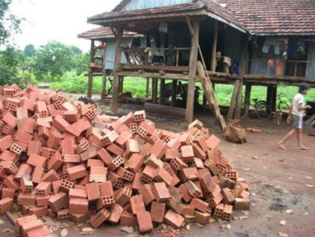
UNIT 6
AN EXCURSION
E. LANGUAGE FOCUS
grammar
1. The Present Progressive (with a future meaning) 2. The Near Future (BE GOING TO)
1. The Present Progressive with a future meaning
S + am/ is/ are + V-ing
Eg.: They are building a new house next week.
---> diễn tả 1 kế hoạch đã được sắp xếp trước.
(có tgian + nơi chốn cụ thể)

Slide 10
UNIT 6
AN EXCURSION
E. LANGUAGE FOCUS
2. The near future: BE GOING TO
S + am/ is/ are going to + V1
*Cách 1: diễn tả 1 ý định hay 1 quyết định (trước lúc nói) về 1 việc sẽ làm trong tương lai gần.
- Mai : All dishes are dirty.
- Tân : Yes, I know. I am going to wash them later.
* Lưu ý: GO/ COME : - không dùng với thì TLgần.
- thay thế bằng thì HTTD.
*Cách 2: diễn tả 1 dự đoán dựa vào tình huống hay bằng chứng ởhiện tại.
- Look ! There’re a lot of black clouds. It is going to rain.

Slide 11
UNIT 6
AN EXCURSION
E. LANGUAGE FOCUS
grammar
3. Practice
Exercise 1. Choose the correct option in the brackets.
Tell me your plan, Lan. What (are you doing/ will you do) this Saturday evening?
2. I fell terrible. I think I (will be/ am going to be ) sick.
3. Marry ( will get married/ is getting married) next week
4. There’s a good play on TV tonight. ( Will you/ Are you going to ) watch it ?
5. There are a lot of black clouds in the sky. It (will / Is going to ) rain.

Slide 12
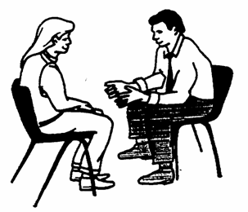
UNIT 6
AN EXCURSION
E. LANGUAGE FOCUS
grammar
3. Practice
Exercise 1. Choose the correct option in the brackets.
are you doing
Tell me your plan, Lan. What ( / will you do) this Saturday evening?

Slide 13


UNIT 6
AN EXCURSION
E. LANGUAGE FOCUS
grammar
3. Practice
Exercise 1. Choose the correct option in the brackets.
2. Marry ( will get married/ ) next week.
is getting married

Slide 14

UNIT 6
AN EXCURSION
E. LANGUAGE FOCUS
grammar
3. Practice
Exercise 1. Choose the correct option in the brackets.
3. There’s a good play on TV tonight.
( Will you / ) watch it ?
Are you going to

Slide 15
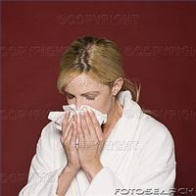
UNIT 6
AN EXCURSION
E. LANGUAGE FOCUS
grammar
3. Practice
Exercise 1. Choose the correct option in the brackets.
4. I felt terrible. I think I (will be / ) sick.
am going to be

Slide 16
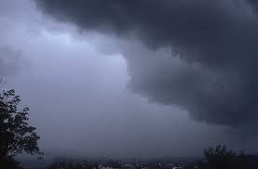
UNIT 6
AN EXCURSION
E. LANGUAGE FOCUS
grammar
3. Practice
Exercise 1. Choose the correct option in the brackets.
5. There are a lot of black clouds in the sky.
It (will / ) rain.
is going to

Slide 17
UNIT 6
AN EXCURSION
E. LANGUAGE FOCUS
grammar
3. Practice
Exercise 2. Put the verbs in brackets in the Present progressive or be going to.
The Browns (go) to the cinema this evening.
are going
are having
2 . We ( have) an English speaking club meeting next week. Would you like to come?
is going to catch
3. The cat is just behind the rat. It ( catch ) the latter.
4. Where you ( put ) this new book case?
are you putting
5. Smoking is very bad for his health,
but he ( not give ) it up.
is not going to give

Slide 18
UNIT 6
AN EXCURSION
E. LANGUAGE FOCUS
grammar
3. Practice
Exercise 3. Complete the exchanges, using the present progressive or be going to.
---> Do E3 at home.
There’s a football match on TV this afternoon. ............................................. ?
No, I’m busy. …………………………
2. Can you come next weekend?
Sorry, we’d love to, but ..................................
3. I hear Tim won a lot of money. What ...............................?
He says ........................................................
4. Should I leave the umbrella at home ?
It’ cloudy and windy. ……………………… Take it along.
5. Do you think the windows are so dirty ?
Oh, yes. …………………………………… later.
Are you going to watch it
I am doing my homework.

Slide 19

UNIT 6
AN EXCURSION
E. LANGUAGE FOCUS
THE FORTUNE WHEEL
STUDENT A
STUDENT B
Mark 10 &
1
6
2
7
3
8
4
9
5
10

Slide 20
UNIT 6
AN EXCURSION
E. LANGUAGE FOCUS
Question 1: Choose the word whose underlined part is pronounced differently from that of the other words.
A. information
B. world
C. visitor
D. connector
4
0
1
2
3
6
5
8
10
9
7

Slide 21
UNIT 6
AN EXCURSION
E. LANGUAGE FOCUS
Question 2: Choose the best option to complete the sentence.
Huyen and I __________to Cuc's birthday party on Monday next week.
A. will go
B. are going to go
C. am going
D. are going
4
0
1
2
3
6
5
8
10
9
7

Slide 22
UNIT 6
AN EXCURSION
E. LANGUAGE FOCUS
Question 3: Choose the best option to complete the sentence.
A: Why did you buy all this sugar and chocolate?
B: I_____________ a delicious dessert for dinner tonight.
A. make
B. will have make
C. am going to make
D. will make
4
0
1
2
3
6
5
8
10
9
7

Slide 23
hOMEWORK
1. Select words containing 2 sounds / ə / and / 3: /
in 6 sentences of the part PRONUNCIATION (p.70)
2. Do Exercise 3/p.71
3. Do the execises of TEST YOURSELF B

Slide 24
Thank you for joining us
GOODBYE

