Slide 1
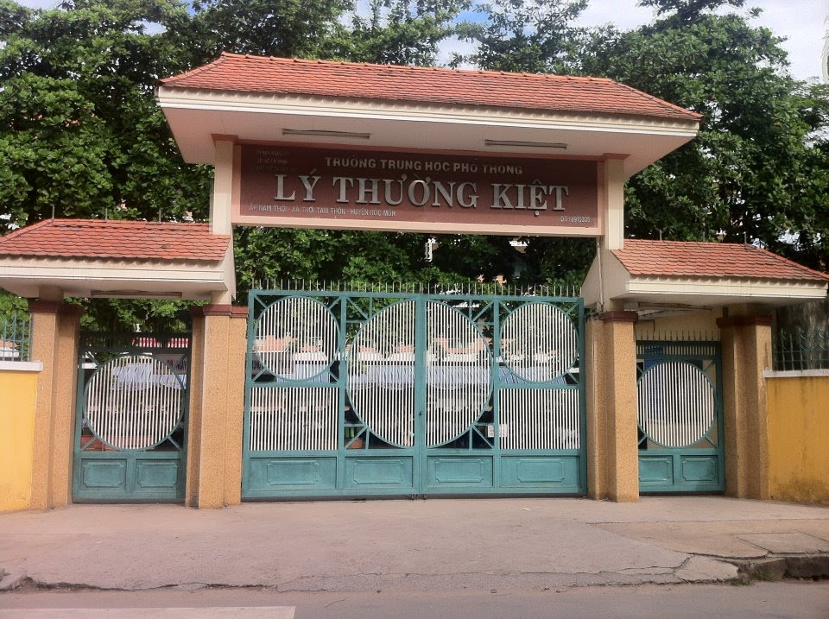
Welcome to our class!

Slide 2


UNIT 6
COMPETITIONS
Part E: LANGUAGE FOCUS

Slide 3
What is this?
What is this number?
It is a train
twenty
It is a dress

Slide 4
Pronounce these words
train | dress | twenty
/trein/ | /dres/ | /’twenti/

Slide 5

I. Pronunciation
1. Listen and repeat
traffic
drive
twelve
twinkle
twin
troops
tropical
trousers
dreadful
drink
dress
twenty
/tr/ | /dr/ | /tw/

Slide 6

2. Practise reading these sentences
John always enjoys traveling by train
Jane’s teeth are troubling her
George is driving dangerously
Her new dress is an absolute dream
She has an amused twinkle in her eyes
Think twice before doing something
traveling
train
troubling
driving
dress
dream
twinkle
twice

Slide 7


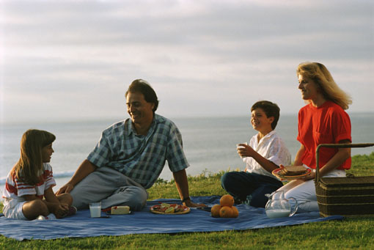
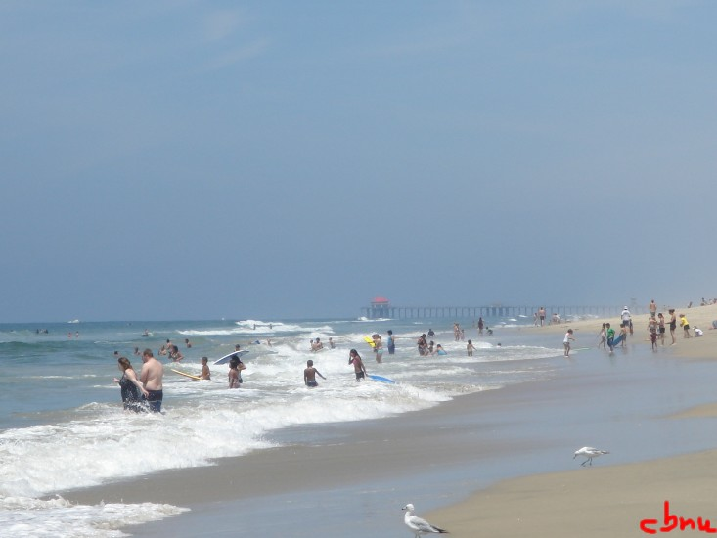
“Let’s go to the beach tomorrow.”
“It’s so hot today.”
What did the little boy suggest ?
He suggested............................
going to the beach the next day.
S + V +V-ing

Slide 8

I’ m sorry I’m late.
MARY
Mary apologized for ............
being late .
S + V + preposition + V - ing

Slide 9
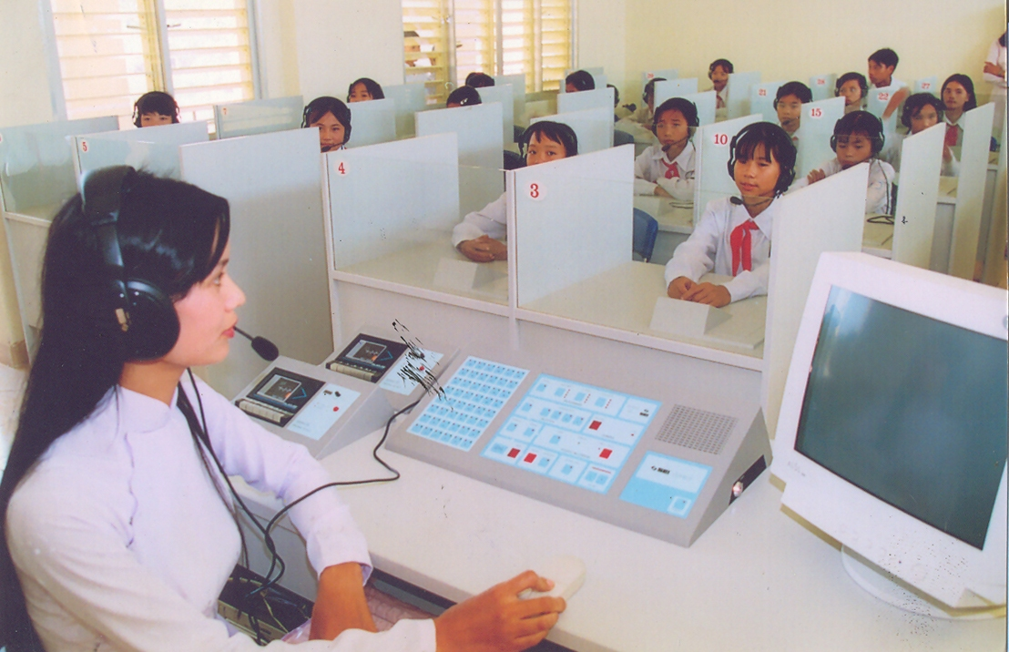

“You don’t pay attention to the lesson, Nam”.
The teacher accused Nam of.......................................................
not paying attention to the lesson.

Slide 10

“Don’t eat so much nutritious food.”
The doctor warned him against .......................................
eating so much nutritious food.
S + V + O + preposition + V – ing.

Slide 11
Unit 6 COMPETITIONS – Part E LANGUAGE FOCUS
II. Grammar : Reported speech with gerund
* Structures
1. S + V +V-ing
admit, deny, suggest, regret
2. S + V + preposition + V - ing
thuù nhaän
apologize for, complain about, insist on, object to, dream of , confess to , think of
3. S + V + O + preposition + V – ing.
ca ngôïi ai veà ñieàu gì
chæ trích ai veà ñieàu gì
accuse sb of, blame sb for, congratulate sb on, warn sb about/against, thank sb for ,criticize sb for, praise sb for, prevent /stop sb from, suspect sb of
nghi ngờ; hoài nghi; ngờ vực

Slide 12
Unit 6 COMPETITIONS – Part E LANGUAGE FOCUS
III. Practice :
Exercise 1 : Change direct speech to into reported speech. Begin each sentence in the way shown.
1. “I hear you passed your exams. Congratulations!” John said to us.
→ John congratulated ........ on ..........................
2. “I’m sorry I didn’t phone you earlier,” Mary said.
→ Mary apologized for ........................................
3. “I’ll drive you to the station. I insist,” Peter said to Linda.
→ Peter insisted on ..............................................
4. “ You didn’t pay attention to what I said," the teacher said to the boy.
->The teacher accused ...............of ..............................
5. “I’ve always wanted to be rich.”, Bob said
->Bob has always dreamed of.......................................
6.“Don’t stay at the hotel near the airport." I said to Ann
-> I warned ............ against ....................................
7. “Stay here! I can’t let you go out tonight.”
->Her mother prevented ...................... from ..............................
8. “ It was nice of you to visit me. Thank you," Miss White said to Jack.
->Miss White thanked ......... for ..............................................
us
having passed/passing our exams.
not phoning me earlier.
driving me to the station.
the boy
not paying attention to what he had said.
being rich.
Ann
staying at the hotel near the airport.
Jane/her
going out that night.
Jack
visiting her.

Slide 13
Unit 6 COMPETITIONS – Part E LANGUAGE FOCUS
III. Practice :
Exercise 2 :Rewrite the dialogue in reported speech, using gerund
1. Linda: Let me pay for the meal.
Tom : Certainly not! I’ll pay.
Tom insisted on _____________________
2. Mr. Smith : I feel like meeting our children soon.
Mrs. Smith: I think so.
Mr. and Mrs. Smith looked forward to _______________________
3. Woman: Hey! You’ve broken the window of my house
Boy : Oh … no, I’ve just arrived here. I don’t know
anything about it.
The boy denied _____________________________________
4. Policeman: You mustn’t leave the shop!
Customer : What’s that?
Policeman: Stay here! You mustn’t leave the shop!
Policeman stopped the customer from _______________.
5. Mary: What shall we do on Saturday?
Ann :What about having a party?
Ann suggested_______________________________
paying for the meal.
meeting their children soon.
having broken the window of her house.
leaving the shop
having a party the next Saturday.

Slide 14
Unit 6 COMPETITIONS – Part E LANGUAGE FOCUS
III. Practice :
Exercise 2 :Rewrite the dialogue in reported speech, using gerund.
6. Mary : What sell we do on Saturday ?
Ann : What about having a party ?
Ann suggested ____________________
7. John’s wife : The house is very nice! We’ll certainly buy it!
John : I think so.
John and his wife were thinking of ___________________
having a party.
buying the house.

Slide 15

Homework
- Learn the structures by heart .
- Prepare for Unit 7

Slide 16


THANK YOU
VERY MUCH

