Slide 1
SỞ GIÁO DỤC VÀ ĐÀO TẠO TPHCM
TRƯỜNG THPT HÙNG VƯƠNG
BỘ MÔN TIẾNG ANH – KHỐI LỚP 11
TUẦN 13/ HK 1 (Từ 29/11/2021 đến 5/12/2021 )
PHIẾU HƯỚNG DẪN HỌC SINH TỰ HỌC
I . NHIỆM VỤ TỰ HỌC, NGUỒN TÀI LIỆU CẦN THAM KHẢO
1. Nhiệm vụ tự học:
Speaking skill: htpps://sachhoc.com, …
Writing skill: Violet.vn,…
2. Tài liệu tham khảo:
Textbook( English 11 ), hoc360.net
II. KIẾN THỨC:
Improving vocabulary
Developing reading skill ( scanning and skimming) and listening skill
Understanding population world, population density, causes and results of overpopulation
III. CHUẨN BỊ CỦA HỌC SINH:
Words/ Phrases related to world population

Slide 2
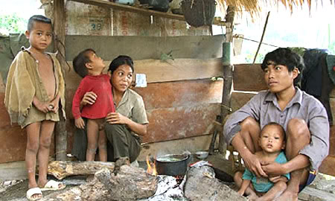
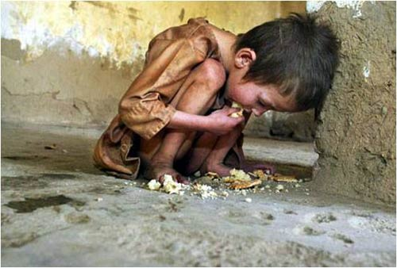
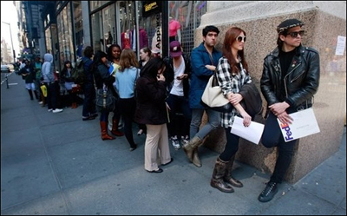
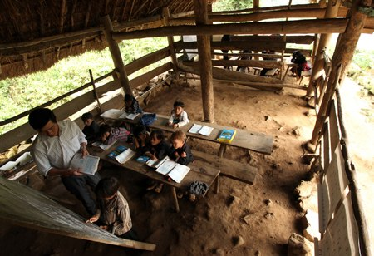
What are the following pictures about?
Poverty
Homeless
Shortage of foods
Unemployment
What is the main cause of these problems?
=> The increase of population
Lack of schools
Population explosion

Slide 3
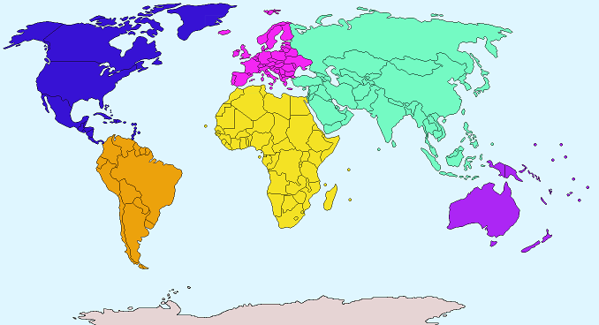
AMERICA
ASIA
EUROPE
AFRICA
AUSTRALIA
What continent has the largest population?

Slide 4
ASIA

Slide 5
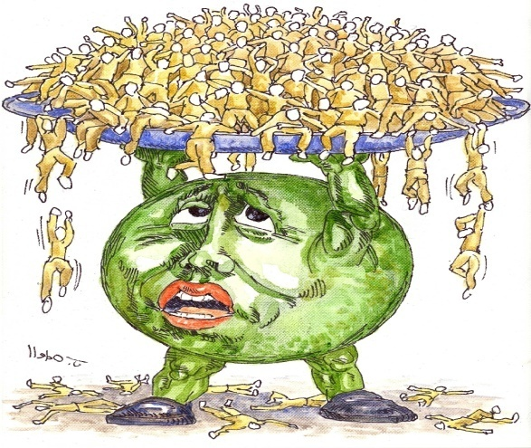
UNIT 7:
World population
Reading

Slide 6
Vocabulary
1. population (n) /ˌpɒpjuˈleɪʃn/ dân số
2. population growth /ˌpɒpjuˈleɪʃn ɡrəʊθ/ tăng dân số
3. population explosion /ˌpɒpjuˈleɪʃn ɪkˈspləʊʒn/ bùng nổ dân số
4. increase (v) /ɪnˈkriːs/ tăng
>< decrease (v) /dɪˈkriːs/ giảm
5. natural resource /ˈnætʃrəl/ /rɪˈsɔːs/ tài nguyên thiên nhiên 6. family planning /ˈfӕməli’plӕnɪŋ / kế hoạch hoá gia đình
7. control (v) / kəntroul / kiểm soát
8. method (n) / ‘meθəd/ phương pháp
9. birth control method /bɜ:θ kən’troul ‘meθəd/ biện pháp kế hoạch sinh đẻ
10. figure (n) = number / ‘figə / con số
Structure
It is time/ about time/ high time + S + V2-ed
- It’s +time/ about time/ high time (+for someone) +to do something : Đã đến lúc (để ai) phải làm gì.

Slide 7
Task 1: The words in the box all appear in the passage. Fill in each blank with a suitable word.
limit (v, n) figures (n) method (n) although
control (v) increases (v) international (adj) resources (n)
__________ millions of women want to limit the size of their families, they know of no safe way to have fewer children.
2. Can you explain the ___________ for changing salt water to fresh water?
3. The number of injuries from automobile accidents ___________ every year.
4. Some countries are poor because they have very few natural ___________.
5. These are all ___________: 1, 75, 293.
6. There is a(n) ___________ of 20 minutes for this short test. Students must turn in their papers at the end of 20th minute.
7. The United Nations is a(n)_______________ organization.
8. Some children behave badly and their parents can’t___________them.
Although
method
increases
resources
figures
limit
international
control

Slide 8
Reading 1: Read the passage and then answer the questions.
The population of the world has been increasing faster and faster . In 10,000 B.C., there were probably only 10 million people. In A.D. 1, there were 300 million. It took 1,750 years for the world population to reach 625 million. In 1850, only one hundred years later the population reach the figure had more than double to reach 2,510 million. In 2000, the world’s population was about 6.6 billion, and by 2015 it is expected to be over 7 billion.
Does the Earth have enough resources to support this many people? Different scientists give different answers to this question. Some say that there are enough resources to support 8 billion people. Others say that we must limit population growth because our resources are limited. Only 10 percent of the Earth’s land can be used for farming and another 20 percent for raising animals. There is a limit to the water we can use. There are also limits to the amounts of petroleum, iron, silver, gold, and other metals.
Research has shown that the average Third World woman has more children than she wants. Among the women who do not think they have too many children, half of them do not want to have any more. However, although millions of women want to limit the size of their families, they know of no safe way to have fewer children. Safe birth-control methods for family planning are not available to them. It is time governments and international organisations did something to help them so that the world population growth can start to decrease instead of continuing to increase.

Slide 9
Task 2. Answer the questions on the passage.
What was the population of the world in 10.000 B.C, 1750, 1850, 1950, 1985 and 2000?
The population of the world in 10.000 B.C was 10 million, in 1750 it was 625 million, in 1850 it was 1300, in 1950 it was 2510 million, in 1985 it was 4760 million, in 2000 it was 6.6 billion.
2. How many people is the world expected to have by the year 2015?
By the year 2015, the population of the world is expected to be 7 billion.
3. Can the Earth have enough resources to support its population?
Some scientists say it can, but others say it can't.
4. Do most Third World women want to have a lot of children?
No, they don't.
5. Why can't women in the world limit the size of their families?
Because they know of no safe way to have fewer children.

Slide 10
to know more about World population, population density , causes and results of over population, PLEASE WATCH A SHORT VIDEO.
To improve the reading skill, please do the tasks below.

Slide 11
Reading 2: Read the following passage and mark the letter A, B, C, or D to indicate the answer to each of the question.
Vietnam’s population is ageing quickly. In 2017, more than 10 per cent of the population will be 60 and ___(6)____, and in 15-20 years the elderly will __(7)____ one third of the total population. This raises concerns __(8)___ healthcare, welfare and pensions for the elderly at a time when Vietnam is focusing on economic integration and requires a large labor force. So far two solutions have been proposed: to loosen the two-child policy and to increase the __(9)___ age to 58 for women and 62 for men. By ending the two-child policy the government expects to make up for the ageing population within the next 20 years. But its effect could be creating an uncontrollable boom in the Vietnamese population. When the government loosened the two-child policy in 2015 in a trial period, in the first 6 months of 2016 the third child birth rate increased __(10)____ by 7.5 per cent.
6. A. young B. younger C. old D. older
7. A. result of B. result in C. account for D. lead to 8. A. about B. with C. on D. in
9. A. period B. retirement C. expectancy D. contract
10.A. remarkably B. rapidly C. considerably D. all are correct

Slide 12
Keys
KEYS
6. D ( meaning of the sentence)
7. C ( account for : to be a particular amount or part of something = make up: chiếm )
result in = lead to : dẫn tới
8. A (concern about = a feeling of worry = worry about : lo lắng về…
concern in = have some responsibility for
9. B (retirement = the period of your life after you have stopped work at a particular age to provide for retirement : sự về hưu
expectancy= the state of expecting or hoping
period of 6 months/ two years
contract= official written agreement: bản hợp đồng
10. increase + considerably, dramatically, enormously, greatly, significantly, rapidly/ sharply /remarkably,…
remarkably : đáng chú ý
6. D ( meaning of the sentence)
7. C ( account for : to be a particular amount or part of something = make up: chiếm )
result in = lead to : dẫn tới
8. A (concern about = a feeling of worry = worry about : lo lắng về…
concern in = have some responsibility for
9. B (retirement = the period of your life after you have stopped work at a particular age to provide for retirement : sự về hưu
expectancy= the state of expecting or hoping
period of 6 months/ two years
contract= official written agreement: bản hợp đồng
10. D ( increase + considerably, dramatically, enormously, greatly, significantly, rapidly/ sharply /remarkably,… )
remarkably : đáng chú ý

Slide 13
Reading 3 : Read the passage and mark A, B, C or D to indicate the correct answer to each of the questions.
Read the passage and mark A, B, C or D to indicate the correct answer to each of the questions.
The population of the world has increased more in modern times than in all other ages of history combined World population totalled about 500 million in 1650. It doubled in the period from 1650 – 1850. Today the population is more than five billion. Estimates based on research by the United Nations indicate that it will more than double in the twenty – five years between 1915 and the year 2000, reaching seven billion by the turn of the century. No one knows the limits of population that the earth can support. Thomas Malthus, an English economist, developed a theory that became widely accepted in the nineteenth century. He suggested that because world population tended to increase more rapidly than the food supply, a continual strain was exerted upon available resources. Malthus cited wars, famines, epidemics, and other disasters as the usual limitations of population growth. With recent advances in science and technology, including improved agricultural methods and great strides in medicine, some of the limiting factors in population growth have been lessened, with obvious results, international organizations have put forward several recommendations to alleviate the problem of overpopulation, including an increase in food production, general economic development in target areas, and a decrease in birth rates. Most experts agree that it will be necessary to combine all three recommendations in an effort to effect a lasting solution.

Slide 14
Question 11. The title below that best expresses the ideas in this passage is .
A. Thomas Mathus’s Theory
B. The United Nations’ Estimate
C. Limiting Factors in Population Growth
D. A Brief History of Population and Overpopulation
Question 12. World population doubled in the years between .
A. 500 – 1650 B. 1650 – 1850 C. 1650 – today D. 1850 – 2000
Question 13. According to this passage, by the year 2000 the earth’s population should exceed the present figure by how much?
A. 500 million B. Five billion C. Two billion D. Seven billion
Question 14. According to this passage, why has overpopulation been caused?
A. Improved technology B. Disasters
C. Scarcity D. Precaution
Question 15. What do most experts recommend in order to solve problems of overpopulation?
A. Famine and epidemic
B. Medical advanced and improved agricultural methods
C. Economic development and a decline in the birth rate
D. Conservation of available resources

Slide 15
Question11. The title below that best expresses the ideas in this passage is .
A. Thomas Mathus’s Theory
B. The United Nations’ Estimate
C. Limiting Factors in Population Growth
Question 2: Choose the best answer:
D. A Brief History of Population and Overpopulation

Slide 16
Question12: World population doubled in the years between .
A. 500 – 1650
B. 1650 – 1850
C. 1650 – today
D. 1850 – 2000
The population of the world has increased more in modern times than in all other ages of history combined World population totalled about 500 million in 1650. It doubled in the period from 1650 – 1850.
Question 2: Choose the best answer:

Slide 17
Question 13. According to this passage, by the year 2000 the earth’s population should exceed the present figure by how much?
A. 500 million B. Five billion C. Two
D. Seven
A. A. 500 million B. Five billion C. Two billion 500 million B. Five billion C. Two billion
Today the population is more than five billion. Estimates based on research by the United Nations indicate that it will more than double in the twenty – five years between 1915 and the year 2000, reaching seven billion by the turn of the century.
To
Toda Today the population is… turn of the century y the population is… turn of the century

Slide 18
Question 14. According to this passage, why has overpopulation been caused ?
A. Improved technology
B. Disasters C. Scarcity D. Precaution
With recent advances in in science and technology, including improved agricultural methods and great strides in medicine, some of the limiting factors in population growth have been lessened, with obvious results, international organizations have put forward several recommendations to alleviate the problem of overpopulation, including an increase in food production, general economic development in target areas, and a decrease in birth rates.

Slide 19
Question 15. What do most experts recommend in order to solve problems of over population?
A. Famine and epidemic
B. Medical advanced and improved agricultural methods
C. Conservation of available resources
D. Economic development and a decline in the birth rate
… , international organizations have put forward several recommendations to alleviate the problem of overpopulation, including an increase in food production, general economic development in target areas, and a decrease in birth races.

Slide 20
For further information, please contact your teacher for help.
HOMEWORK
Learn by heart all the new words.
Read as much as possible.

