Slide 1
TENSE REVIEW
INSTRUCTOR: PHAN LIEN YEN PHI

Slide 2
PAST
PRESENT
FUTURE
WAS/ WERE
AM/ IS/ ARE
WILL + BE
V2/ED
V1(S/ES)
WILL + V1
SIMPLE
CONTINUOUS
BE + V-ING
PERFECT
HAVE + BEEN + V-ING
PERFECT CONTINUOUS
HAVE + V3/ED
V
HAD
HAVE/ HAS
WILL + HAVE

Slide 3
PRESENT
SIMPLE
CONTINUOUS
S + AM/ IS/ ARE + V-ING
PERFECT
S + HAVE/ HAS + BEEN + V-ING
S + V1(S/ES)
PERFECT CONTINUOUS
S + HAVE/ HAS + V3/ED

Slide 4
PRESENT SIMPLE
+ | S + V1(s/es)
- | S + don’t/ doesn’t + V1
? | do/ does + S + V1…?
ADVERBS | every (day/ month), always, usually, often, sometimes, seldom, rarely, never…

Slide 5
PRESENT CONTINUOUS
+ | S + am/ is/ are + V-ing
- | S + am/ is/ are + NOT + V-ing
? | am/ is/ are + S + V-ing…?
ADVERBS | (right) now, at present, at the moment, Look!, Listen!, Watch out!…

Slide 6
PRESENT PERFECT
+ | S + have/ has + V3/ed
- | S + have/ has + NOT + V3/ed
? | have/ has + S + V3/ed…?
ADVERBS | just, ever, never, already, recently, lately, yet, once, twice,… since + mốc thời gian for + khoảng thời gian

Slide 7
PRESENT PERFECT CONTINUOUS
+ | S + have/ has + BEEN + V-ing
- | S + have/ has + NOT + BEEN + V-ing
? | have/ has + S + BEEN + V-ing…?
ADVERBS | just, ever, never, already, recently, lately, yet, once, twice,… since + mốc thời gian for + khoảng thời gian Nhấn mạnh sự liên tục của hành động

Slide 8

PAST
SIMPLE
CONTINUOUS
S + WAS/ WERE + V-ING
PERFECT
S + HAD + BEEN + V-ING
S + V2/ED
PERFECT CONTINUOUS
S + HAD + V3/ED

Slide 9
PAST SIMPLE
+ | S + V2/ed
- | S + didn’t + V1
? | did + S + V1…?
ADVERBS | yesterday, last (week/ month), ago, in + time in the past…

Slide 10
PAST CONTINUOUS
+ | S + was/ were + V-ing
- | S + was/ were + NOT + V-ing
? | was/ were + S + V-ing…?
ADVERBS | at 8 yesterday morning, at that time, when, while…

Slide 11
PAST PERFECT
+ | S + had + V3/ed
- | S + had + NOT + V3/ed
? | had + S + V3/ed…?
ADVERBS | Past Perfect + before + Past Simple Past Simple + after + Past Perfect

Slide 12
PAST PERFECT CONTINUOUS
+ | S + had + BEEN + V-ing
- | S + had + NOT + BEEN + V-ing
? | had + S + BEEN + V-ing…?
ADVERBS | Nhấn mạnh sự liên tục của hành động

Slide 13
FUTURE
SIMPLE
CONTINUOUS
S + WILL + BE + V-ING
PERFECT
S + WILL + HAVE + BEEN + V-ING
S + WILL + V1
PERFECT CONTINUOUS
S + WILL + HAVE + V3/ED

Slide 14
FUTURE SIMPLE
+ | S + will + V1
- | S + won’t + V1
? | will + S + V1…?
ADVERBS | tomorrow, next (week/ month), in + time in the future…

Slide 15
FUTURE CONTINUOUS
+ | S + will + be + V-ing
- | S + won’t + be + V-ing
? | will + S + be + V-ing…?
ADVERBS | at 3 tomorrow afternoon, this time next week…

Slide 16
FUTURE PERFECT
+ | S + will + have + V3/ed
- | S + won’t + have + V3/ed
? | will + S + have + V3/ed…?
ADVERBS | by the time, by next Tuesday, by the end of…

Slide 17
FUTURE PERFECT CONTINUOUS
+ | S + will + have + been + V-ing
- | S + won’t + have + been + V-ing
? | will + S + have + been + V-ing…?
ADVERBS | Nhấn mạnh sự liên tục của hành động

Slide 18
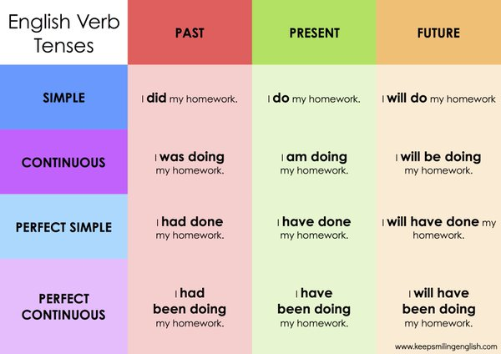

Slide 19
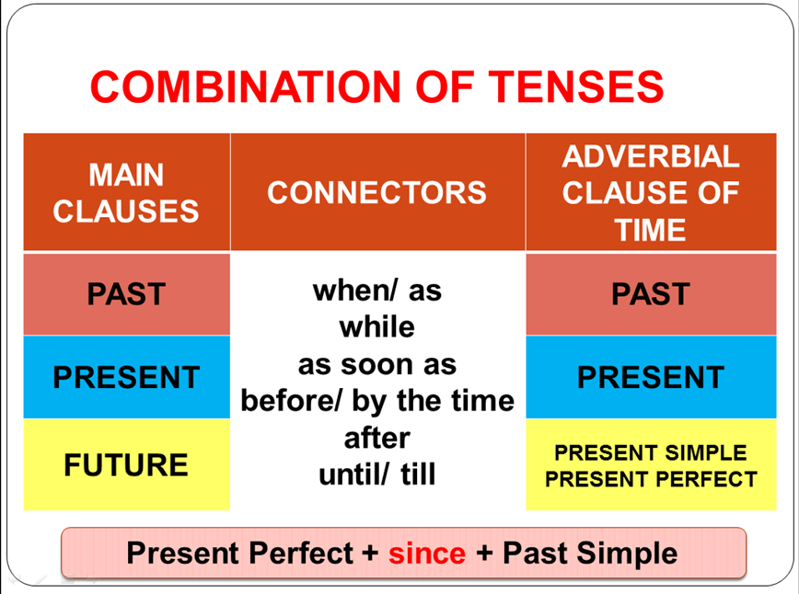
CONJUNCTIONS

