Slide 1
WELCOME TO OUR CLASS - 10A1
Unit 6:::: :;:;;- Money
6A- Spending power
Vocabulary

Slide 3
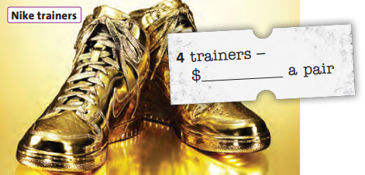
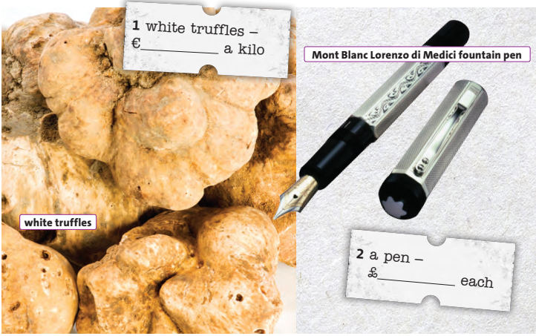
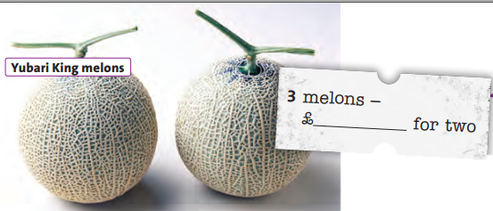
1. Which is the most expensive? Which is the cheapest?

Slide 4
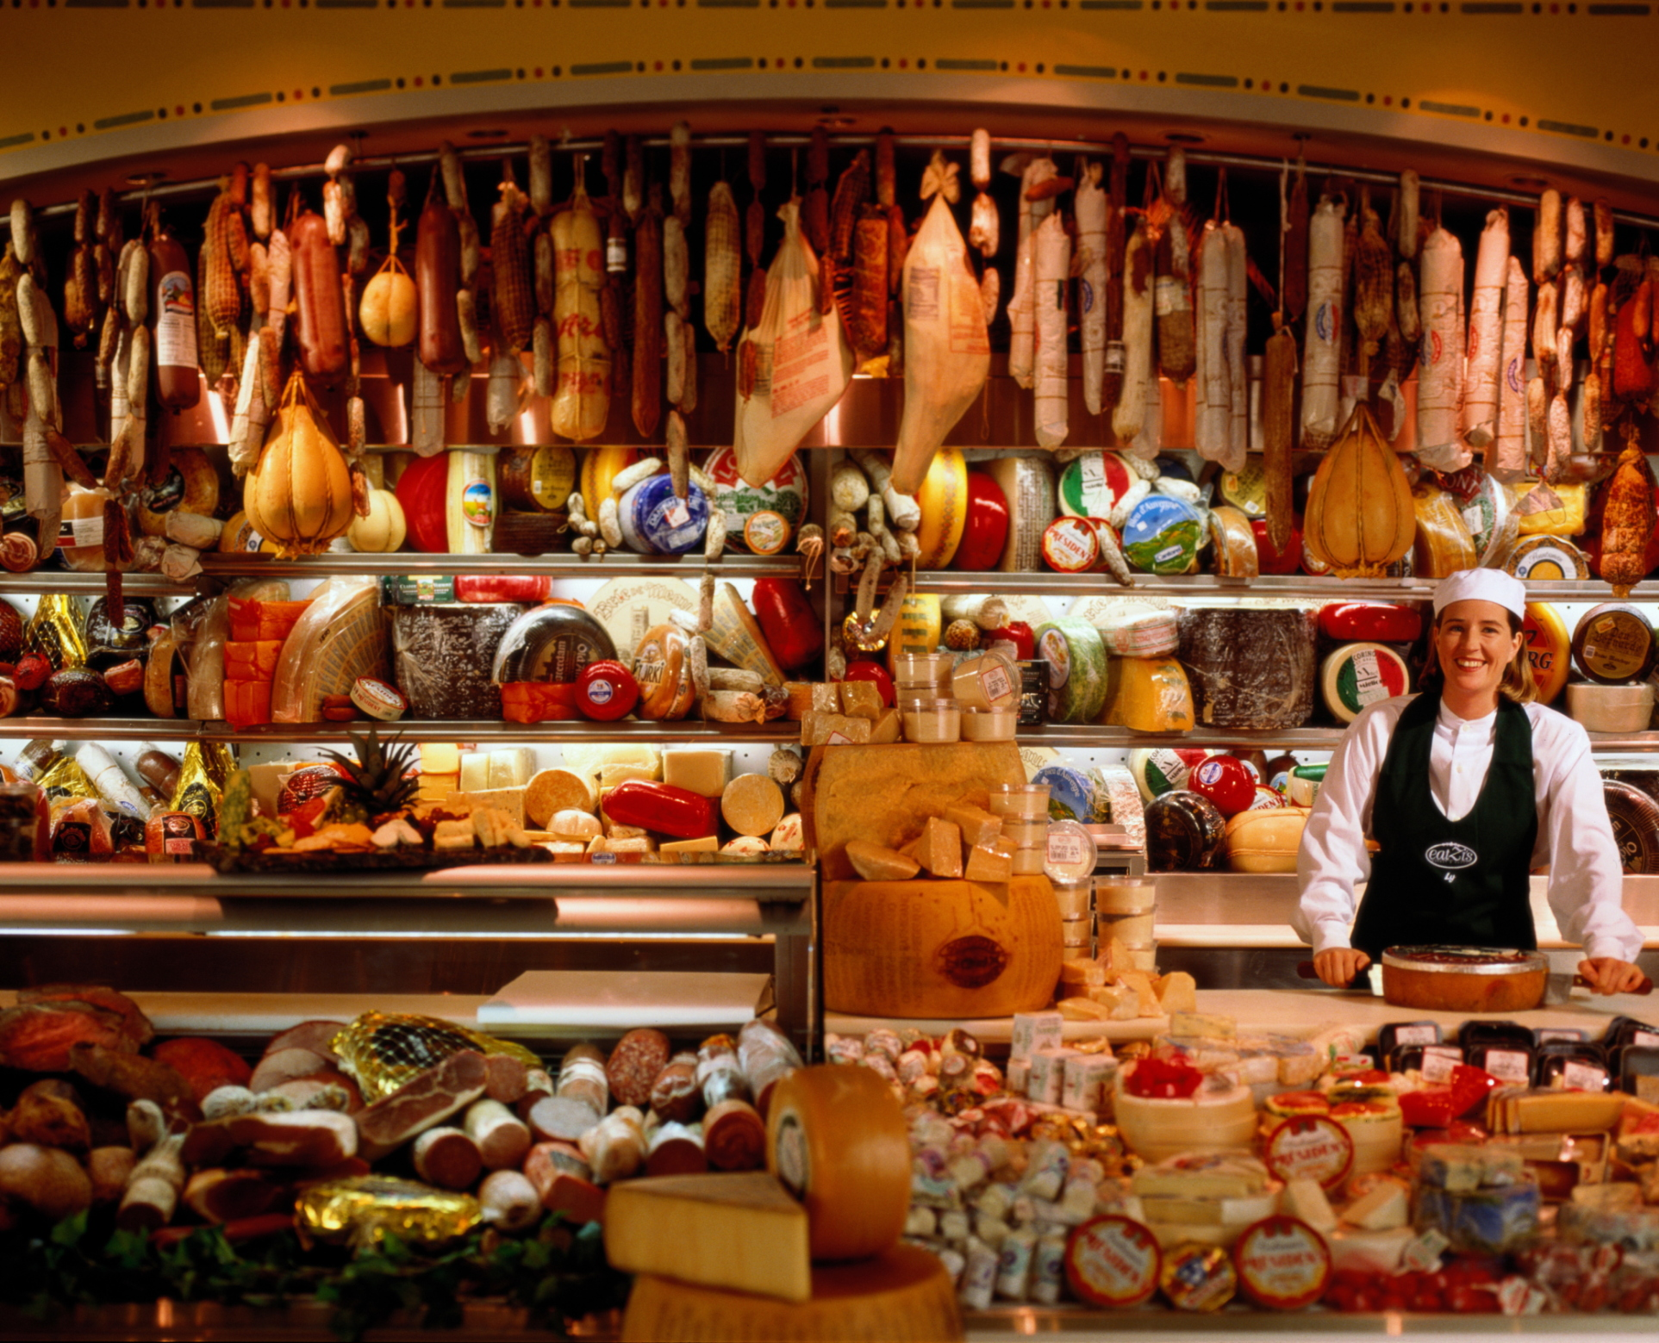
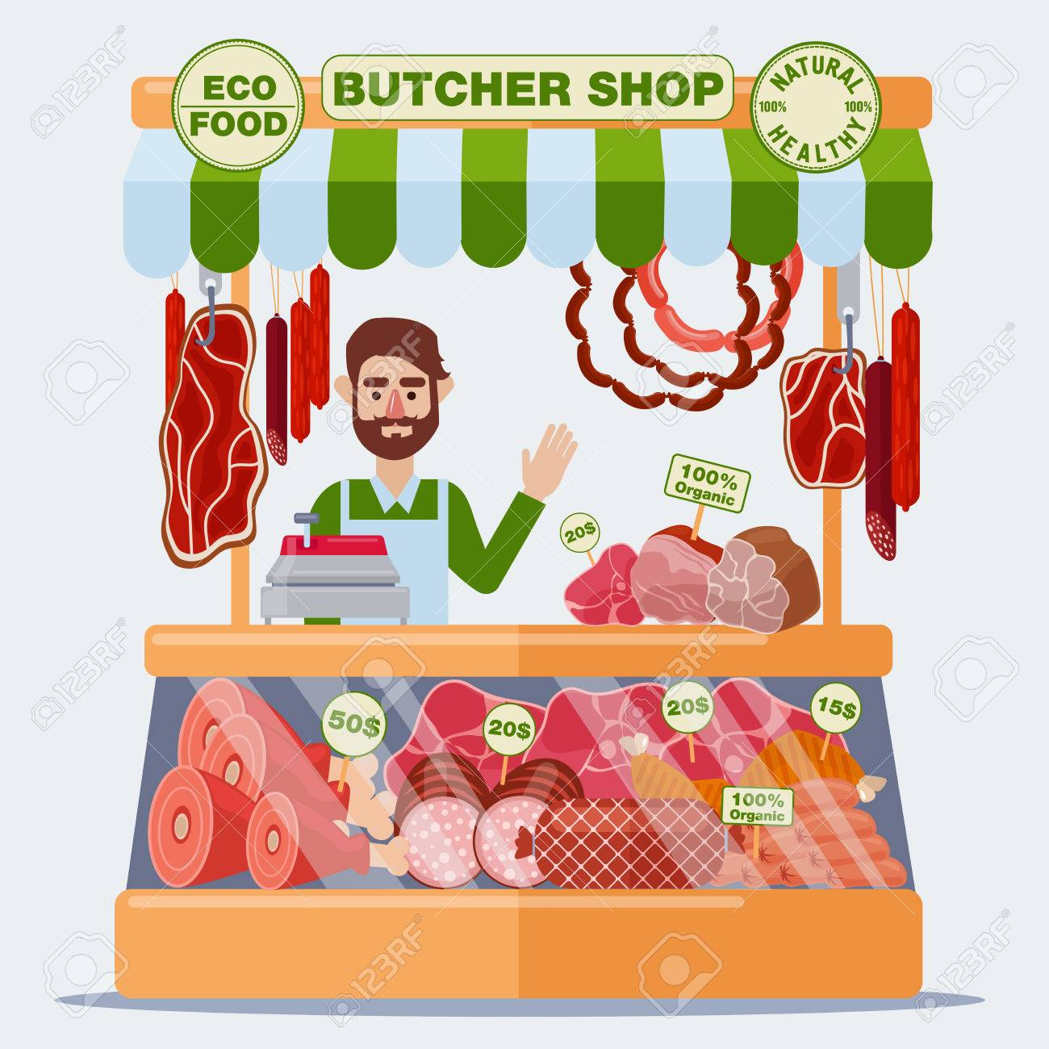
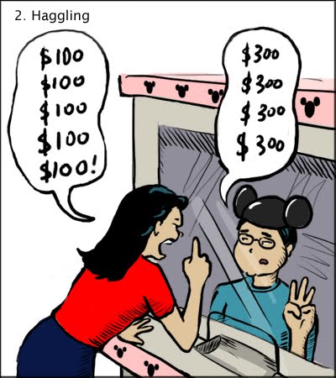
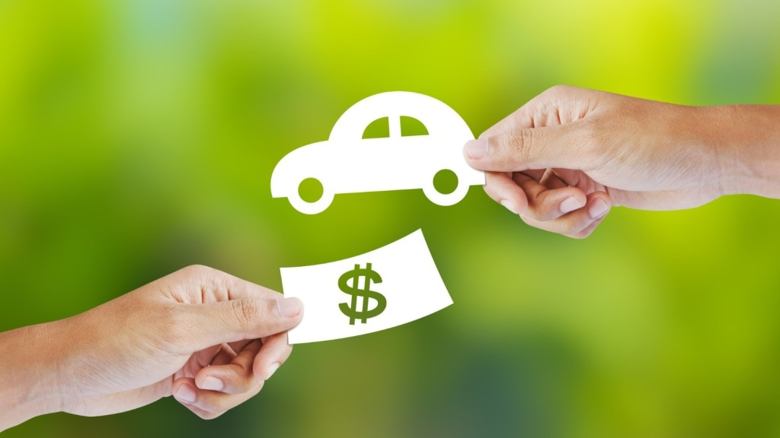
Vocabulary
1. Afford (n) /əˈfɔːrd/ If you can afford something, you have enough money to pay for it
2. Bargain (n) /ˈbɑːrɡən/ a thing bought for less than the usual price
3. Butcher (n) /ˈbʊtʃər/ a shop that sells meat
4. Deli /’deli/= delicatessen /ˌdel.ɪ.kəˈtes.ən/
a small shop that sells high-quality foods, such as types of cheese and cold cooked meat, often from other countries, and, especially in the United States, sandwiches made using these foods

Slide 5
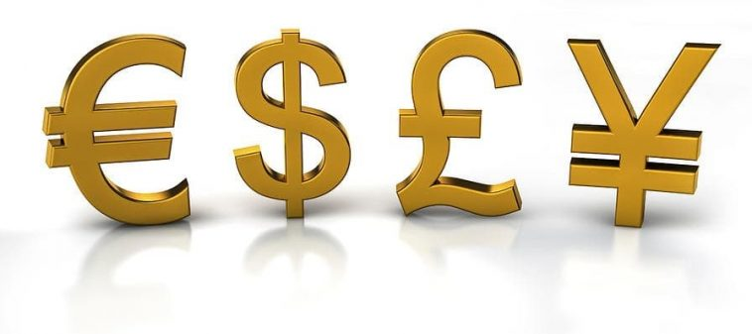
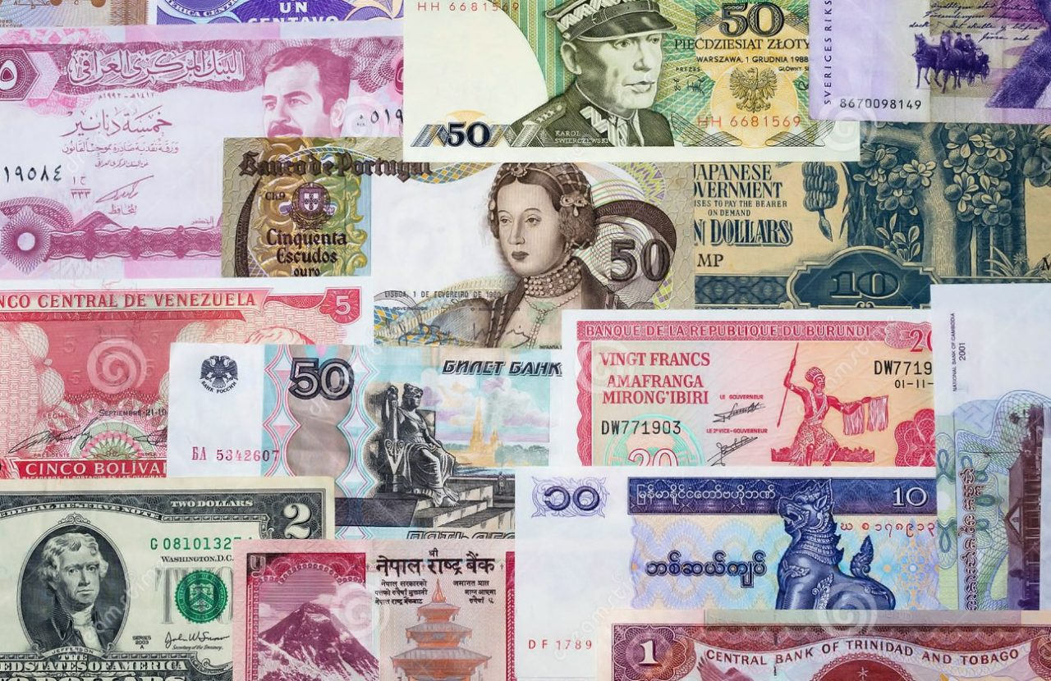
2. Read aloud the numbers and currencies below in pairs .
What other currencies do you know?
/ˈdɒl.ər/--> 23,600 VND
/ˈjʊə.rəʊ/--> 25,393VND
/paʊnd/--> 28,813 VND
/jen/--> 179,28 VND

Slide 6
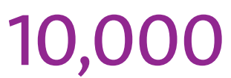
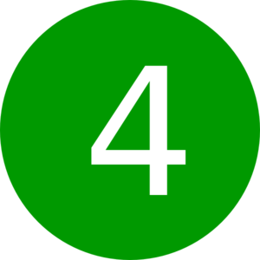
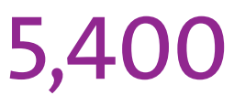
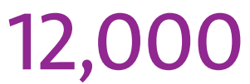
3. Listen to the audio.
Complete the prices using the numbers below
5,400 6,850 10.000 12,000

Slide 7
4. Where would you buy the items in exercise 1 ? Match them with the shops and services below
1.
Deli (delicatessen)
3.
Greengrocer’s
2.
Stationer’s
4.
Shoe shop

Slide 8
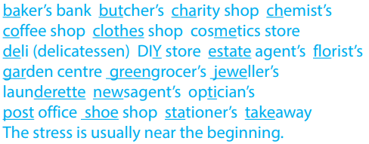
5. Listen and repeat all of the shops and services words from exercise 4.

Slide 9
6. Listen to four dialogues. Match them with four of the shops and services below
Dialogue
1
Dialogue
2
Jeweller's
Dialogue
3
Clothes shop
DIY store
Dialogue
4
Newsagent’s

Slide 10
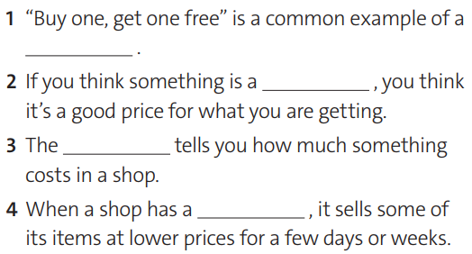
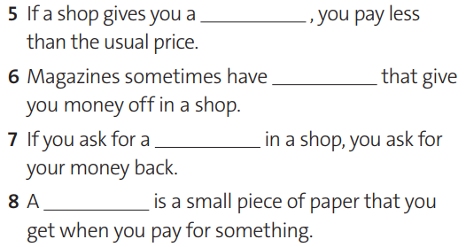
7. VOCABULARY. Complete definitions 1-8
with the words and phrases below.
discount
special offer
bargain
coupons
price tag
refund
sale
receipt

Slide 11
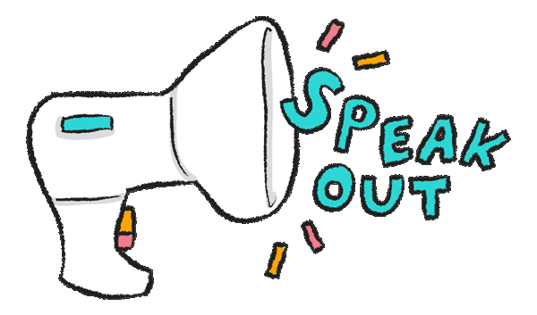

Slide 12
8. Read the Recycle! box. Look at the questionnaire below and complete the questions with the present perfect form of the verbs in brackets and ever. Then do the questionnaire in pairs.
1. Have you ever asked for a discount in a shop?
2. Have you ever used coupons from magazines to get money off ?
3. Have you ever compared prices in two or three shops before buying something?
4. Have you ever waited for something to be in sale before buying it?
5. Have you ever seen something in a shop and then looked for it online to save money?
6. Have you ever checked the price of the product and then put it back?
7. Have you ever bought something that you never used it?

Slide 13
Thank You
for your attention
to our presentation

