Slide 1
WELCOME TO OUR CLASS!
UNIT 5:
TECHNOLOGY AND YOU
E – LANGUAGE FOCUS

Slide 2
Let’s start
Unit 5
Technology and You
E- Language Focus
(1st period)
+ Pronunciation
+ Grammar points
Notes:
Back to school

Slide 3
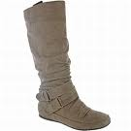
WARM-UP : Guessing Game
Try to guess : what are in these boxes?
Box A
Box B
Cues:
They have still 4 letters
- they still start with letter /b/
-In Box A: it always appears in the school bags
- In Box B: It is used to protect our legs
b
a book
b
a boot
[buk]
[bu:t]

Slide 4
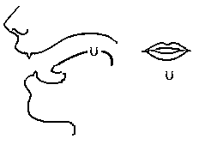
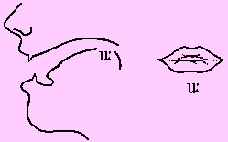
PRONUNCIATION
(short)
/u:/ (long)
/Ω/

Slide 5
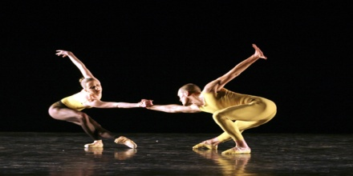
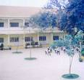
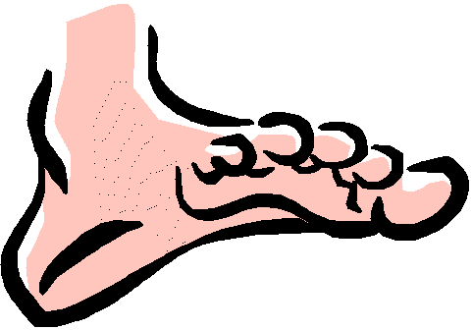
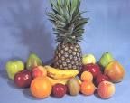
PRONUNCIATION
* Listen and repeat
(short)
/ u: / (long)
/Ω/
food
pull
school
full
tooth
foot
cook
fruit

Slide 6
Unit 5
Technology and You
II/ Grammar point:
1/ The present perfect
2/ The present perfect passive
3/ Who, Which, That
Notes:
Back to school

Slide 7
1/The present perfect

Slide 8
GRAMMAR
FORM OF PRESENT PERFECT
Really? Have you read all of his books?
Active form:
(+) S + have/has + V3/ed + O
(-) S + haven’t/hasn’t + V3/ed +O
(?) have/has + S + V3/ed + O?
You know, my father wrote this book. He has written many books since he was 15.
No. I haven’t read all of them yet

Slide 9
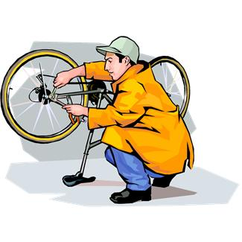
1. A recently completed action Adv : just, already, recently,…
GRAMMAR
USES OF PRESENT PERFECT
Put these verbs into present perfect active form.
Present perfect tense expresses:
My friends _______(just/ push) me into swimming pool.
have just pushed
2. An action starts in the past and continues to present.
Adv: since, for, up to now, so far, yet…
My bike ____ (break down) since yesterday.
has broken down
3. An action in the past (time is not mentioned)
Adv: before, ever,
Excuse me, ____we____(meet) each other before?
have we met

Slide 10
II. Grammar:
(+) S + has + PII + O have
1. The Present Perfect :
Exercise 1: (Page 60)
Write what you think Tan has done before Quang comes ( using the suggested verbs)
1. The door is open.(open)
→ Tan has opened the door.
2. The TV is on.(turn on)
→ Tan/He has turned on the TV.
3. The house is tidy.(tidy)
→ Tan/He has tidied the house.
4. The floor is clean.(clean)
→ Tan/ He has cleaned the floor.
5. The lights are on. (switch on)
→Tan/He has switched on the lights.
6. Two bottles of water are laid on the table(lay)
→ Tan/He has laid two bottles of water on the table.

Slide 11
2/ The present perfect passive

Slide 12
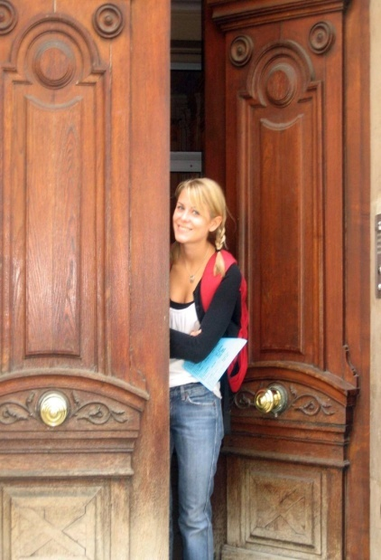
Active → Passive :
S + have/has + V3/ed + O
S + have/has been + V3/ed + (by O)
Note: “by O” can be omitted when Object are:
+ someone, somebody, anyone, anybody, people, no one, nobody
+ me – you – us – them – him – her - it
Turn to passive voice
1. She has opened the door.
→ The door has been opened (by her).

Slide 13
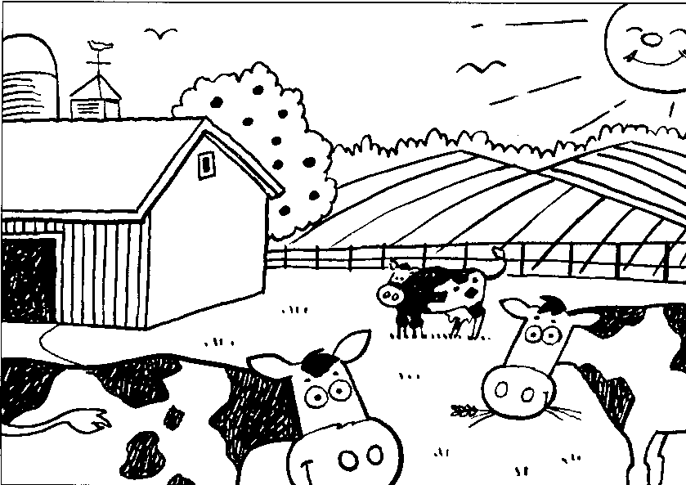
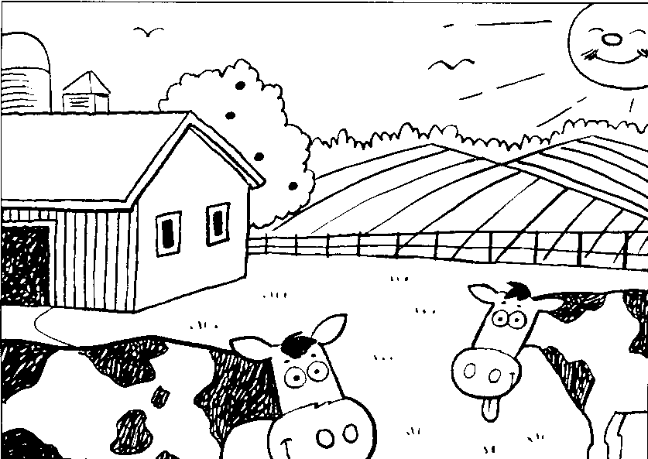
Game
Find differences between 2 pictures
One cow / lose
The antenna / lose
Small cow’s face/ change
4. One more window/ add
→ One cow has been lost.
→ Small cow’s face has been changed
→ The antenna has been lost.
→ One more window has been added.

Slide 14
II. Grammar:
2. The Present Perfect Passive:
S + has been PII +( by O)
have
Exercise 2: (page 61) Build sentences after the model.
A new hospital for childen/ build/ in our city
→ A new hospital for childen
has been
built
in our city.
1. Another man-made satellite / send up / into space.
→ Another man-made satellite has been sent up into space.
2 . More and more trees / cut down/ for wood/ by farmers.
→ More and more trees have been cut down for wood by farmers.
3. Thousands of animals / kill / in the forest fire.
→ Thousands of animals have been killed in the forest fire.
4. More than 50 films / show / in Hanoi / since June.
→ More than 50 films have been shown in Hanoi since June.
5. Their hands/ wash and dry / on a towel
→ Theirs hands have been washed and dried on a towel.
6. Another book / read / by the students.
→Another book has been read by the students.

Slide 15
3/ Relative clause:

Slide 16
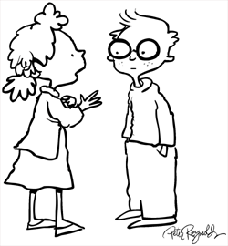
RELATIVE CLAUSES
A relative clause is one kind of dependent clause. It gives more information about a noun. A relative clause always begins with a “relative pronoun,”: WHO, WHOM, WHICH, THAT…
For example:
Do you know the girl ?
She lives in next door .
→ Do you know the girl? She lives in next door?
→ Do you know who/that lives in next door?
the girl
Relative clause

Slide 17
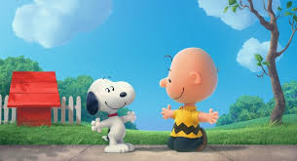
I. TWO TYPES OF RELATIVE CLAUSE:
Defining relative clauses: the information is important in specifying what is being discussed
For example:
This is a dog
This is a dog which my children like best
Defining relative clause

Slide 18
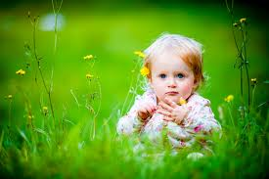
I. TWO TYPES OF RELATIVE CLAUSE:
Non-defining relative clauses: provide some additional information that is not essential and may be omitted without affecting the contents of the sentence.
* Non –defining relative clauses always use commas.
* In non-defining relative clauses, who/which may not be replaced with that.
For example:
➔ Mary who is playing in the garden is my daughter
,
,
Non-defining relative clause

Slide 19
Note: using the non-defining relative clause when modified noun is defining noun.
Defining Noun:
_ Modified by a possessive adjective. (My, his, her, your, its…)
_ A proper Noun (Hanoi, Nam…)
_ Modified by a demonstrative adjective: (This, that, these, those.)

Slide 20
WHO, WHICH AND THAT ( Relative pronouns)
WHO and WHICH (THAT) can be used in place of noun subjects and noun objects.
When they refer to the subject, they can not normally be omitted.
EX: This is the man who lives next my door.
When they refer to the object, they can normally be omitted.
EX: This is the girl who (m) I like.
-WHO refers to people.
-WHICH refers to things.
-THAT is used to replace for WHO, WHICH in the defining clause

Slide 21
II. Grammar:
3. Relative Pronouns; who, which , that
Exercise 3: Fill each blank with who, which or that.
1. A clock is an instrument………………. tells you the time.
which/ that.
who/that
2. A nurse is a person…………… looks after patients.
which / that
3. These are the pictures……. ……… my son drew when he was young.
who/ that
4. Can you help me find the man..…. ……….…saved the girl?

Slide 22
CONSOLIDATION

Slide 23
Choose the correct answer A,B,C or D
1. We…………………the sounds / u / and / u: /
A. has learned
B. learned
C. is learning
D. have practiced
2. I met the woman ……………can speak six languages.
A .which
B . who
C. whose
D. whom
3. A number of trees along the street……………down.
A. has been cut
B. has cut
C. have been cut
D. have cut
4. She…………….to Hanoi many times.
A. have been
B. was
C. is
D. has been
5. She always asks me questions……….are difficult to answer.
A. who
B. whose
C. which
D. whom
6. They have painted that picture for a long time.
A. That picture has painted for a long time.
B. The picture have been painted for a long time.
C. The picture has been painted for a long time.
D. The picture is painted for a long time.

Slide 24
Thanks for
your attention!
Have a nice day!

