Slide 1


Instructor: Phan Liên Yến Phi
WELCOME TO CLASS 10A3

Slide 2


CROSSWORD
1
C
H
A
R
A
C
T
E
R
2
S
I
L
E
N
T
3
S
C
E
N
E
4
S
E
Q
U
E
N
C
E
5
M
U
S
I
C
A
L
6
A
C
T
O
R
2. (6 letters) quiet, without any sound
1. (9 letters) a person in a film
3. (5 letters) a part of a film
6. (5 letters) a person playing character part in a film
4. (8 letters) series of related events or actions
5. (7 letters) related to music
?
1
2
3
4
5
6

Slide 3

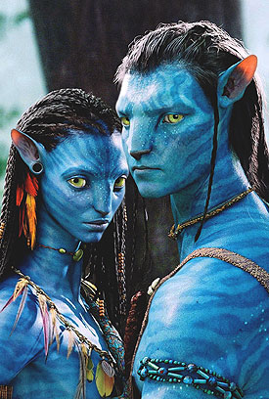
AVARTAR – SCIENCE FICTION

Slide 4
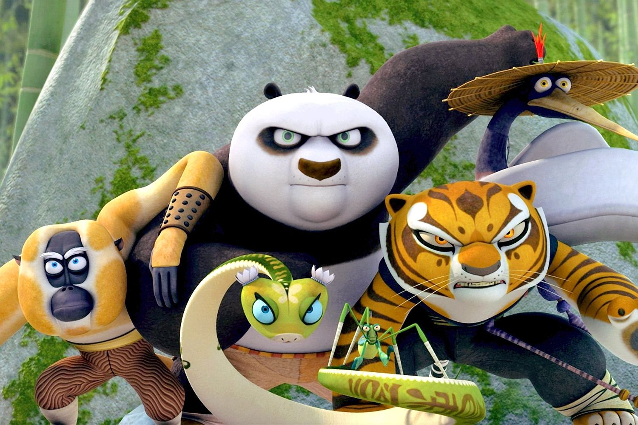
KUNG FU PANDA - CARTOON

Slide 5
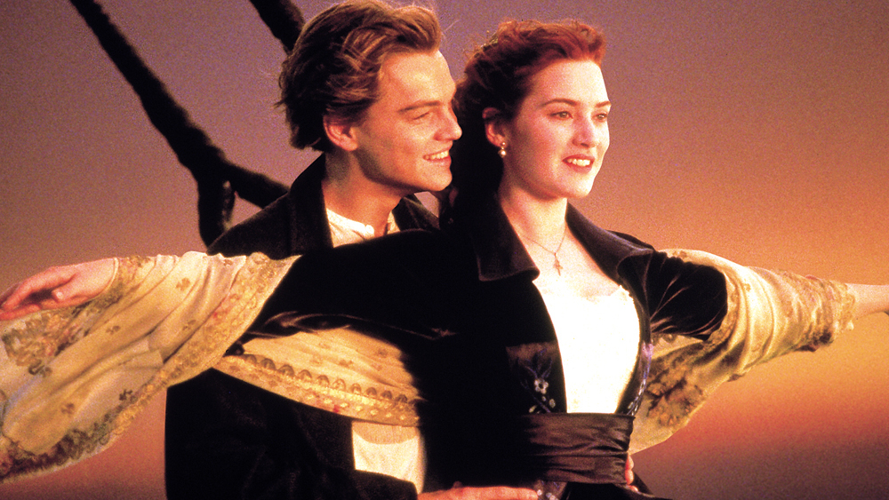
TITANIC – LOVE STORY

Slide 6
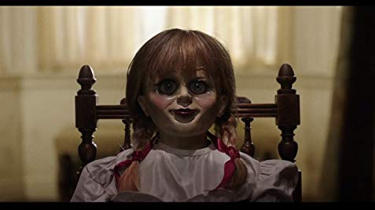
ANNABELLE - HORROR

Slide 7
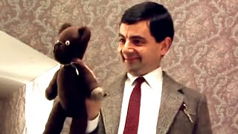
MR. BEAN - COMEDY

Slide 8

KINDS OF FILM
ACTION
HORROR
LOVE STORY
COMEDY
WAR
SCIENCE FICTION
CARTOON
DETECTIVE
THRILLER

Slide 9

Unit 13
FILMS AND CINEMA
B. SPEAKING

Slide 10



ACTIVITY 1
Find someone who… | Name | Notes
1. likes science fiction films
2. often goes to the cinema
3. likes horror films
4. likes detective films
5. prefers going to the cinema to watching films at home
6. likes cartoon films

Slide 11

ACTIVITY 2
Sample conversation:
A: What is your favorite kind of film?
B: Well, I like action films most.
A: What do you think of action films?
B: I find them very exciting.
A: So do I. What other kinds of film do you like?
B: I also like science fiction and cartoon films.
A: Which do you prefer?
B: Well, it’s difficult to say. But I suppose I prefer science fiction films to cartoon ones.

Slide 12

ACTIVITY 3: Role-play
Work in pairs. Read your card and play your role.

Slide 13
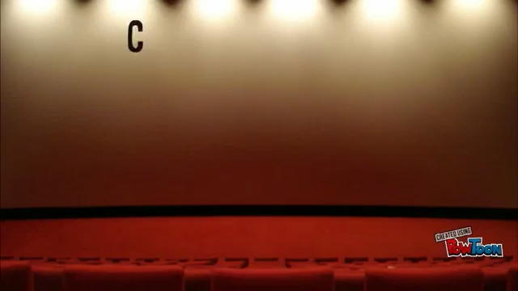
ACTIVITY 3: Role-play

Slide 14
ACTIVITY 4: Film review
Work in groups. You have 5 minutes to discuss and decorate your paper. Then you have 1-2 minutes to talk about a film you have seen.
Film
Kind of film
Plot
Main characters
Your opinion/ feeling
The reason you like it

Slide 15

FILM REVIEW

Slide 16


HOMEWORK
Practice speaking at home
Prepare for the next lesson: Unit 13, part C. Listening.

Slide 18
C
H
A
R
A
C
T
E
R
S
I
L
E
N
T
S
C
E
N
E
S
E
Q
U
E
N
C
E
M
U
S
I
C
A
L
A
C
T
O
R

