Slide 1
WELCOME TO 11A17 CLASS
TEACHER : TRAN THU HA

Slide 2



Unit 6:
HIGH-FLYERS
Unit 6:
HIGH-FLYERS
Grammar

Slide 3
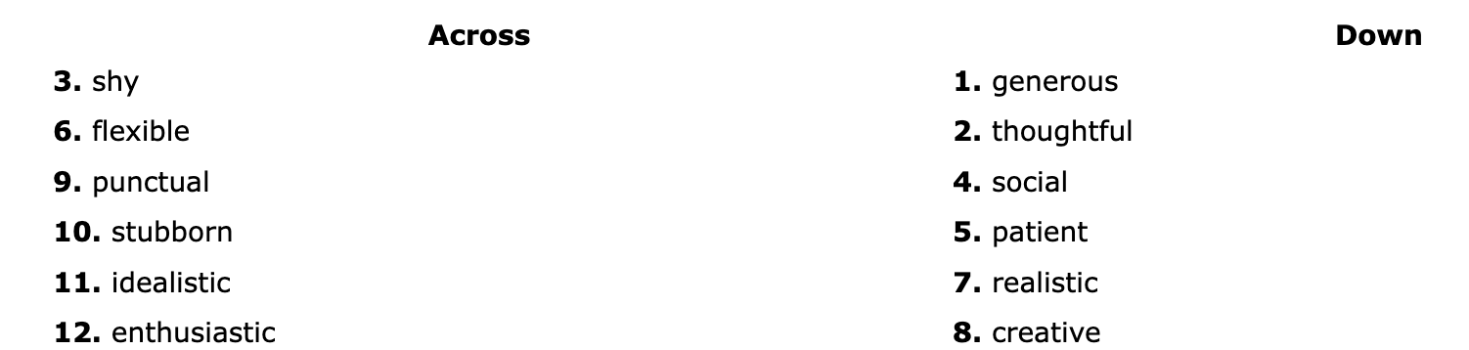
Review Vocab – Crosswords
Complete the crossword puzzle by forming nouns from the corresponding adjectives below
13 . honest

Slide 4
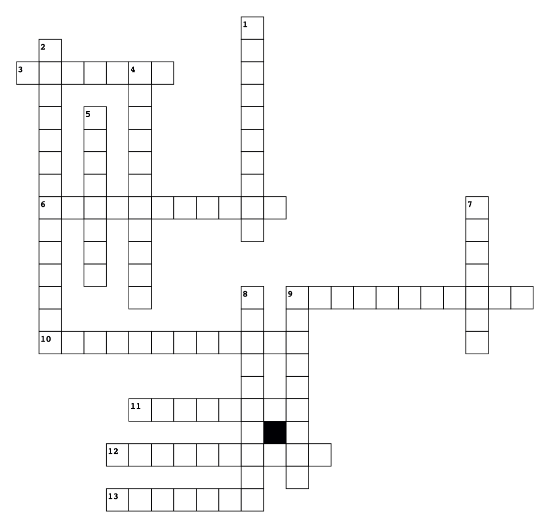
13. honest

Slide 5

13. honesty

Slide 6



Slide 7
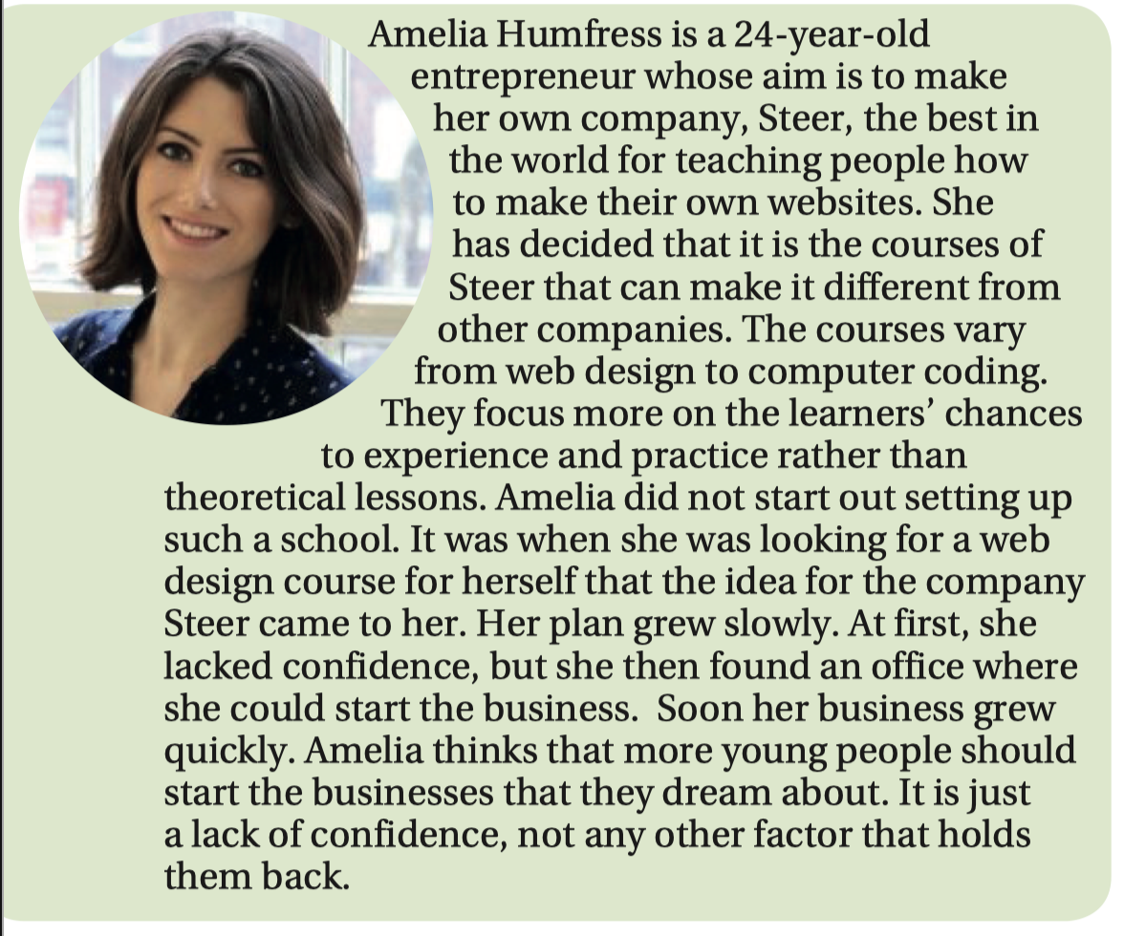
1 Read the article. What qualities does she think young people should have to set up their own business successfully?

Slide 8
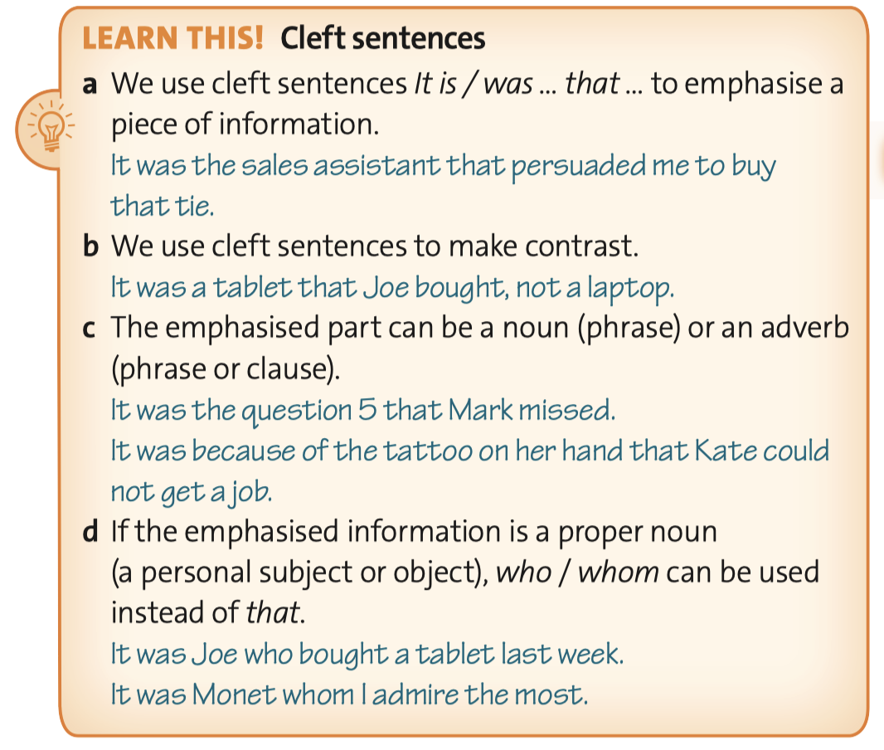
2 Read the Learn this! box. Underline three examples of use a, b and c in the article.

Slide 9
2 Read the Learn this! box. Underline three examples of use a, b and c in the article.
a We use cleft sentences It is / was … that … to emphasise a piece of information.
b We use cleft sentences to make contrast.
c The emphasised part can be a noun (phrase) or an adverb (phrase or clause).

Slide 10
3 Finish each of the following sentences emphasizing the underlined information.
1 Dancers in A O Show gave their performance with great devotion.
2 The Vietnamese silk paintings typically depict the countryside and landscapes.
3 Vincent van Gogh painted Starry Night, not Gaugin.
4 We missed the chance to meet a celebrity because we came so late.
5 The young entrepreneur has mentioned some new design techniques.
It was with great devotion that dancers in A O Show gave their performance.
It is the countryside and landscapes that the Vietnamese silk paintings typically depict.
It was Vincent van Gogh, not Gaugin who painted Starry Night.
It was because we came so late that we missed the chance to meet a celebrity.
It is the young entrepreneur that has mentioned some new design techniques.

Slide 11
4 Make cleft sentences from the following cues.
1 It / be / creativity and inspiration / most artists / need
2 It / be / with/ self-confidence / scientists / make / good inventions
3 It / be / sociability / some jobs / require / not intelligence
4 It / be / Dame Anita Roddick / found / The Body Shop / in 1976
5 It / be / because / they / have / colourful tones and optimistic images / Dong Ho paintings / be / part of Vietnamese Tet holidays
It is creativity and inspiration that most artists need.
It was with self-confidence that scientists made good inventions.
It is sociability that some jobs require, not intelligence.
or It is sociability, not intelligence that some jobs require.
It was Dame Anita Roddick who founded The Body Shop in 1976.
It is because they have colourful tones and optimistic images that Dong Ho paintings are part of Vietnamese Tet holidays.

Slide 12
5 USE OF ENGLISH Reread the Learn this! box. Identify the mistake in each of the following sentences.
1 It is sympathy, not pride brings friends together.
2 It is a leading environmentalist that came to our school club last month.
3 It was Monday that the winners of the school sports games were awarded.
4 It was when Jack came back from the war we learnt the truth about his cousins.
5 It is shyness that the teacher wants the children to grow out of it.
6 It was Rachel Carson that wrote Silent Spring, not Julia Hill.
a We use cleft sentences It is / was … that … to emphasise a piece of information.
b We use cleft sentences to make contrast.
c The emphasised part can be a noun (phrase) or an adverb (phrase or clause).
d If the emphasised information is a proper noun (a personal subject or object), who / whom can be used instead of that.
that brings
was
on Monday
that we
of
who

Slide 13

1 Match 1–8 with a–h to make meaningful sentences.
1 It was in 1937
2 It is Florence, not her sister
3 It is sports activities after school
4 It was not until the police officer came
5 It is with language abilities and flexibility
6 It was because the tickets were too expensive
7 It is success stories in newspapers
8 It was Rafa Nadal
e
a that bring all of the children together.
b whom the spectators gave the nickname ‘raging bull’.
c that give me enough confidence and patience to start my own business.
d that the drunk man decided to leave.
e that RKO Radio Pictures produced the comedy film ‘High Flyers’.
f that an interpreter works efficiently.
g who will meet us at the airport when we arrive in England. h that the show became a poor turnout.
g
a
d
f
h
c
b

Slide 14
2 Rewrite the following sentences using cleft sentences.
1 Many patients can recover from illnesses because they are always full of optimism.
It is because_______
2 Sarah, not Elly won the first prize in our school Art Competition.
It was Sarah _______
3 High-flyers have made success of their original ideas thanks to self-motivation.
It is thanks to _______
4 Wangari Maathai, one of the greatest environmentalists, won the Nobel Peace Prize in 2004.
It was in 2004 _______
5 Amelia Humfress came up with the idea of a business when she was looking for a design course.
It was when _______
6 Lack of confidence prevents young people from making success.
It is lack _______
7 Instrument makers create their products with great accuracy.
It is with _______
8 The architect Dang Viet Nga created the Crazy House.
It was the Crazy House _______

Slide 15
2 Rewrite the following sentences using cleft sentences.
1 It is because many patients are always full of optimism that they can recover from illnesses.
2 It was Sarah, not Elly who won the first prize in our school Art Competition.
or It was Sarah who won the first prize in our school Art Competition, not Elly.
3 It is thanks to self-motivation that high-flyers have made success of their original ideas.
4 It was in 2004 that Wangari Maathai, one of the greatest environmentalists, won the Nobel Peace Prize.
5 It was when Amelia Humfress was looking for a design course that she came up with the idea of a business.
6 It is lack of confidence that prevents young people from making success.
7 It is with great accuracy that instrument makers create their products.
8 It was the Crazy House that the architect Dang Viet Nga created.

Slide 16
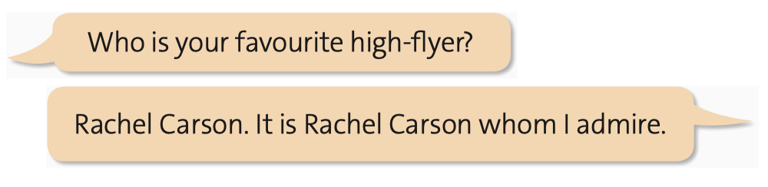

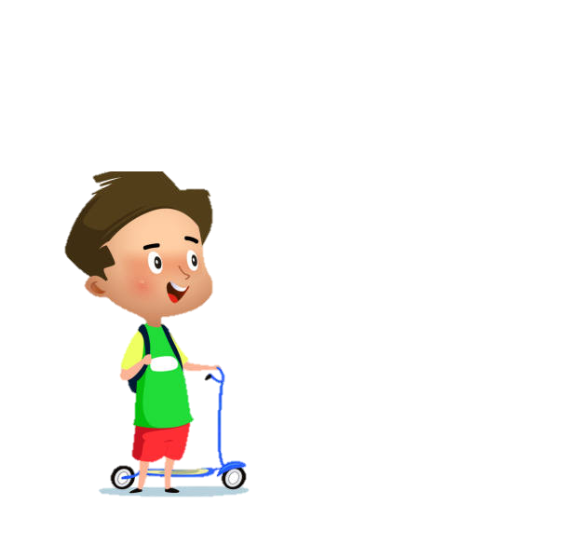
6 SPEAKING Work in pairs. Ask and answer about your favourite high-flyer. The following cues can help you.
The high-flyer you admire
How you got to know about him / her
The reason why you like him / her
What you think decides his / her success
Answer the questions again using cleft sentences to emphasize some information.

